Slide 1





ENOUGH IS ENOUGH: Europe's Industry, Europe's Jobs, Our Future.

Slide 2

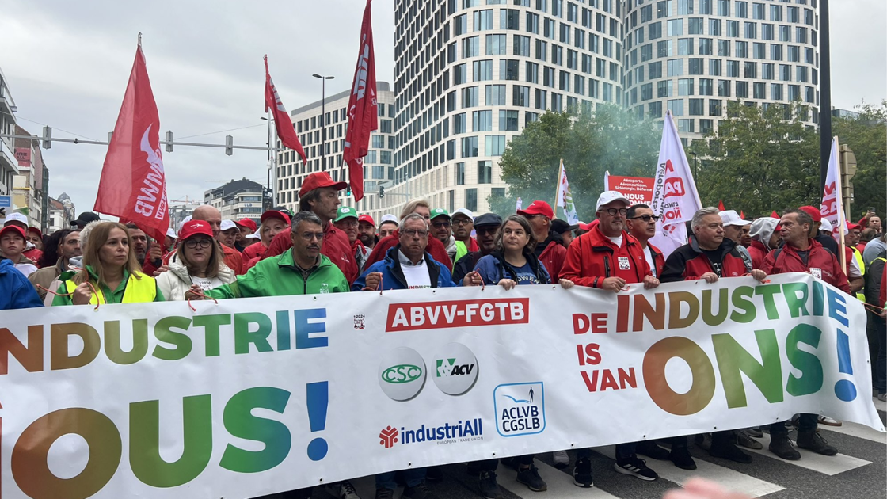
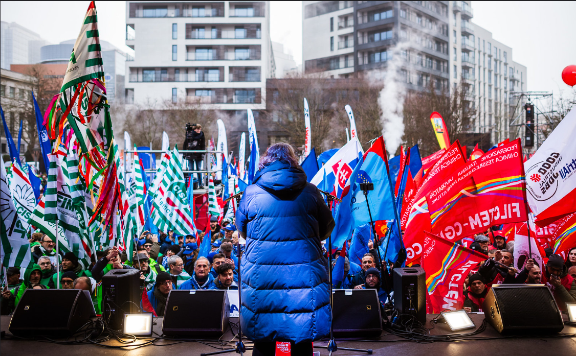
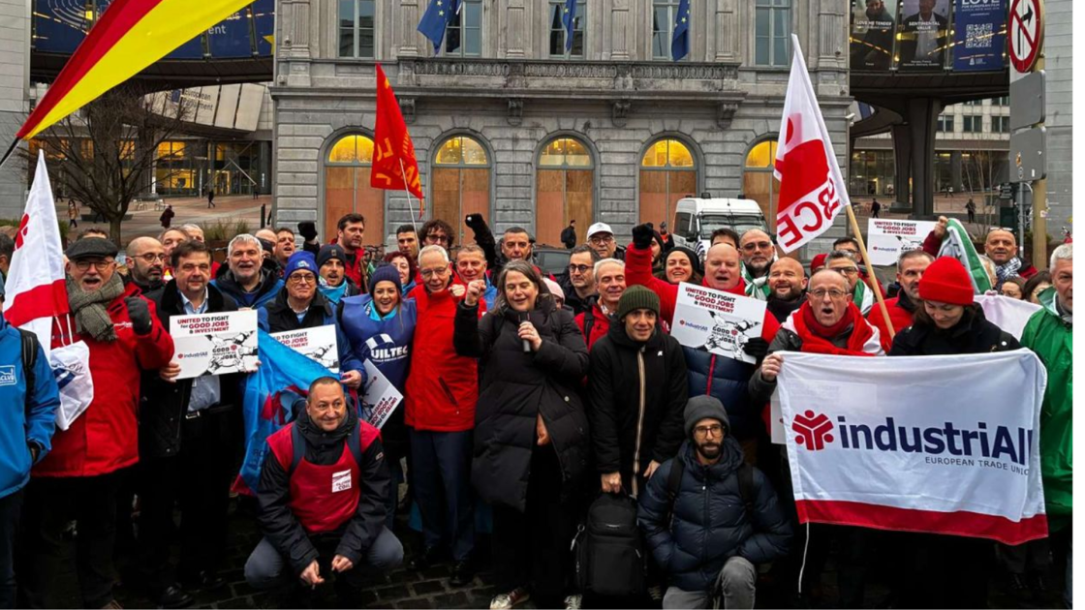
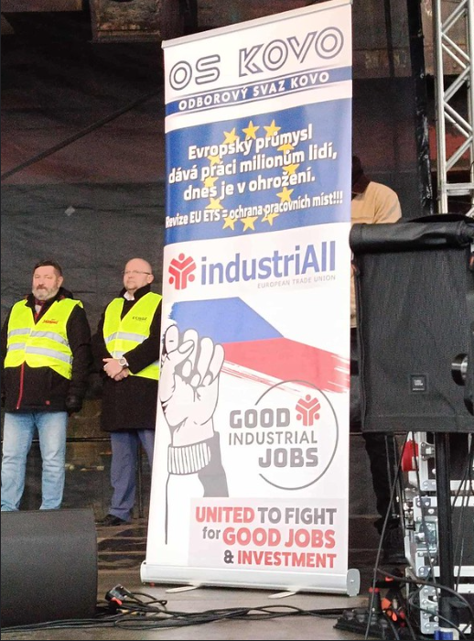
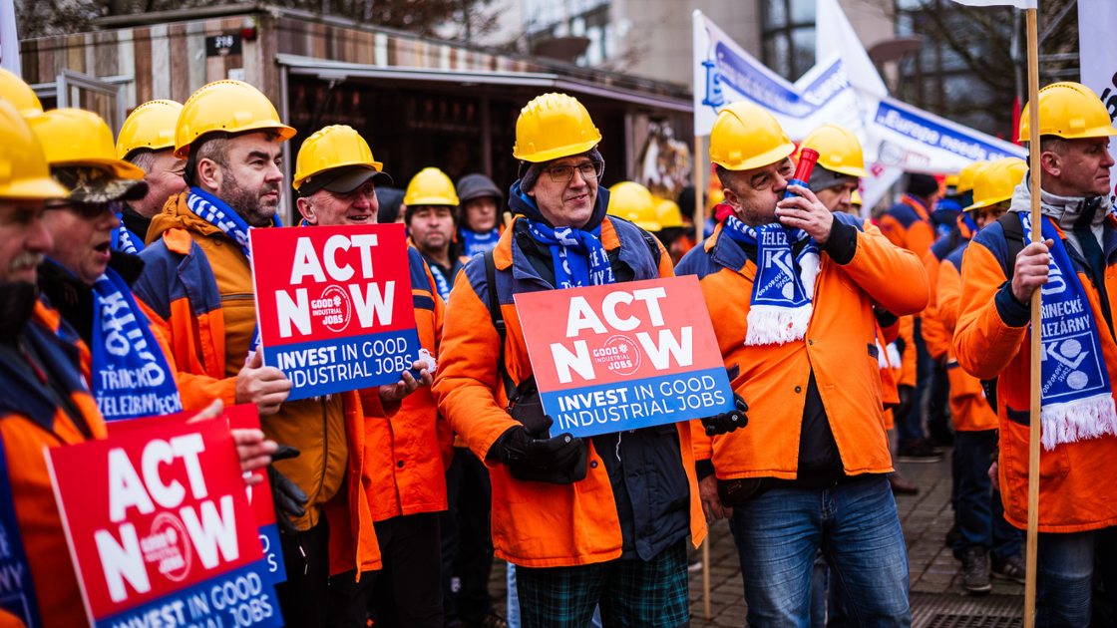
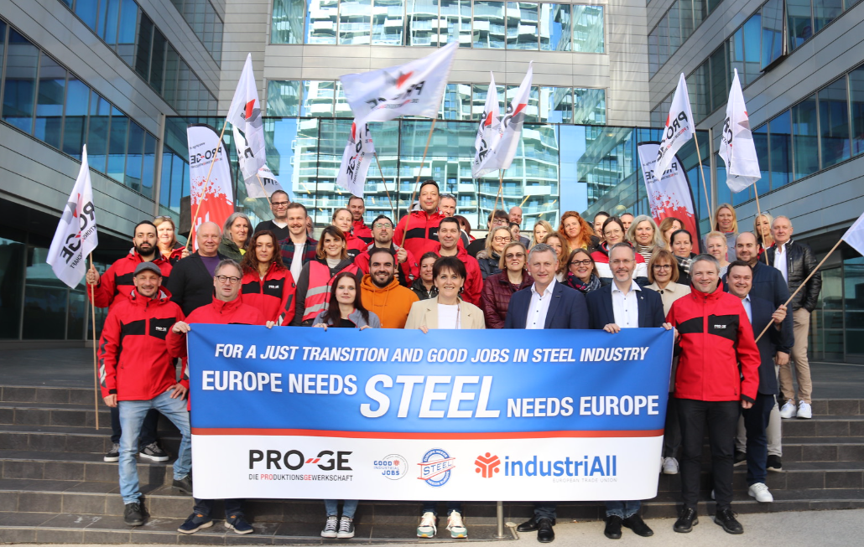
2025
2024
2026

Slide 3
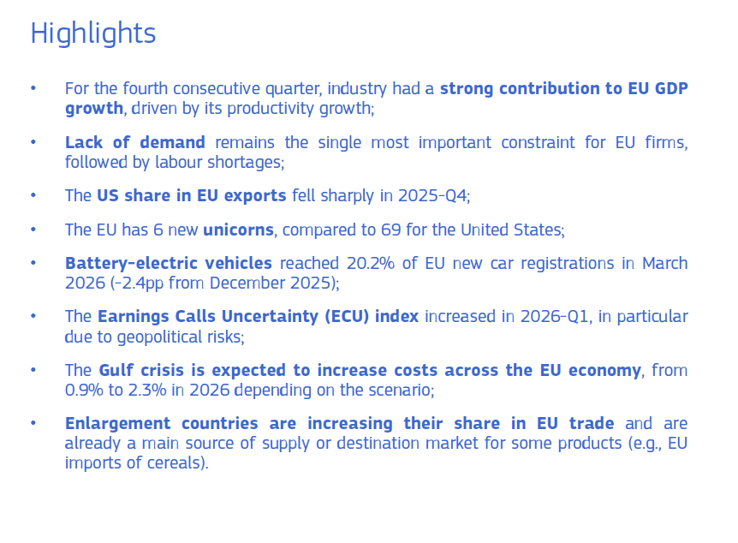
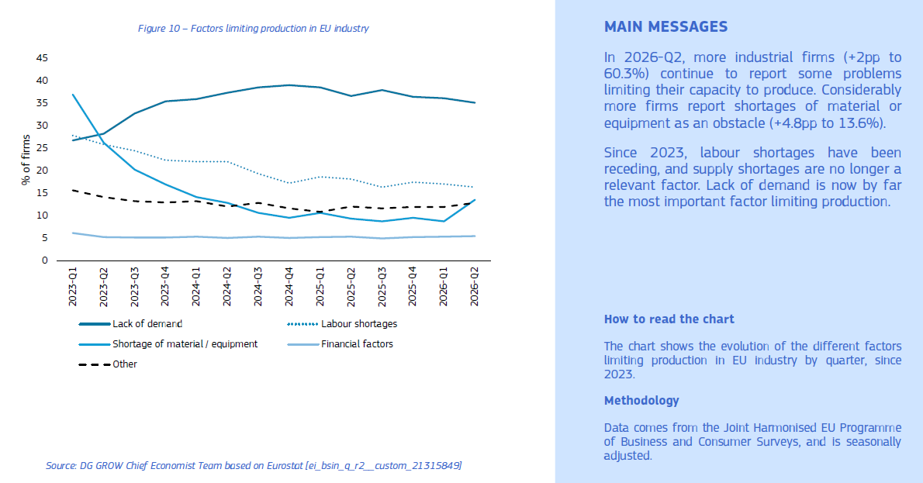
Our context: it’s demand, stupid.

Slide 4
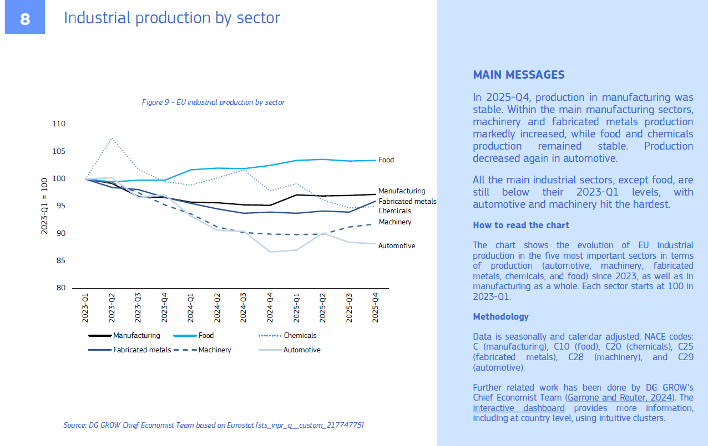
Our context: sectoral differences

Slide 5
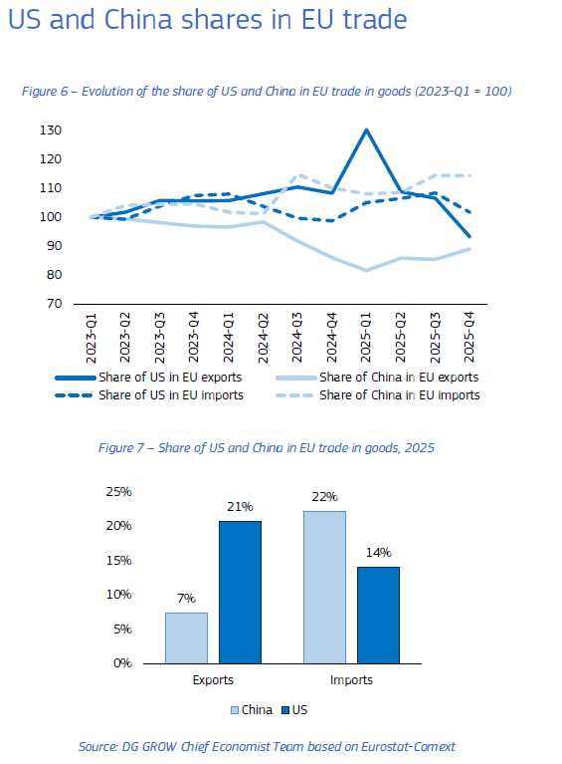
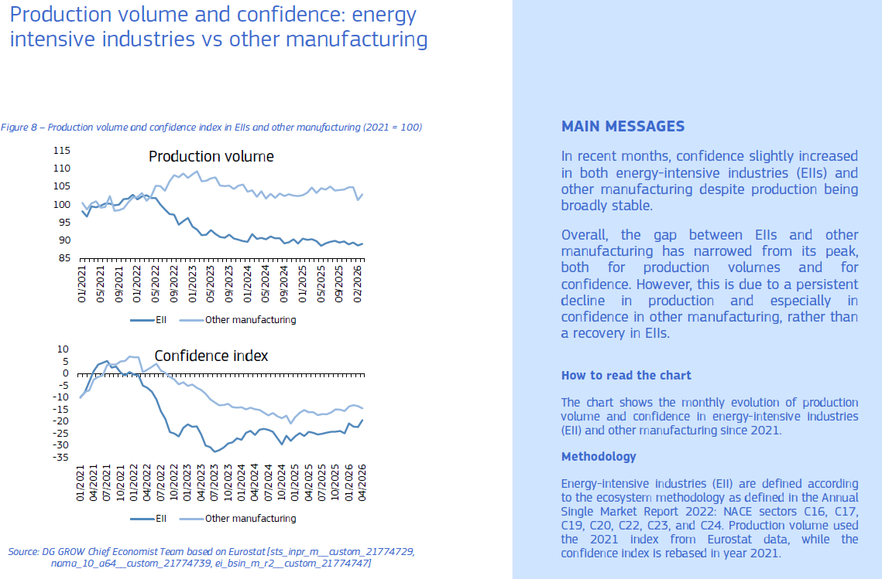
Our context: fragile situation, collapsed US trade/China Shock 0.2

Slide 6
2026 IN NUMBERS
July 2026 has brought one of the worst restructurings ever seen in the European auto sector.
VOLKSWAGEN GROUP
100,000
Up to 50,000 in Germany & almost 1 in every 6 employees wordwide
50% cut in model variants
Global capacity down to 9m units, from 12m post-Covid
CEO Oliver Blume said the group had been unable to “find alternative uses” for four sites: ZWICKAU, EMDEN, HANOVER, and NECKARSULM
PORSCHE
5,000
Further cuts, on top of 3,900 agreed in 2025
About a fifth of the workforce gone by 2035
Chinese sales below half their 2021 peak
A further −32% drop in the first half of 2026
BMW
8,000
Several thousand German redundancies confirmed
To be completed by the end of 2027
STELLANTIS
Poissy (FR) 900 job reduction to 2028
750 job cuts in Tychy (PL)
650 redundancies Russelsheim (DE)
looking to sell or share four of its European assembly plants
NB. 17,000 jobs lost in Italian sites since 2021
RENAULT
a voluntary departure plan affecting 800 engineers (FR)
VOLVO CARS
cut 15% of its white-collar workforce (about 3,000 jobs)

Slide 7
INDUSTRIALL EUROPE’S PERSPECTIVE
MANAGEMENT DECISIONS DESERVE CLOSER SCRUTINY
2.1
The money was there for investment. It went to shareholders.
2.2
Who profits and who pays for the crisis.
2.3
Public support without public reward.

Slide 8
2.1 THE MONEY WAS THERE. IT WENT TO SHAREHOLDERS.
European carmakers say they can no longer afford Europe’s workers. Their own financial accounts say otherwise.
€554bn
Combined net profit, nine major European and US automakers operating in Europe, 2012–2025
€221bn
Paid to shareholders in dividends and buybacks over the same period
€250bn
Cash and short-term investments still held at the end of 2025.
Total dividends grew 4x from 2020 to 2023, peaking at €33bn in 2023.
In 2025 the group as a whole swung to a combined €16bn loss — and €20bn still went out of the door.
Workers appear like the only stakeholders with a long-term interest in Europe still producing cars.
Nine groups: Volkswagen, Mercedes-Benz, BMW, Stellantis, Renault, Volvo Cars, Ferrari, Ford and Tesla.

Slide 9
2.2 WHO PROFITS AND WHO PAYS
2021–2023 were the best years in the auto industry’s history. When margins collapsed in 2025, the first response was plant closures — not restraint on payouts.
€88bn
Combined net profit, 2021
€77bn
Combined net profit, 2022
€83bn
Combined net profit, 2023
−€16bn
Combined result, 2025
Among the automakers that disclose labour costs, 2019–2023:
+92%
Growth in profit
+19%
Growth in workers’ pay — barely tracking inflation
14.1% → 12.9%
Workers’ share of revenue

Slide 10
2.3 PUBLIC SUPPORT WITHOUT PUBLIC REWARD
Our research uncovered at least €5.3 billion in direct public support to these same companies since 2016.
€5.3bn+
In direct European public grants, subsidies and tax breaks awarded
€2.1bn
In repayable public loans used to de-risk private investors
€1.2bn
Volkswagen
€1.2bn
Automotive Cells Company (JV)
€1.1bn
Stellantis
€0.9bn
Mercedes-Benz
€0.4bn
Renault
Not one state-aid award we examined obliged the recipient to maintain employment, keep a site open, or refrain from distributing the money to shareholders. There was also no clawback mechanism when a subsidised plant later closes.

Slide 11
Our proposed plan
Mobilising for European action days: country-by-country decentralised action with delegations from other countries crossing-borders
Providing research to affiliates for dissemination:
  Crisis in the Automotive Sector: Putting People above Profits
  Restoring European Competitiveness: Are workers really the cost to be cut?
  White collar jobs: The Danger of Europe becoming an assembly line
  The unfortunate truth of overcapacity - corporate decisions without corporate responsibility
  Investments: The ETS Review & the need for social conditionalities
  Enough is Enough: Europe Needs a Serious Industrial Strategy not Corporate Welfare
Joint comms strategy: IAE website and social channels, articles & digital advocacy
Political pressure in ALL national capitals for European leaders to act swiftly on industrial policies that protect good industrial jobs

Slide 12
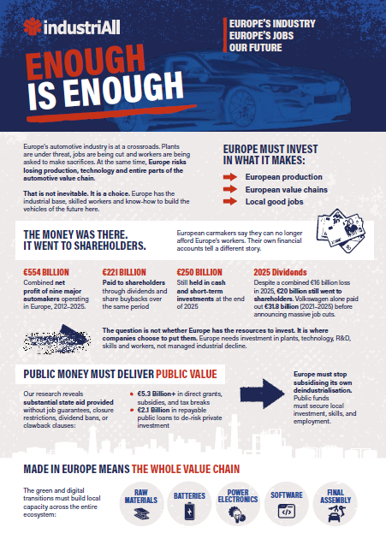
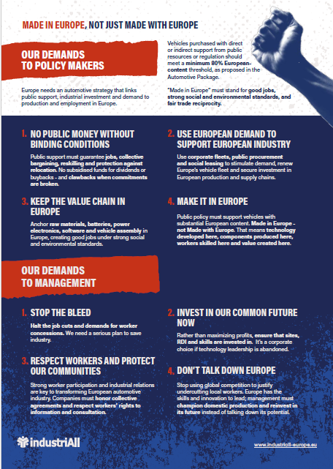
OUR DEMANDS

Slide 13
EUROPEAN TRADE UNION COORDINATION
To strengthen solidarity and coordination beyond borders and prevent being played off against each other, industriAll Europe will envisage:
SOLIDARITY BEYOND BORDERS
Anticipate the impact of decisions and agreed measures beyond borders and along the value chain. Maintain communication throughout the restructuring process and guarantee transparency between countries and sites.
FULL USE OF EUROPEAN WORKS COUNCILS
Make full use of transnational information, consultation and participation rights in multinational companies. Better articulate national and European information and consultation rights. Ensure the involvement of the EWC coordinator throughout the restructuring process.
01
02
TRADE UNION COORDINATION BEYOND BORDERS IN MULTINATIONAL COMPANIES IN EUROPE AND BEYOND
Develop a joint strategy in case of transnational restructuring. Include common demands to mitigate the impact on employment in the different countries and along the value chain. Promote negotiated solutions at all levels
EXTERNAL COMMUNICATION
Reach out to national and European policy-makers, shareholders and any other stakeholders to raise awareness and get support for fair solutions.
03
04
Sources: Dealing with transnational company restructuring – recommendations part 1 and part 2 (2020)
Transnational company restructuring: Towards strengthened trade union cooperation and greater solidarity (2015)

Slide 14
ENOUGH IS ENOUGH: Campaign Timeline Update (as of October 19th)
Date | iAE Action/Mobilization | Other mobilisations
21 September | Decentralised action day (Germany) Research briefing, flyer, web news, social media, and materials sent to the ExCom | 24/9 EU Inc (Brussels)
7 October | Digital action towards Critical Chemical Alliance assembly (8 Oct). Chemicals-specific flyer and video messages in social media.
9 October | Belgian National TU Action: Op-Ed | 9/10 Belgian TU Action
12 October | Paris Motor Show: Op-Ed
16 October | Comms in support of TU rally in Sofia, Bulgaria against the state budget | 16/10 Bulgarian TU Action
19 October | White-Collar Jobs Crisis & Silent Deindustrialisation: Research briefing, flyer, web news, social media, and materials sent to the ExCom
2 November | ETS & Social Conditionalities: Research briefing, flyer, web news, social media, and materials sent to the ExCom | 2/11 EFFAT Rally in Brussels “Hands of Social Conditionalities”
5 November | Mobilisation for higher wages, public services and the future of industry in France (Paris), amplifying Enough is enough campaign
9 November | Decentralised action day in Hungary at the Audi Plant: Research briefing, flyer, web news, social media, and materials sent to the ExCom | 9/11 Action in Győr, Hungary, 12:00 –14:00 at the factory gate; OZ KOVO, OS KOVO, IGM, IAE, AHFSZ, Vasas
24 November Morning @ 9:30 | European action at European Parliament in Strasbourg: Research Briefing, model letters to MEPs, Web-news, flyer, social media, and materials sent to the ExCom | 24/11 Rally in Strasbourg on IAA & auto package votes
December 7 or 8 | Syndex #2 report launch, iAE industrial-workers film screening in European Parliament & panel debate | Teaser trailer released on 1 December (TBC)
Nov-Dec | Additional sector-briefings (metals, energy) TBD

Slide 15
03
Communications objectives
MAKE VISIBLE
CHALLENGE
EXPOSE
the scale and political significance of Europe’s industrial crisis
the claim that workers and labour costs are the primary cause of competitiveness problems
the consequences of corporate choices on investment, shareholder distributions and restructuring
BUILD THE CASE
SHOW CHOICES
for public support tied to strong social and industrial conditions
that Europe has policy options to defend and transform its industrial base
industriAll Europe | #EnoughisEnough
4

Slide 16
04
Targeting political decisions
Political influence and worker mobilisation must reinforce each other.
PRIMARY POLITICAL AUDIENCE
MOBILISATION & PUBLIC AUDIENCE
• Members of the European Parliament
• European Commission
• National governments
• Decision-makers on industrial, trade, employment and automotive policy
• Workers and trade union members across industrial sectors
• industriAll Europe affiliates
• Industrial communities
• Journalists and opinion-formers
• Wider European public
industriAll Europe | #EnoughisEnough
5

Slide 17
05
Communications toolkit
A shared campaign identity, adapted for political advocacy, public communication and mobilisation.
POLICYMAKER
DATA
WORKER VOICES
MOBILISE
Short flyer / briefing for European Parliament and policy events
Simple infographics and coordinated social media cards
Very short videos filmed at industrial sites across Europe
Separate affiliate call-to-action flyer as the campaign develops
OPINION
HUB
BRIEFINGS
ADVOCACY
Op-eds in European media, including Social Europe and Euractiv
Dedicated website page with downloadable affiliate materials
Regular short email briefings to ExCom and affiliates
Model letters to MEPs tailored by sector and situation
industriAll Europe | #EnoughisEnough
6

