Slide 1

Europe’s industry at a crossroads - Can deindustrialisation still be resisted?
5 February 2026
industriall-europe.eu

Slide 2

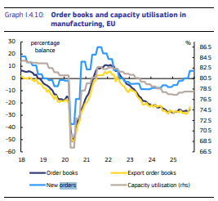
Volatile context
Fragile economic situation & growing geopolitical turbulence
Defence and security high on the agenda
EU funds, including the Recovery and Resilience Facility (RRF), have become a crucial funding source for investment in Member States
Austerity squeezing national budgets
→Threat of deindustrialization: clear and present danger
Euractiv roundtable

Slide 3

Stagnation of private investment in EU over past 25 years
decline in labourʼs share of income - now around 63% of GDP compared to almost 66% in the 1990s - means that roughly 37% of value added is captured by capital.
Yet only about one third of this income is reinvested in the real economy, as private investment by firms accounts for barely 12–13% of GDP (historic low).
In other words, two thirds of capital income are distributed rather than reinvested, feeding financial markets instead of productive capacity.
Despite record profits, this imbalance between accumulation and investment has become structural, undermining innovation, decarbonisation and job creation.
Meanwhile, for households, the investment-to-GDP ratio has hovered between 17% and 20%
Key causes include corporate financialization, rigid fiscal rules, weak household demand.
Source: ETUC Macroeconomic Outlook (Link)

Slide 4
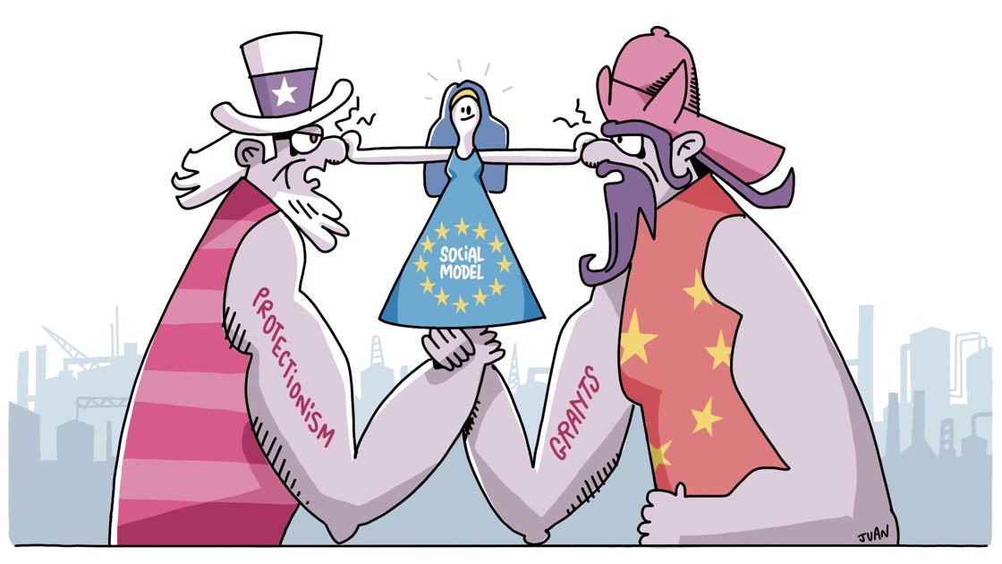
Ending European naivety
Facts and figures through a review of 19 industry sectors
https://news.industriall-europe.eu/Article/1390
20th November 2025

Slide 5
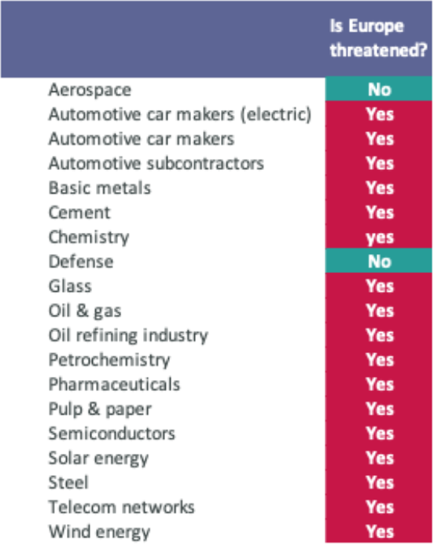
Almost the whole European industry is under threat
Beyond the automotive sector, almost every sector is under pressure.
Pharmaceuticals is under US pressure and is highly dependent on China and India.
Basic materials and steel are very fragile. The solar energy industry has disappeared.
The telecom industry is dominated by China. Solar industry has disappeared in Europe.

Slide 6

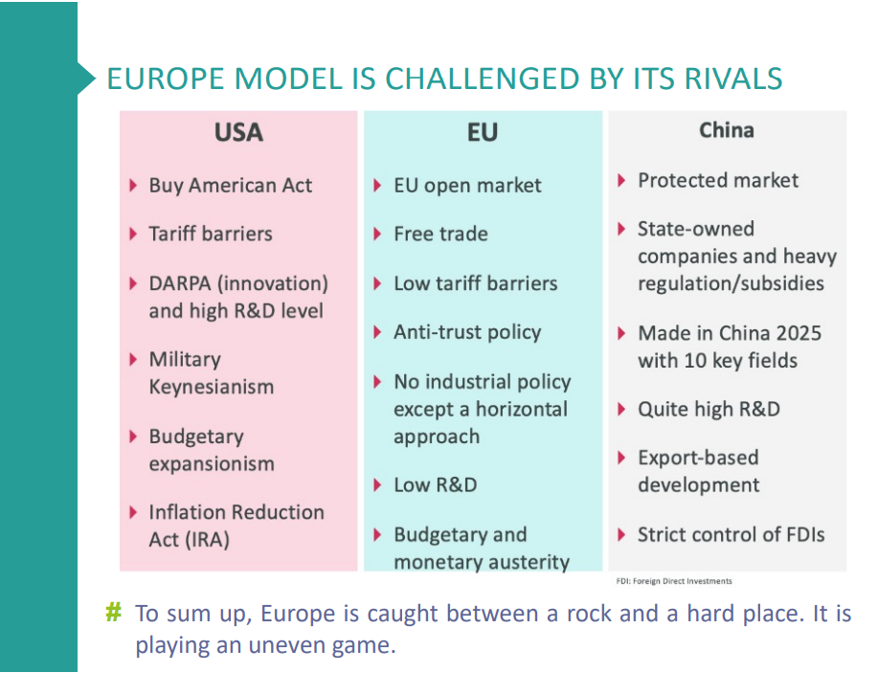
Europe must step up to the challenge quick
IPC September 2025

Slide 7

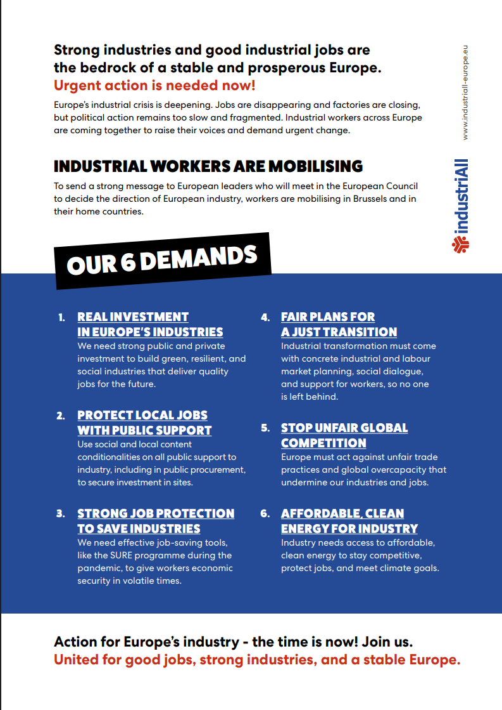
United for Good Jobs & Investment

