Slide 1




Promoting successful
social partnerships
in the European textiles
and clothing Industry

Slide 2
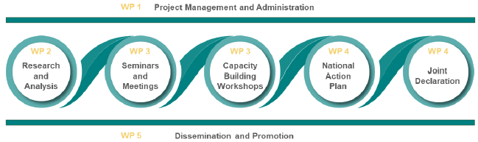


Objectives
Foster meaningful and constructive dialogue between textiles and clothing industry social partners.
Strengthen the capacity of social partners.
Support the green and digital transitions in the textiles and clothing sector.
Increase awareness and collaboration among stakeholders.
Provide policy recommendations based on project findings.
May 2024 – April 2026

Slide 3
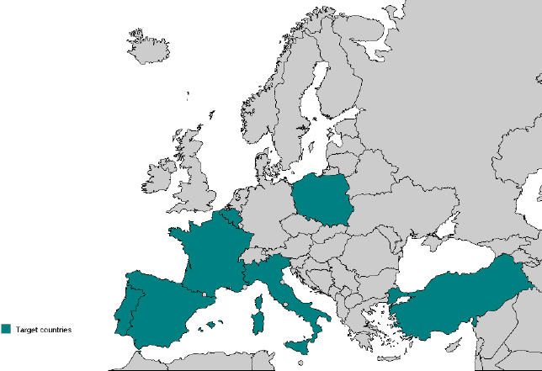


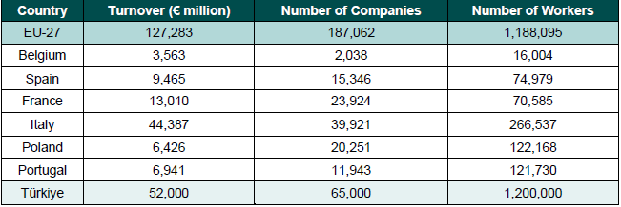
Partners
Project coordinator

Slide 4
Phase 1: Research & Analysis
June – October 2024
Desk Research:
Identify and gather relevant documents, literature, and reports.
Review and analyse the gathered information to extract key insights and understand the employment, social, and economic challenges.
Identify and collect statistical data on the T&C sector.
Summarise the desk research finding
Field Research:
Conduct comprehensive research and analysis to gather relevant information on the European T&C industry, social dialogue, and collective bargaining.
Identify key challenges, trends, and opportunities in the industry and social dialogue landscape.
Provide actionable recommendations based on the research findings to support the promotion of social dialogue and collective bargaining in the targeted countries.
Research Report:
Present the desk and field research findings in a structured report.
Identify key challenges, trends, and opportunities.
Develop actionable recommendations and strategies to strengthen social dialogue and collective bargaining.
Translate the research report into the relevant languages.
Review and proofread the research report before publication and dissemination.
Data Analysis:
Organise the collected data from desk and field research.
Analyse the data to identify critical challenges and opportunities related to employment, social dialogue, collective bargaining, sustainability, and digital transition.
Interpret the data analysis results and extract meaningful insights that address the research objectives.

Slide 5
Phase 2: Stakeholder Engagement
November 2024 – May 2025
Plan and coordinate high level seminars that address each country’s textiles and clothing industry's specific needs and challenges.
Gather feedback to evaluate the relevance, usefulness, and impact of the discussions.
Identify key topics and priorities requiring further attention or improvement to develop national action plans and organise training capacity-building activities.
What is expected of you?
Planning & collaboration
Provide inputs & sights
Support with logistics (venue, accommodation, catering, AV)

Slide 6
Phase 3: National Strategy Development & Capacity Building Workshops
June 2025– January 2026
Develop a national action plan to promote social dialogue in the T&C industry in the targeted countries.
Draft a joint declaration outlining shared principles and commitments.
Strengthen the capacity of social dialogue representatives to engage in effective & inclusive social dialogue.
What is expected of you?
Actively participate in the workshops
Organise joint training events
Support with logistics (venue, accommodation, catering, AV)

Slide 7
Final phase: Final conference
January – April 2026
Platform to share the most relevant outputs of the project and engage in panel discussions with social partners representatives from the seven countries.
To facilitate the exchange of good practices and experiences, promote a multi-cultural approach, and foster synergies with other European sectoral social dialogue committees and groups.
Brussels, February 2026.

Slide 8
Project Timeline

Slide 9
Q&A
Thank you!

