Slide 1



FLY-SUS EU Project
Strengthening cooperation through the supply chain for a sustainable transformation of the aviation sector
industriall-europe.eu

Slide 2



Summary
Intro: FLY-SUS project
Project participants
Project aims
Process and deliverables

Slide 3

Introduction to FLY-SUS
Full title: Strengthening cooperation through the supply chain for a sustainable transformation of the aviation sector
Timeline: March 2024 - February 2026
Who: industriAll Europe (IAE) with support from Syndex.
Steering Committee: IAE affiliates
Project page on IAE website: HERE

Slide 4

IndustriAll European Trade Union
Project coordinator
A federation of independent and democratic trade unions representing manual and non-manual workers in the metal, chemical, energy, mining, textile, clothing and footwear sectors and related industries and activities.
Representing 7 million working men and women united within 200 national trade union affiliates in 39 European countries.
Represents workers in the entire aerospace manufacturing supply chain including civil aeronautics.
European Aerospace Network meets on a regular basis.
Member of the EU Pact for Skills with ASD and aerospace companies.
Website

Slide 5

Syndex
Project support (sector experts)
Tasks include desk research, coordination of surveys, conducting interviews and drafting final report.
Syndex is a consulting firm exclusively dedicated to employee representatives.
Since 1971, Syndex has been defending the interests of employees. Its vocation is to advise and support employee representatives, health and safety committees as well as the trade union organisations.
Website

Slide 6
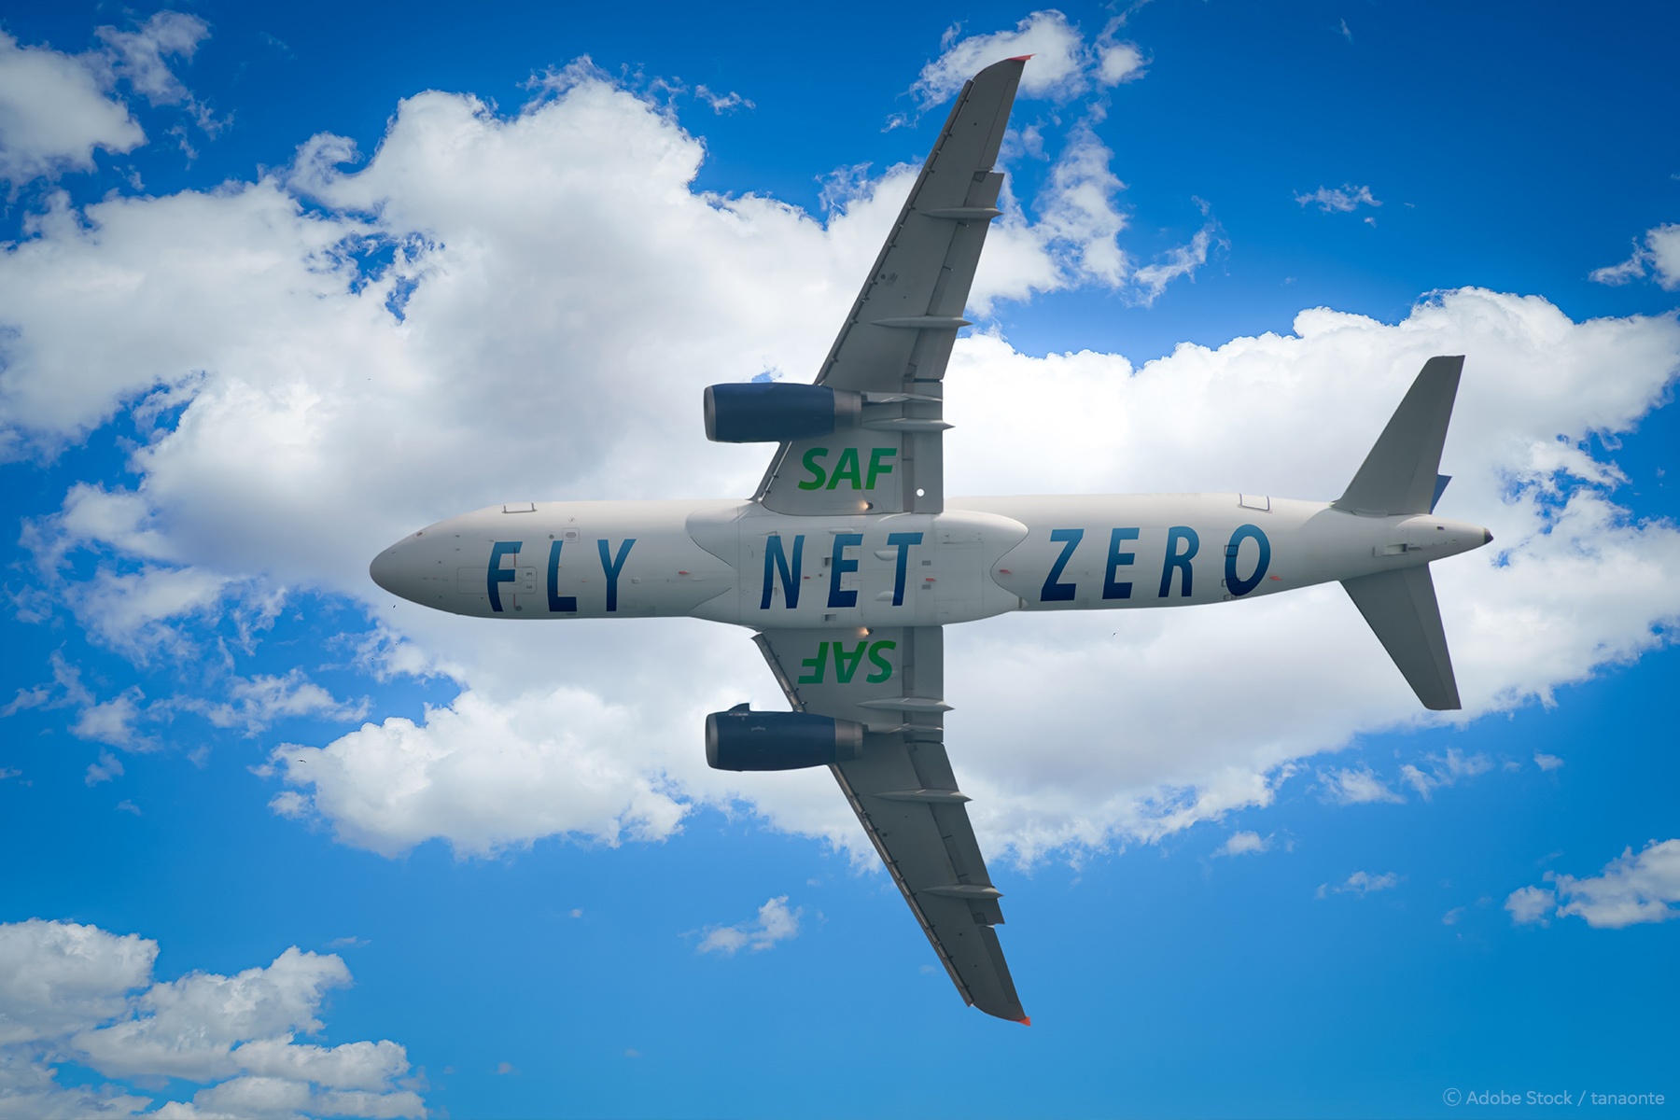
Overall project aims
To address the sustainability and the resilience of the European aerospace industry by promoting innovative cooperative relationships between stakeholders along the value chain.
To investigate the challenges encountered from three different standpoints economic, environmental, and social.
To provide insight into potential strategies and solutions.
To improve social dialogue.

Slide 7
Specific project aims
BEGINNING OF THE PROJECT
Map and analyse the European aeronautics supply chain.
THROUGHOUT THE PROJECT
Gather information on specific issues.
Gain better understanding of the regional challenges.
Identify and promote sustainable solutions.
Identify practices to ensure a more balanced relationship (supplier/OEM).
Identifying good social dialogue practices.
Identify non-unionised sites.
BY THE END OF THE PROJECT
Have a detailed understanding of the issues facing the supply chain.
Agree on potential strategies and solutions.
Publish recommendations.
Strengthen trade union capacity in the supply chain.
Improve social dialogue throughout the supply chain.

Slide 8
Process
To be conducted by Syndex.
Participants: trade unions, companies and relevant stakeholders.
Aims:
  Dive deeper into the country specifics on sustainability
  Better understand national social partner representativeness and capacity
  Help identify local/regional challenges and possible solutions
  Will help shape agenda for each regional workshop.
Desk Research
Surveys
Kick-off Conference
Interviews
Regional Workshops
Final Report
Short Report
Video
Final Conference

Slide 9


Join us!
Follow our website and social media:
www.industriall-europe.eu
industriAll_EU
industriAll Europe

