Slide 1
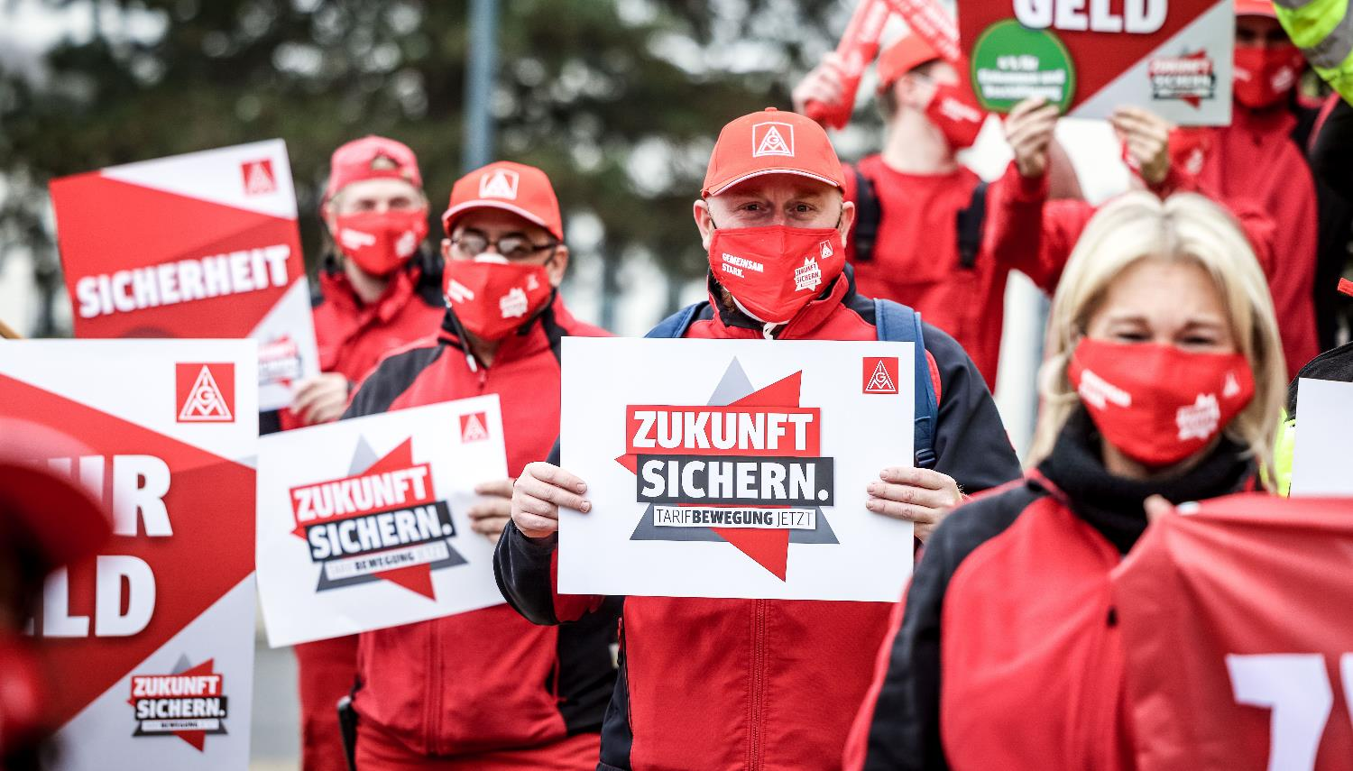

FAIR CHANGE: ONLY WITH US
FUTURE COLLECTIVE AGGREMENTS AND PARTICIPATION

Slide 2
Topics
IG Metall
Future Collective Agreements
Example: ZF
The Company Map (Process)
Feedback & Discussion

Slide 3
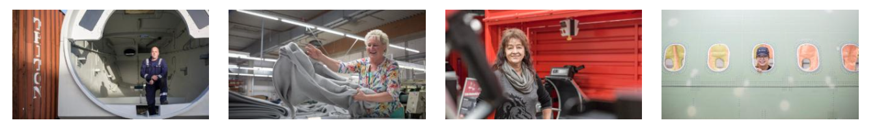
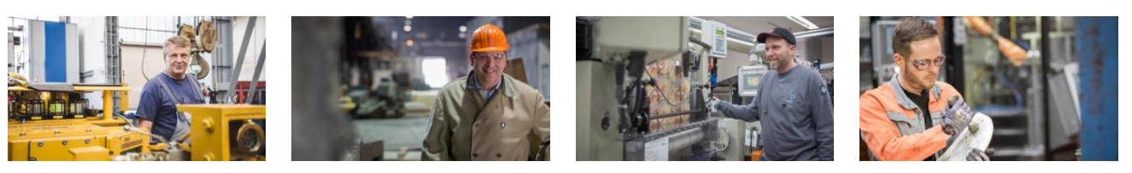
1. IG Metall
New Energies
Textile Industries
Crafts
IT and Engineering
Mechanical Engineering
Iron and Steel
Wood, Furniture, Plastic
Metal and Electrical

Slide 4
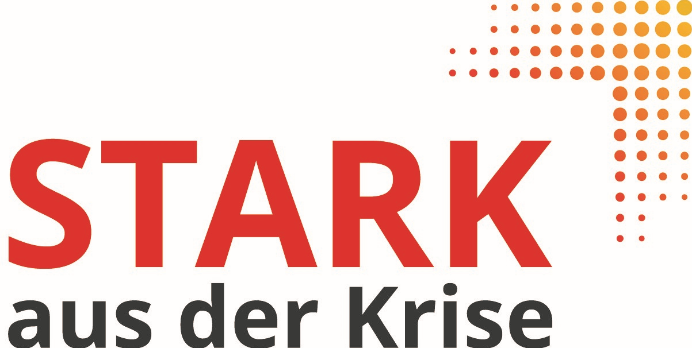
Stages of crisis/options for action
“Future agrreements” approach
Strategy crisis
Product/sales crisis
room for maneuver
Sales crisis
Liquidity crisis
insolvency
Inclusion of IG Metall currently.
Time
Notes:
Abgrenzung zu Pforzheim

Slide 5


2. FUTURE COLLECTIVE Agreements
The operating parties advise on the challenges of the transformation.
Each company party can consult the collective bargaining parties.
The company and collective bargaining parties should carry out an analysis by mutual agreement - or even unilaterally.
If there is no agreement, a moderator can be involved.
This makes a written recommendation about the need for action/measures

Slide 6


Framework rules for future collective agreements
Tariff result 2021 (NRW)
Analysis
Evaluation
Implementation
1
2
3
The operating parties discuss the challenges of the transformation. It is possible to consult the collective bargaining parties and external experts. Goal: joint analysis.
1. Schritt:
  There is a need for action
Negotiations about
- Target image
- Change management
- competitiveness
- Personnel and qualification planning
- Securing employment and locations
2. Schritt
Beratung
  no need for action
1. Schritt
No negotiations
1. Schritt
  no agreement possible
Moderation can be agreed. If no agreement is reached, the process is over.
Obligation to report at the next works meeting on the progress and results of the discussions
Notes:
Die regionalen Besonderheiten sind zu beachten.

Slide 7
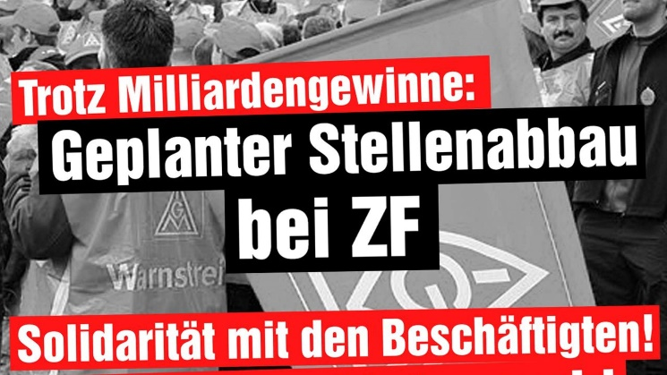
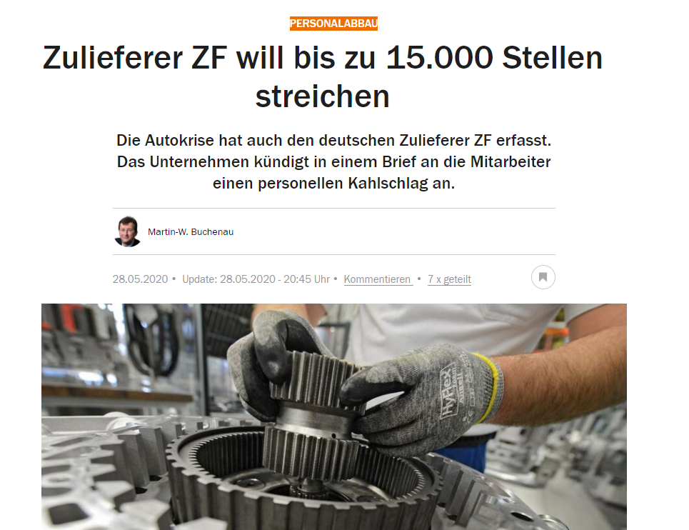
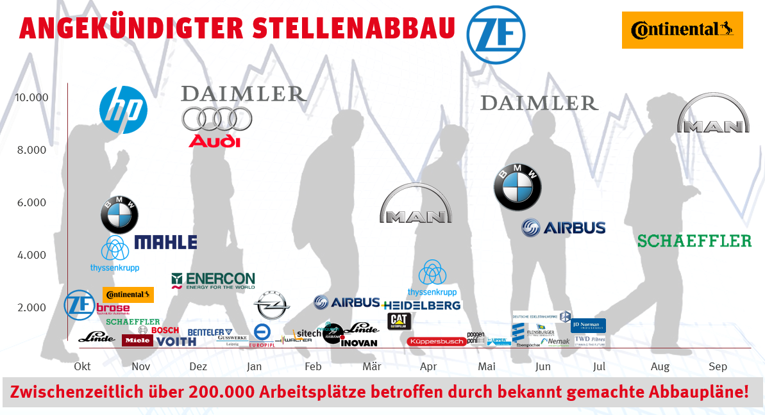
3. Situation at ZF
Spring 2020
Announced job cuts

Slide 8
Collective agreement transformation
Collective bargaining agreement transformation: two years of security for employees and flexibility for the company
- Employment security agreed until the end of 2022
- ZF can adjust capacities through short-time work, reduction of working hours by up to 20 percent, partial retirement and severance payments
- The number of trainees remains at the current level
- The company and employee representatives work together to develop long-term visions of the future for the locations
Agreement on the structural realignment of the company was reached. This "Transformation" collective agreement applies until the end of 2022 for the approximately 50,000 collective bargaining employees in Germany and gives ZF the necessary flexibility to cope with the consequences of the economic crisis under the influence of the corona pandemic and to transform the company in the course of to further advance mobility change
§4 Target image process:
In an analysis phase, the effects of the Corona crisis and the upcoming transformation of industries are recorded for each location and a competency analysis (summary of strengths and weaknesses, technological position, competitiveness) is created. From this, goals and concrete measures for the development of the locations from an economic perspective and for strategic future orientation are derived. This target image is created, discussed and discussed between the site management and the works council with the necessary information and, if necessary, with the help of specialist expertise, and the resulting measures are defined. Topics and content of the target images are, in particular, future products and utilization, investments, employment, development of competitiveness and necessary qualifications.
The target images should at least specifically address the period up to 2025 in the fields mentioned and also show a perspective towards 2030. If no agreement can be reached on a target image, the group-wide “Transformation and Employment Security” steering committee is contacted and consulted.

Slide 9
Target image process at ZF
§4 in the collective agreement transformation
Impact of Corona and Transformation Competence Analysis: Strengths and Weaknesses Technology Position - Competitiveness
Goals and measures for the economic development of the locations
Goals and measures for strategic future orientation
Analysis
Derivation of goals and measures
Future products and utilization
Investment and employment
Development of competitiveness
Necessary qualification
Future direction until 2025 and 2030
Creation of target image location

Slide 10
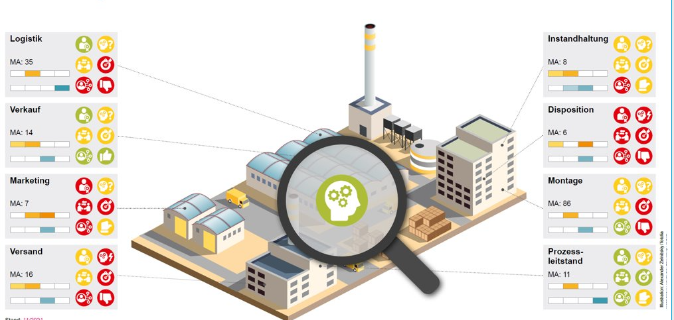
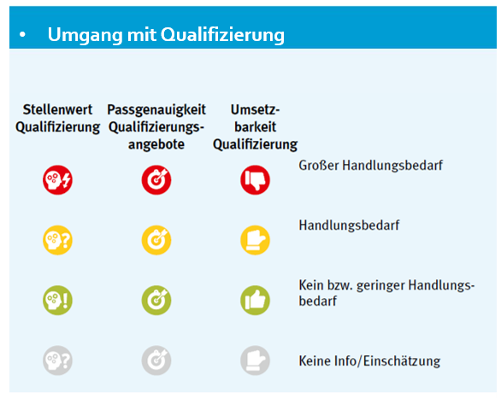
4. The Company Map
Dealing with qualification
Importance
Accuracy
practicability
of Qualification
great need for action
Need for action
No or little need for action
No info/assessment

Slide 11
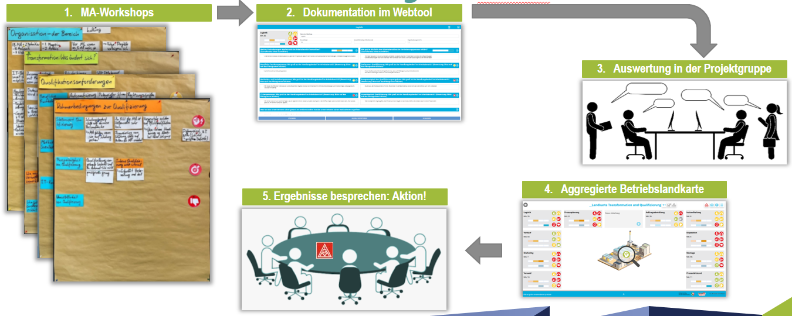
The company map process
1. Workshops
2. Documentation
3. Evaluation in the project group
4. Aggregated company map
5. Discuss results: Action!

Slide 12
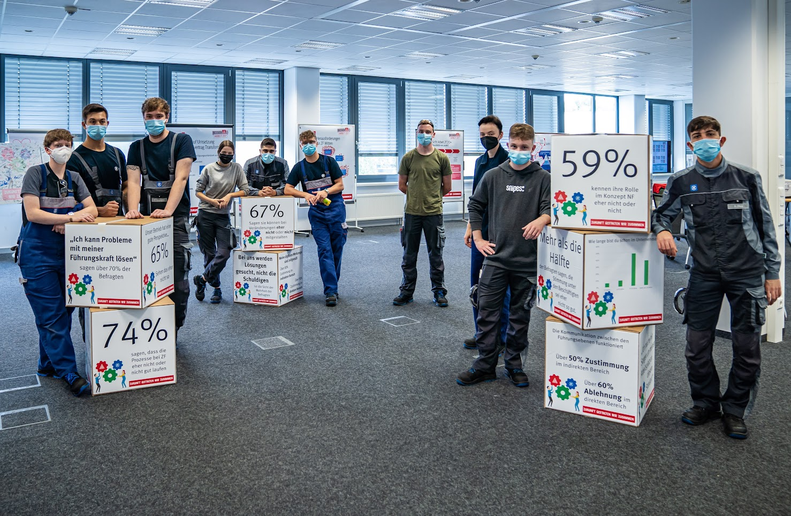
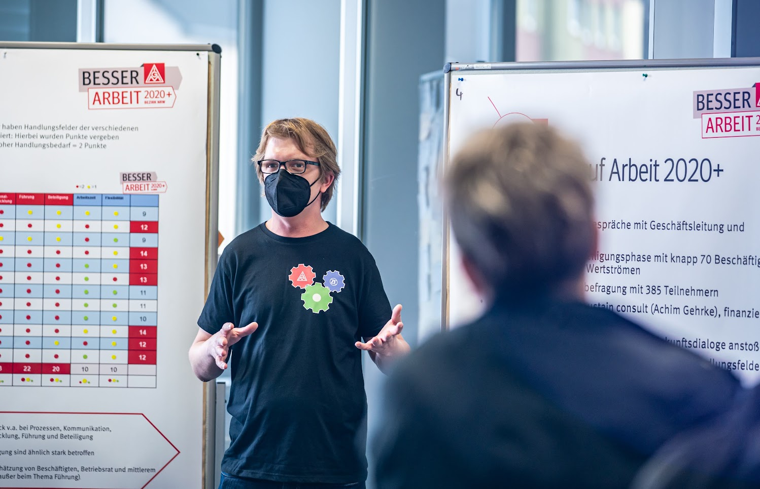
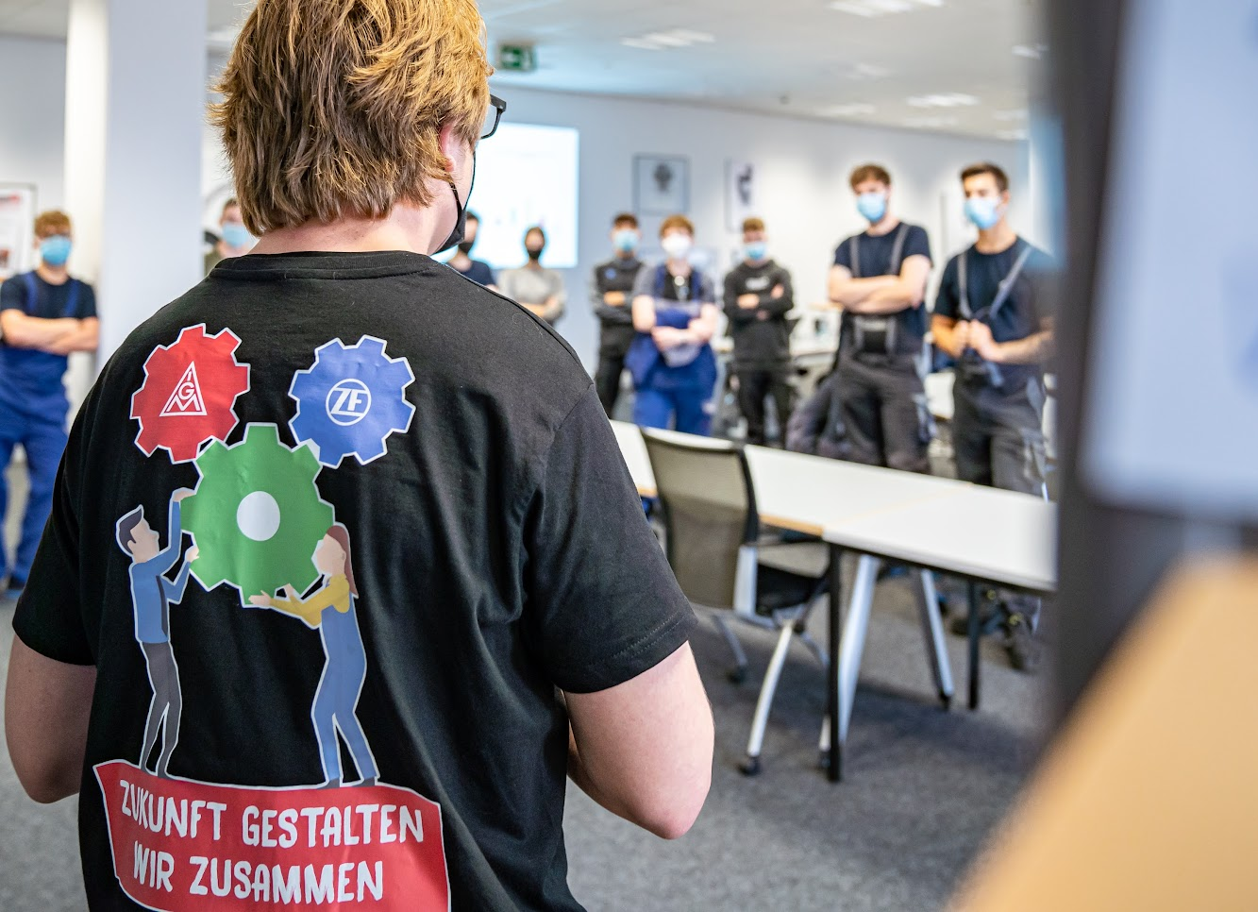
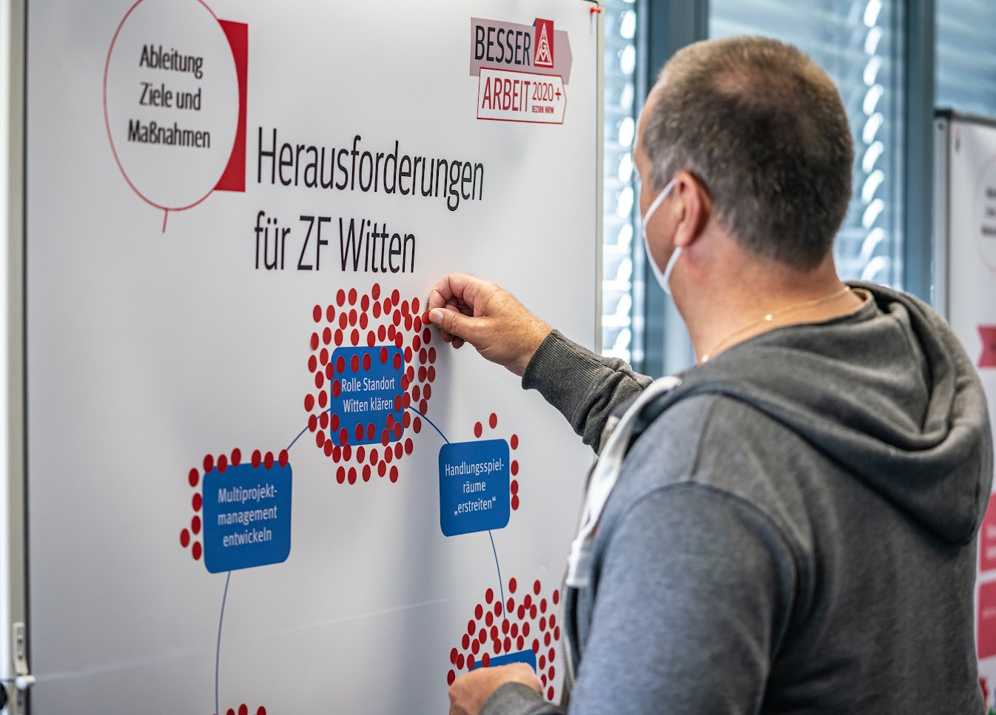
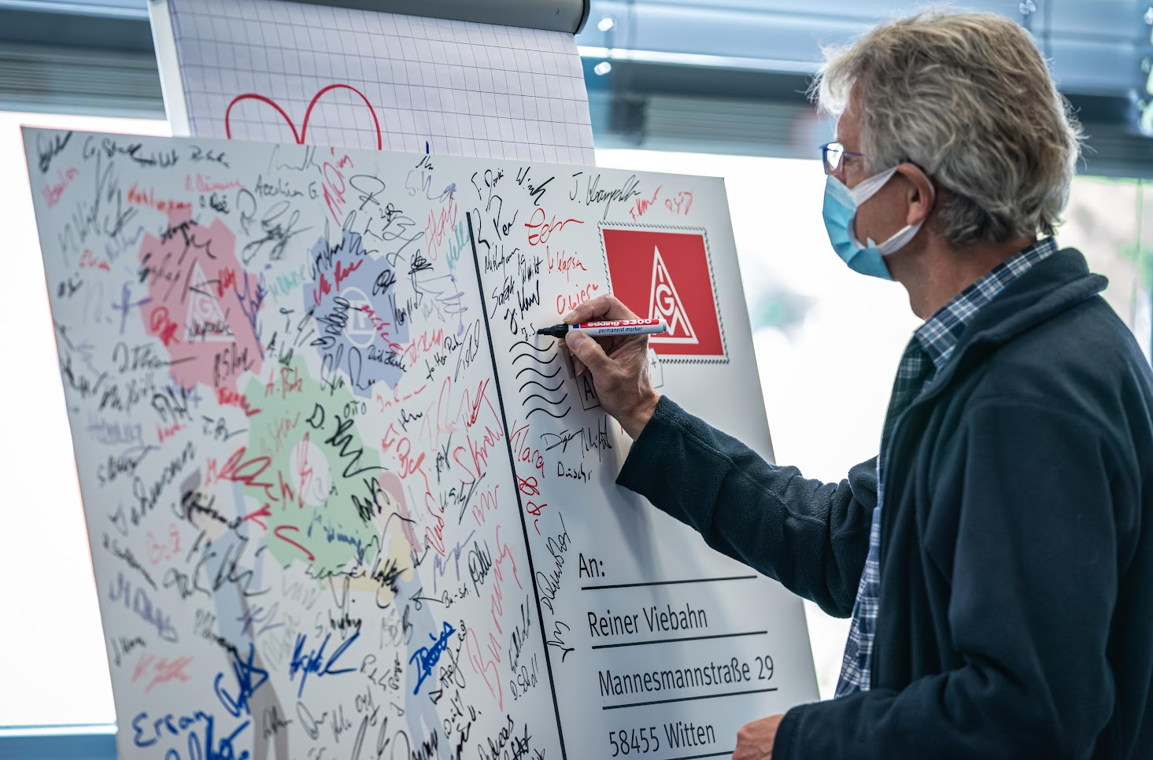

Slide 13
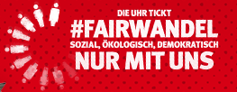
Nick Woischneck
Nick.woischneck@igmetall.de
0049 151 / 1623955
www.igmetall.de

