Slide 1

BASF’s Path to Climate Neutrality
Diana Chillón
Conference “On the Road to Climate Neutrality 2050”– March 2023.

Slide 2
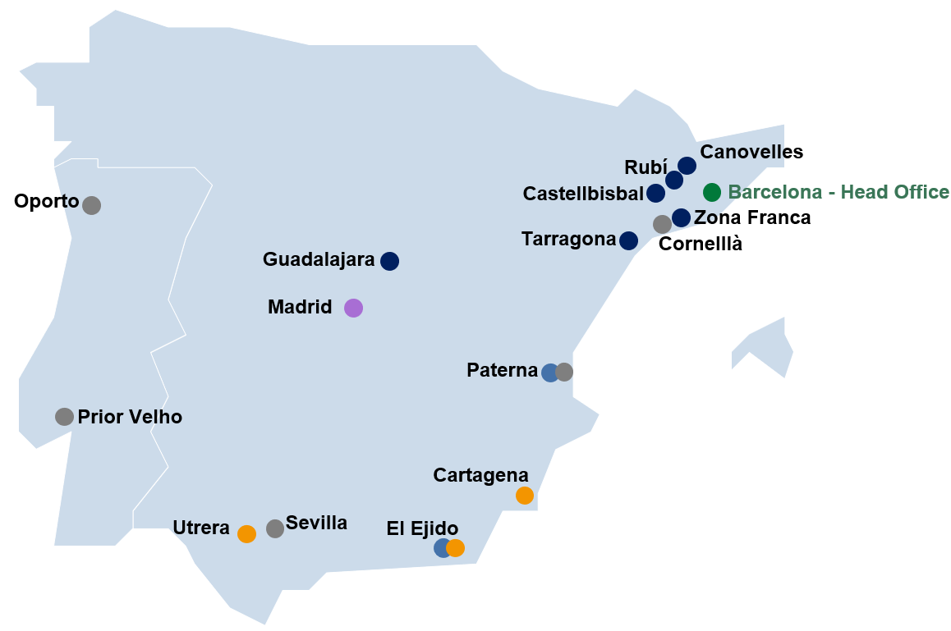

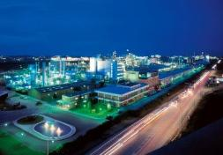

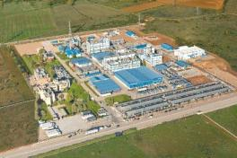
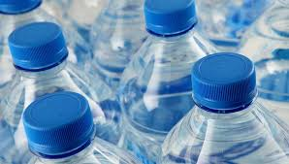

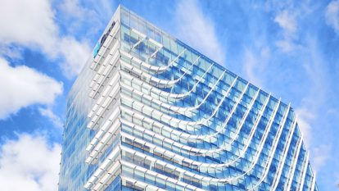





BASF in Spain
Facts & Figures
Key industries
Major Sites
Tarragona
Automotive
Guadalajara
Agriculture
Tarragona/Guadalajara
Chemicals & Plastics
Digital Hub Madrid
Production sites
6
Home & Personal Care
Total # of sites
18
Employees
2.577
Packaging
Investments 2022
50M€

Slide 3




Key transformative challenges
The Chemical industry is facing a quadruple transformation
Developments in all industries
Additional developments in the Chemical industry
CO₂ neutral
Digital
Zero tox
Circular

Slide 4
BASF: Our commitments to reaching the Paris Climate Agreement
25%
CO₂ emissions reduction
(compared with 2018)¹
2030
net zero
CO₂ emissions¹
2050
¹ Scope 1 and Scope 2; 2030 target compared with 1990: 60% CO₂ reduction

Slide 5
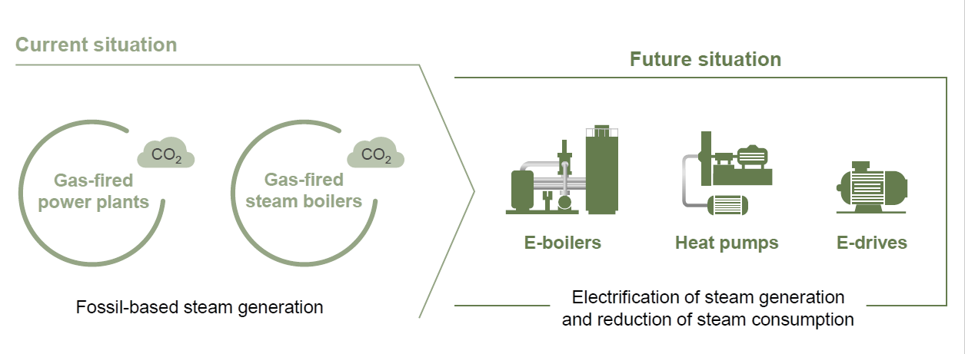
High potential from changing from power to heat allows decoupling from electricity supply

Slide 6

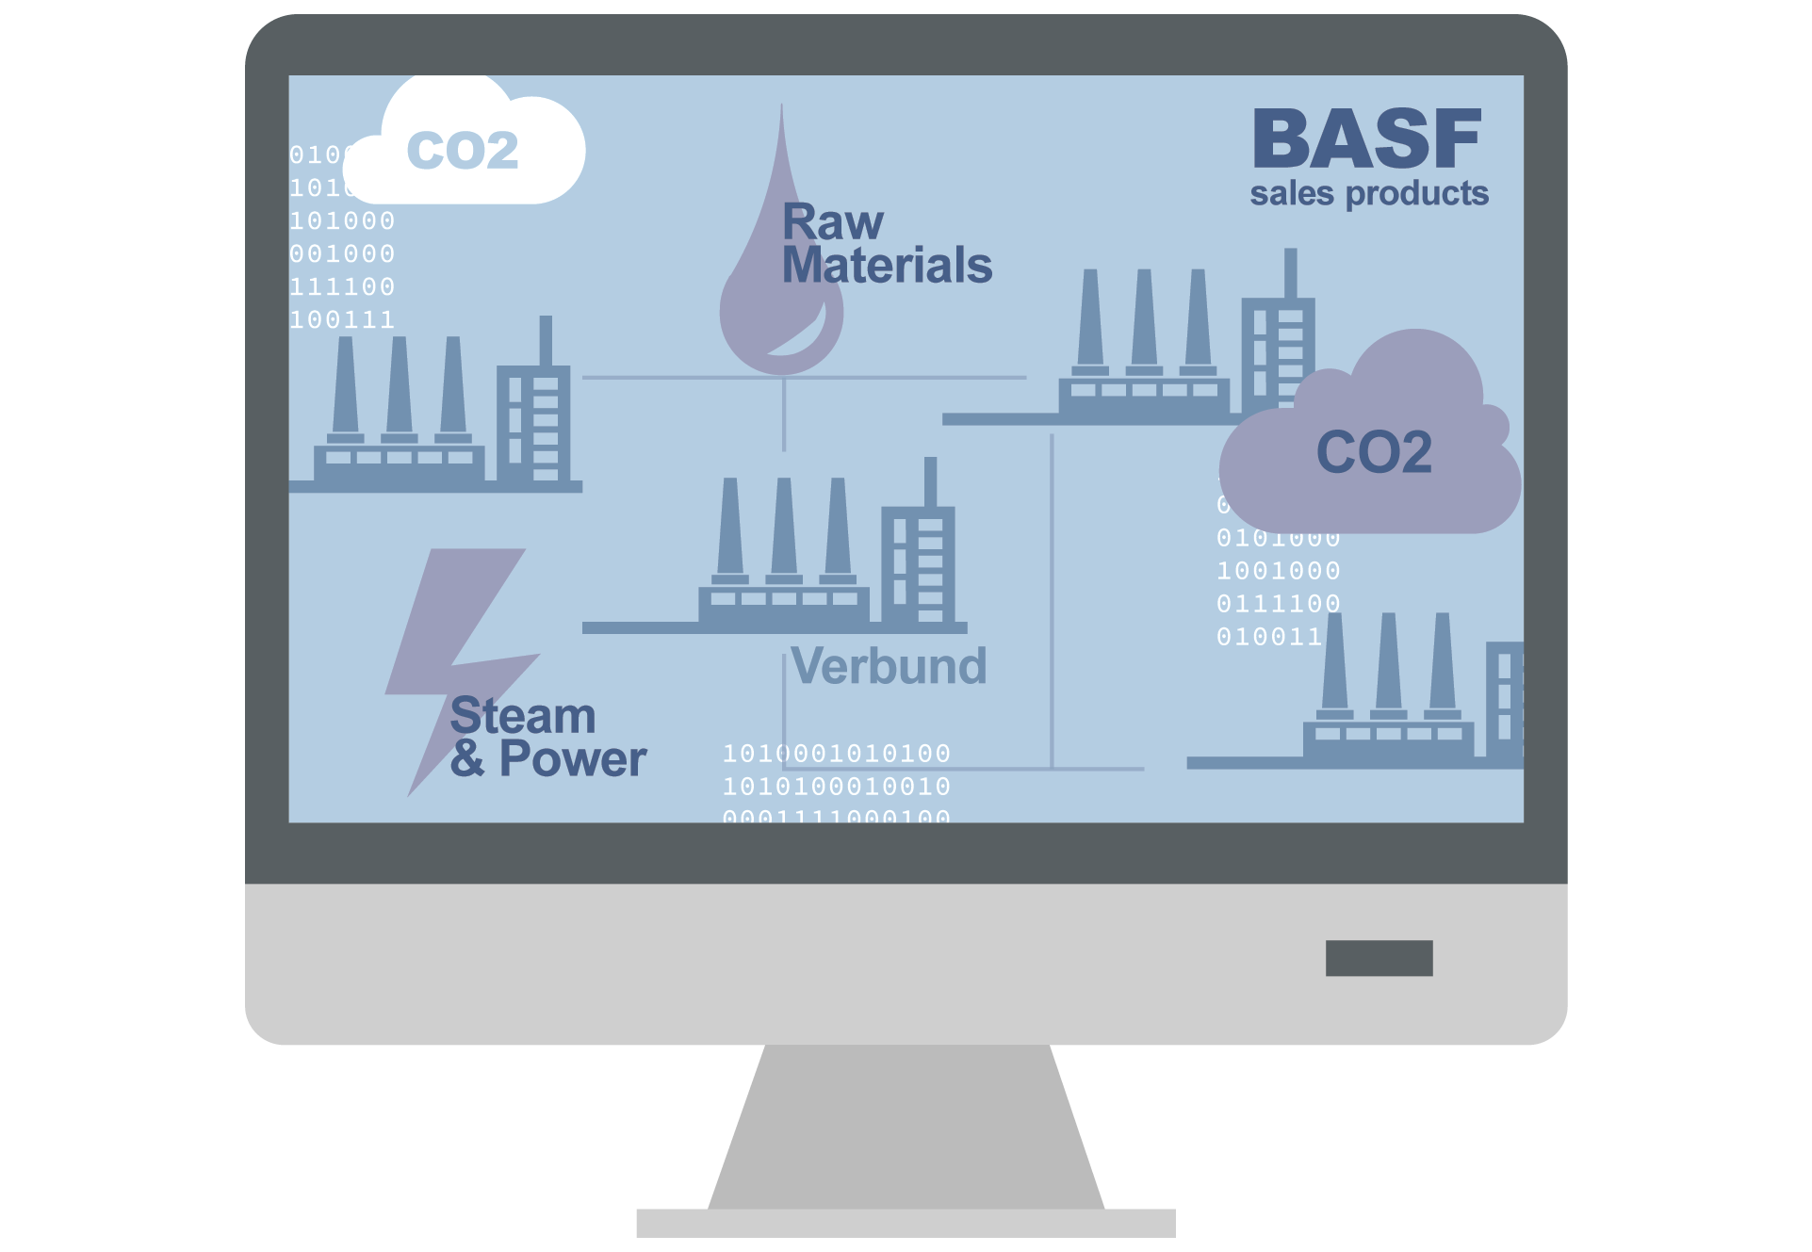

Product Carbon Footprints create transparency for customers
Digital application to calculate greenhouse gas emissions for the entire portfolio of approximately 45,000 products
20,000
Raw materials
Scope 3
700
Production plants
Scope 1
1011101010100001010100101010101011110101010110100
1011101010101010111101010101101001010100101010100010101010100
Product Carbon
Footprints of
~45,000
Sales Products
CO₂
10 TWh/a
Energy
Scope 2
10111010101000010101001010
In Spain we work together with our customers in order to create a strategy of using products with the less PCFs and helping the entire value chain to reduce their numbers as well.

Slide 7
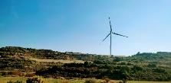
BASF Española uses renewable energy in most of its sites
25 years onshore wind power from SPAIN
since January 2022
Picture sources: BASF, American Public Power Association

Slide 8

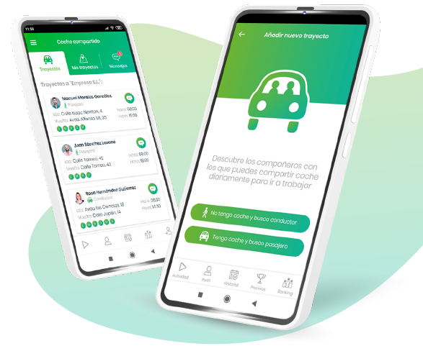
Share & Go!
Workers of BASF Española initiative to reduce the use of vehicles.
CICLOGREEN
If we reduced the number of vehicles by
50%
we would save
~400 t/year of CO₂.

Slide 9
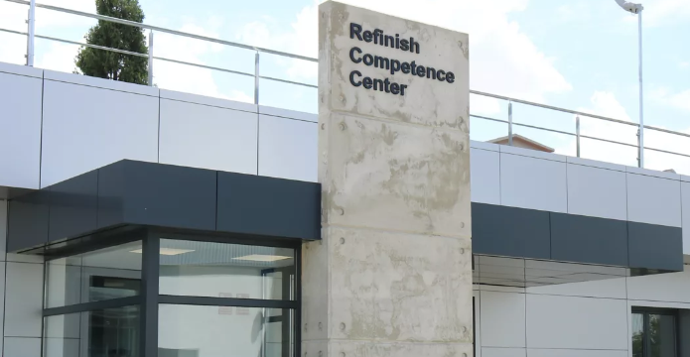
Refinish Competence Centre
BASF Española – Guadalajara
Our training center is dedicated to training technicians from repair shops, distributors and major automobile brands, all BASF customers in Spain.
Hosts numerous events aimed at promoting the training of the young professionals of the future, through initiatives such as the R-M Best Painter Contest or as the headquarters of Castilla - la Mancha Skills.
Training of Vocational Training teachers through the FORTECO course program.
https://youtu.be/qJEOaM_dzqs

Slide 10
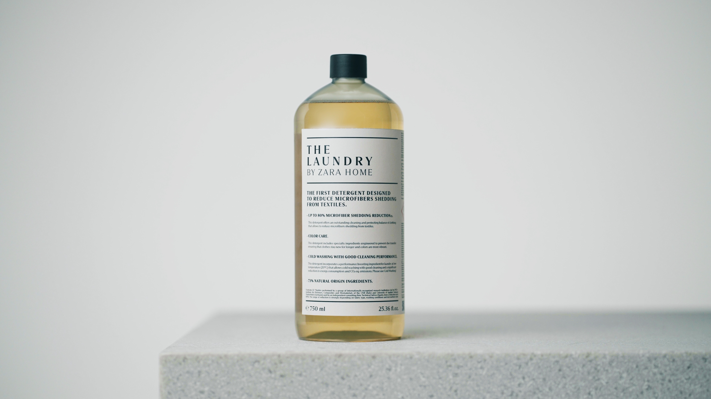

Other projects
Inditex and BASF
High efficiency detergent
Citroën and BASF
Oli Prototipe

Slide 11
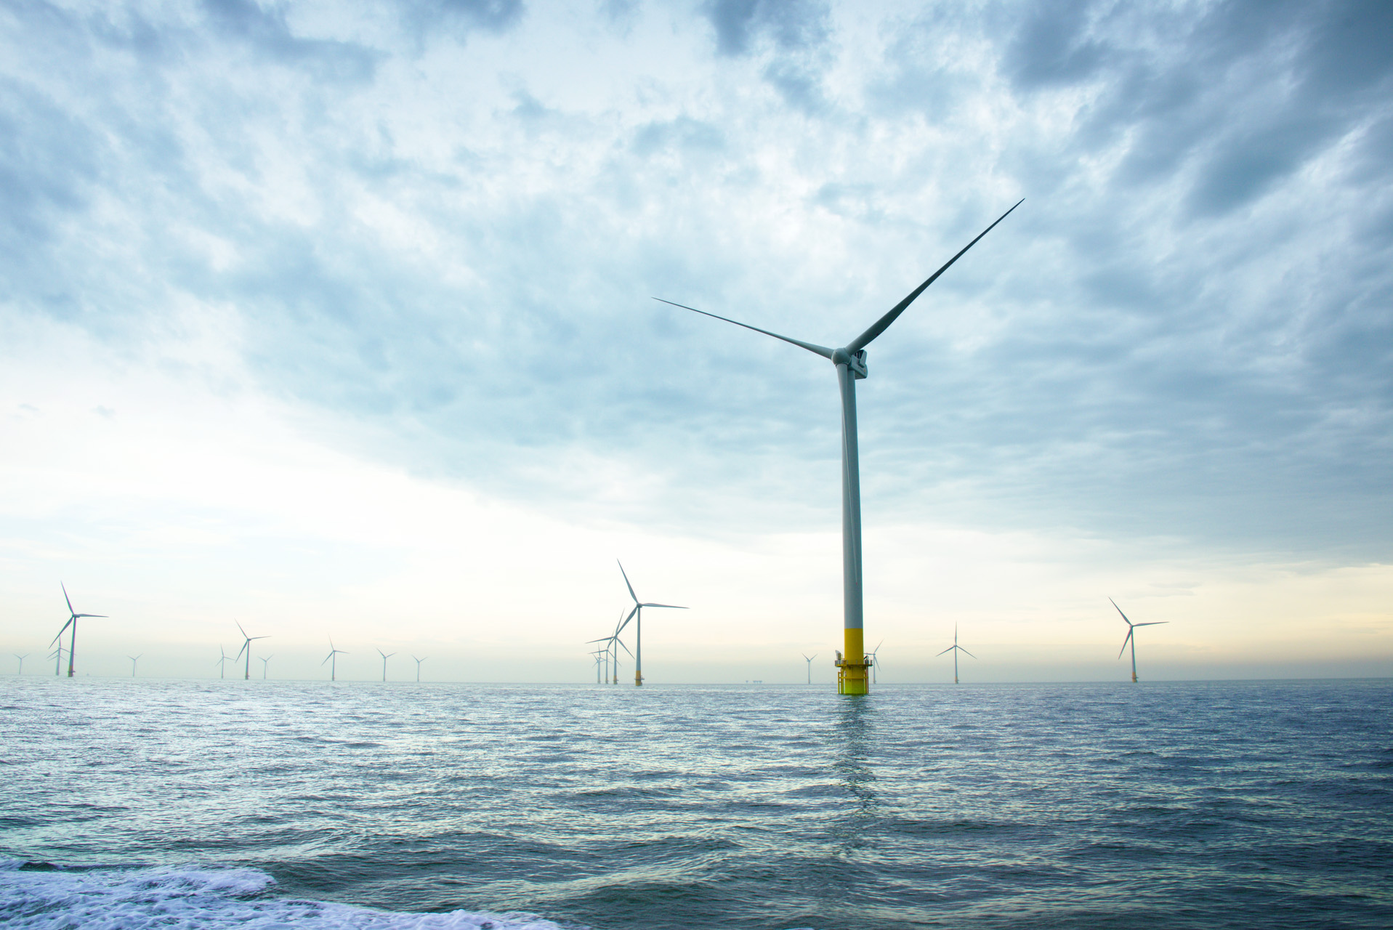

We create chemistry
for a sustainable future

