Slide 1
A green Skills roadmap for the climate transition in the energy intensive industry
Helena Van Langenhove & An Katrien Sodermans
Department of Work and Social Economy – Flanders (Belgium)
On the Road to Climate Neutrality 2050, Rome, 8/03/2023

Slide 2
Overview
Policy context
Green skills roadmap study for the energy intensive industry
Case: green apprenticeships in the chemical industry
Questions and discussion

Slide 3
Policy context

Slide 4
Green skills and jobs policy context
The green transition will have a structural impact on the way we produce, consume and live.
EU Green deal and Paris agreement require new regulation and investment in technology and innovation
The transition to a low-carbon, resource efficient and green economy can only be made by having a workforce with the right skills
Initial education won’t be sufficient. Need for upskilling & upskilling of the current workforce
Specific context for Flanders:
Human capital is Flanders’ greatest resource
Labour market shortages

Slide 5
Green skills and jobs policy actions in Flanders
Notes:
Transversal lifelong learning policies.

Slide 6
Green skills roadmap study for the energy intensive industry
Roland Berger study for the Department of Work and Social Economy

Slide 7
The study
Conducted in 2021 by Roland Berger on behalf of the Flemish government (Department of Work and Social Economy)
Identified, for the first time, the concrete skills challenges facing the traditional energy-intensive industries (chemicals, petrochemicals, primary metals and rubber and plastics) in Flanders for the period 2020-35
Built on an extensive literature review, quantitative analysis of several skill forecasting studies and interviews with more than 50 industry experts
https://www.rolandberger.com/en/Insights/Publications/Skills-Roadmap-for-climate-transition-%5B2020-2035%5D.html

Slide 8
The insights of +50 stakeholders from very diverse backgrounds were taken into account

Slide 9
The Flemish energy intensive industry represents an interesting case of changing human capital needs

Slide 10
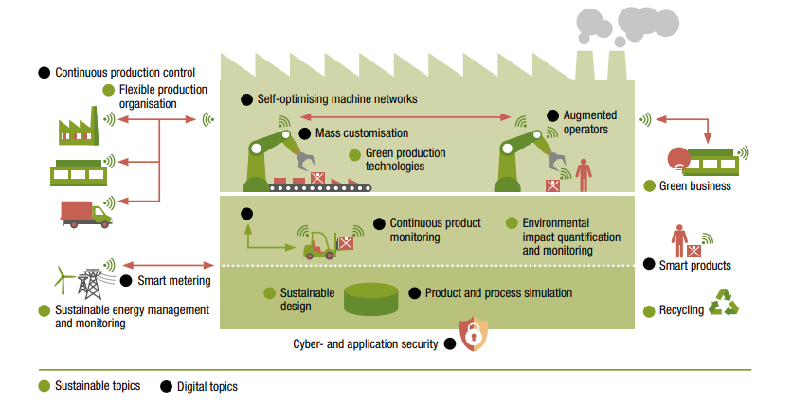
In the workplace of the future, the green and digital transition go hand in hand
‘Twin transition’

Slide 11
Competences on the workplace are a combination of knowledge, technical and soft skills
Skills for the green transition

Slide 12
The most important skills needs for the energy-intensive industry

Slide 13
The skills challenges for the energy-intensive sectors in Flanders

Slide 14
The need for upskilling in green themes for c. 59 000 workers

Slide 15
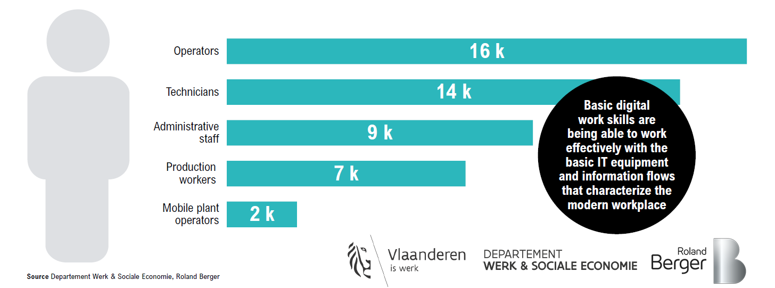
The need for upskilling in digital themes for c. 49 000 workers

Slide 16
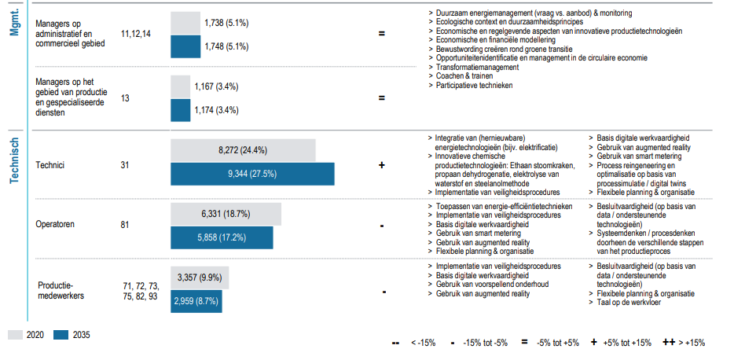
Need for technicians expected to rise by 2035 – Digital and green skills needs for technical profiles

Slide 17
Demand for scientists and engineers will rise – decline in administrative roles

Slide 18
Increase in number of salespeople expected by 2035 with new skills needs such as circular economy sales models

Slide 19
Actions for policy makers & sector associations – Three objectives to be achieved to respond to the skills challenges

Slide 20
Case: green apprenticeships for operators in the chemical industry
2021 joint Cedefop/OECD symposium on Apprenticeships for greener economies and societies
An Katrien Sodermans, Helena Van Langenhove, Frederick Van Gysegem, Sarah Pascal

Slide 21
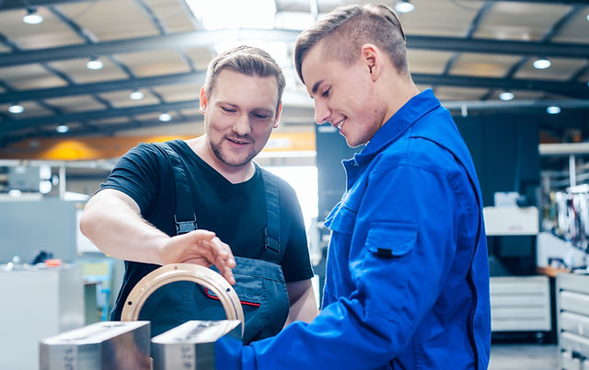
Apprenticeships as a solution for training students as well as reskilling and upskilling employees
Benefits of apprenticeships:
Flexible training method that ensures workers develop the right skills
Provides a strong learning environment with real-life work experiences
The productive contribution of apprentices to the employer during their period of apprenticeship.
No indirect training cost of unworked paid hours in comparison with training for employees outside the workplace
Recruitment of the most productive apprentices
employers offering apprenticeships enhance their reputation

Slide 22
Chemical operators will need to upskill in green, digital and soft skills

Slide 23
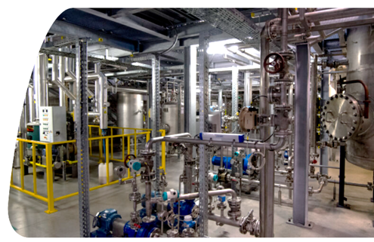
The ‘Acta’ case The greenification of an existing training module in the chemical sector
What is ACTA?
a technical training centre for the chemical industry near the port of Antwerp
target group: employees, teachers, students, the unemployed.
A chemical plant (400 m²) for training and observation of learners
Chemical process techniques (CPT) programme
prepares young people in 1 year to become a process operator in the chemical industry.
Collaboration between education and the chemical industry
The secondary schools: theoretical training
Chemical company: apprenticeship
ACTA: 7-day training module (distillation, flow, pressure, pumps, measuring devices and steam generators)
Greenification of the ACTA training module based on the Roland Berger study

Slide 24
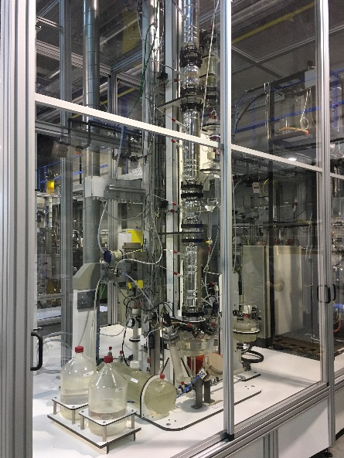
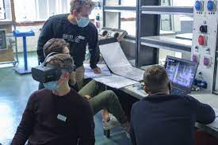
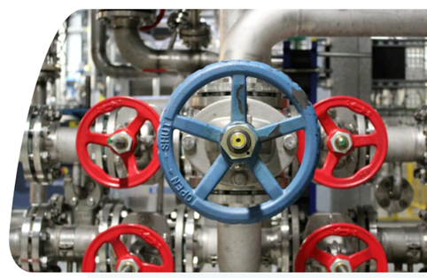
Some examples
game at the distillation column
VR quest ‘search for green crimes’
→ make ecological impact visible and increase awareness
→ Learn to detect spills or leakages
Notes:
Adding energy management to the distillation training

Slide 25
Some examples
Include sector-orientated sustainability cases in new course material
→ increase the general knowledge about current problems, challenges and innovative solutions regarding the sustainability debate in the chemical industry

Slide 26
Interviews with stakeholders involved in the case
June-July 2021
Interviewees:
Head of Co-Valent, a joint (parity) sectoral training fund in the chemistry, plastics and life sciences sector
Education and labour market specialist @ Essensscia, Belgian sector federation of the chemical industry and life sciences
HR representative and production manager + 2 process operators (former apprentices) @ BASF
Consultant @ Regional Technological Center Antwerp (RTC)
Chemistry teacher @ VET school
Apprenticeships coordinator @ VET school
ACTA program coordinator

Slide 27
Interview questions
Is there currently sufficient awareness of green themes in the existing training for the sector? How can we make progress in this area? Are there any obstacles?
In what way can training providers get started with competence frameworks such as in the Roland Berger study?
Are there specific points for attention regarding green skills in apprenticeship training?
Which partners/stakeholders should be involved in make training modules greener?
What is the role of companies?
What is the role of training providers?
What is the role of other actors?
How can the ACTA case be a lever for introducing green skills into other courses as well?
What do you think is needed from the policy to put the green theme on the (training) map?

Slide 28
Main findings

Slide 29
1. Green skills are a combination of knowledge and skills but also attitude
skills for the green transition are a combination of knowledge, technical skills, soft skills + attitudes & awareness
The ‘green reflex’

Slide 30
2. It is difficult to teach green skills in a school context only
A ‘green’ awareness/reflex can be best taught at the workplace, during repetitive handling and exposure

Slide 31
3. Teachers should be sufficiently trained to teach green skills
little resources invested from schools in training courses or train-the-trainer modules for their teachers on green themes
Large gap between teachers and company floors (or changes that adaptation to a carbon neutral society will bring)
Good practice @ BASF:
school teachers are required to visit the production plant
Teachers give on-site classes to their students
Teachers have the opportunity to do internships in the company (varying from 2 hours to 2 weeks)
Mentors are invited to the classroom, to experience lab activities together with their apprentices

Slide 32
4. There is a lack of coordination and course material on green skills
The attention given to green themes at schools is greatly dependent on single actions and initiatives of teachers or school leaders
lack of course material on the green transition or knowledge on how to teach it
Apprenticeships can fill this gap

Slide 33
5. In companies, short-term economic return still takes precedence over ecological thinking
Apprenticeships are only an effective training method for skills for the green transition when companies are really adopting ecological awareness.
most companies are still not always eager to work in a more ecological and sustainable way if this would mean a loss in profit in the short term
Acting on green transition is often limited to the management and the research and development department

Slide 34
6. Greenification of a training module requires close collaboration between different partners
Companies: providing company-based learning and reaching out to schools
Schools: including green skills in the course materials and training their teachers
Regional actors: connect industry and educational fiels

Slide 35
Policy recommendations
1. Create awareness by specific green skills forecasting
2. Incentivise (financially) the integration of green skills in training and education
3. Stimulate apprenticeships to teach green skills
4. Facilitate strong partnerships for apprenticeships
Notes:
Before skills for the green transition can be included in curricula and apprenticeships programmes, it must be clear which skills are desired. Skills assessments and anticipation/forecasting exercises give policy-makers, companies and training providers information on current and future skill needs. The study on skills for the green transition in the energy-intensive industry made these skills more concrete for stakeholders (sectoral actors, training providers and policy-makers) and demonstrated the urgency of taking action in this field. The ACTA case showed that a skill forecast study, as carried out for the energy-intensive sectors in Flanders, can be a good start to thinking about adapting training modules to skill needs for the green transition.
skills for the green transition are not yet a topic high on the agenda in sectors and companies. Therefore, there is no demand stimulus for training providers to develop training courses. To solve this, it is recommended for governments to give financial support to education and training providers to adapt their courses to new developments regarding skills for the green transition. Ideally, these support measures are put in place simultaneously with measures to stimulate skills forecasting in clusters and sectors. However, it is not enough to include this in objectives and school curricula. It must also be made transparent how teachers can get started developing skills for the green transition and how they can work on them in the classroom. The theme should, therefore, also be addressed in teacher training courses and classroom materials.
Skills for the green transition are best taught in a combination of learning at school and at the workplace. The classroom or school, on the one hand, is necessary to gather theoretical knowledge on green technologies and innovations. The workplace, on the other hand, is a good place to develop a ‘green attitude’ when performing tasks, which complements knowledge of green technologies. Apprenticeships can provide added value for developing skills for the green transition. Through dual learning, apprentices immediately apply learning content at the workplace. The interview with graduates showed that theoretical knowledge on green innovation and technology learned in the classroom did not have the same impact on them as learning at the workplace during their apprenticeship at a company.
The present case makes it clear that a strong (local) partnership is necessary for apprenticeships to work. The roles and tasks of the various players must be clear. Our case identified the stakeholders who are crucial: Educational providers, companies, Sectoral players, Regional players

Slide 36
Questions?
https://www.cedefop.europa.eu/en/events/2021-joint-cedefopoecd-symposium-apprenticeships-greener-economies-and-societies
https://www.vlaanderen.be/publicaties/skills-roadmap-voor-de-vlaamse-klimaattransitie-focus-op-de-energie-intensieve-sectoren-2020-2035
https://www.rolandberger.com/en/Insights/Publications/Skills-Roadmap-for-climate-transition-%5B2020-2035%5D.html
Contact:
Helena.vanlangenhove@vlaanderen.be
Ankatrien.sodermans@vlaanderen.be

