Slide 1
What is a Just Transition?

Slide 2
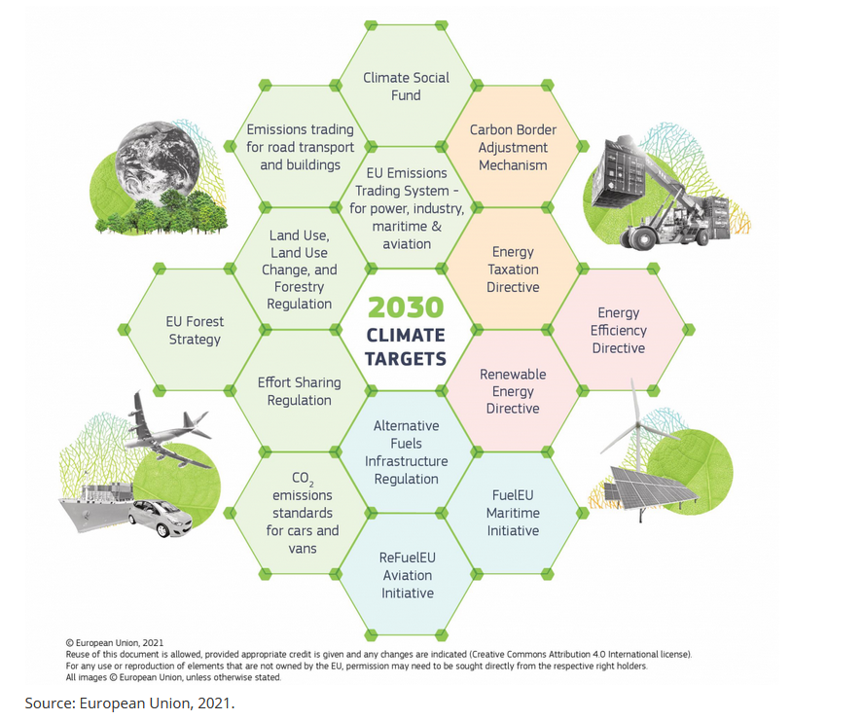
EU Green Deal - Transforming our economy, jobs and way of life
Paris Agreement - limiting global warming to well below 2°C, preferably 1.5°C
EU Green Deal - climate neutrality by 2050 with an ambitious action plan
EU climate law also sets a 55% greenhouse gas emission reduction target by 2030
‘Fit for 55% -Package’ revises essential legal base in the field of energy, transport and climate – 13 proposals
+ additional proposals: 3rd Energy Package for Gas, Reducing Methane emissions in the energy sector, Energy Performance of Buildings, Council Recommendation social dimension
Energy crisis and REPowerEU impacting the transition

Slide 3
Moving to 55 % - a quick and deep structural change for industry
Approximately a tripling of annual emission reductions compared to what the EU achieved from 1990 to 2018
Unprecedented intensification of emission reductions for industries
Employment:
25 million industrial jobs across Europe face changes
No significant impact at macro level (as for GDP) but significant impact in some sectors and regions
Low level of sectoral granularity: automotive or aerospace missing
Investment challenge: on average EUR 438 bn of additional annual investment needed, equivalent to 2.7-3% of GDP
Source: 2030 Climate Plan is accompanied by an in-depth Impact Assessment based on a modeling exercise presenting four main scenarios; Each scenario combines various policy options and assumptions (scope of ETS, Regulatory tools, C pricing, Bunkers) : https://eur-lex.europa.eu/legal-content/EN/TXT/?uri=CELEX:52020SC0176

Slide 4
What is proposed in terms of Just Transition?
As part of the European Green Deal a Just Transition Mechanism was set up for coal and carbon-intensive regions, including a Just Transition Fund worth €17.5bn, however it does not provide funding for other sectors/region in transition
A Social Climate Fund has been proposed alongside the introduction of a separate ETS for buildings and transport to alleviate the redistributive impacts of higher prices for transport and housing
A Council Recommendation for a fair transition to climate neutrality proposes a set of measures addressing the social dimension, but recommendations are soft law → Member States are not required to adopt them

Slide 5
IndustriAll Europe’ Just Transition Manifesto

Slide 6
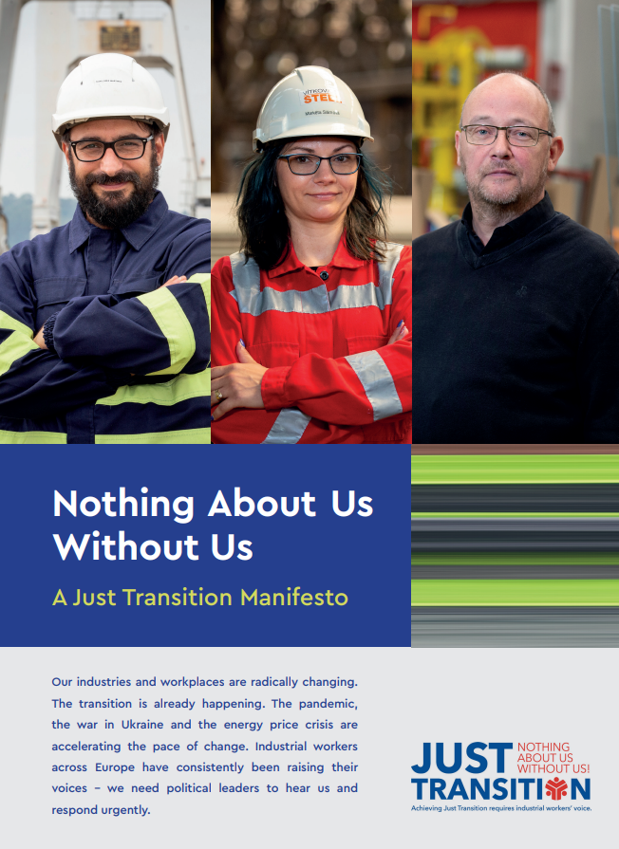
Our Just Transition Manifesto
1. An industrial policy fit for ambitious climate goals
and good quality jobs
2. Funding the transition
3. Stronger collective bargaining and social dialogue
4. A tool of workers’ rights and companies duties to anticipate and shape the change
5. Tackling new skills needs and a right to quality training and lifelong learning

Slide 7
Don‘t wait until your company comes up with a plan, create your own trade union agenda!
#1 Develop your own trade union agenda.
Assess your company’s scenarios.
Coordinate internally.
#2 Get involved in your company
Decarbonisation is a topic for social dialogue in Companies
#3 Discuss with management.
Bring up decarbonisation in your EWC. Engage in information and consultation.

Slide 8
Just Transition Coalition Automotive/Mobility: Common call for action for a Just Transition Framework
Mapping of employment impacts at company, regional and national levels to ensure effective skills intelligence and anticipation of change.
Policy support and exchanges of best practices: the extension of the Just Transition Platform to the scope of the European Green Deal.
Transition planning and social dialogue, including negotiated transition plans at company, regional and sectoral levels, and strengthening of social dialogue through binding social conditionality on access to EU funds.
Adequate resources for active labour market policies, including retraining and upskilling, through a dedicated fund for the mobility ecosystem.

Slide 9
JT in Trialogue CO2 standards cars and vans
(11a) In order to identify funding gaps in ensuring a just transition in the automotive supply chain, and with particular attention for SMEs and the regions that are most affected by the transition, the Commission should, by 31 December 2025 at the same time of the first progress report, and building on ongoing initiatives such as the transition pathway for the mobility ecosystem and the Automotive Regions Alliance of the Committee of the Regions, in cooperation with Member States, regions and local authorities and all relevant stakeholders, present a report with an analysis identifying such funding gaps. That report should be accompanied, where appropriate, by proposals for adequate financial measures to address the needs identified.
Article 14a
By 31 December 2025, and every two years thereafter, the Commission shall report on the progress towards zero emission road mobility. The report shall in particular monitor and assess the need for possible additional measures to facilitate a just transition, including through financial means.
(f) impacts on employment in the automotive sector,
(fa) the effectiveness of existing financial measures and the need for further action including adequate financial measures, at Union, Member State or local level to ensure a just transition and to mitigate any negative socioeconomic impacts, in particular in the regions and the communities most affected;
(g) progress in social dialogue, as well as aspects to further facilitate an economically viable and socially fair transition towards zero emission road mobility;
2. At the same time of the first progress report, the Commission shall, in cooperation with Member States and all relevant stakeholders, present a report with an analysis to identify any funding gaps in ensuring a just transition in the automotive supply chain, with particular attention for SMEs and the regions that are most affected by the transition. The report shall, where appropriate, be accompanied by proposals for adequate financial measures to address the needs identified. ‘

Slide 10
