Slide 2
SETTING OUT THE EUROPEAN POLICY FRAMEWORK
TRANSPORT SERVICES/OPERATIONS

Slide 3
ETF Sectoral Structure
ETF represents more than 5 million transport workers from more than 200 transport unions and 38 European countries
LOGISTICS + E-COMMERCE
LAND TRANSPORT DEPARTMENT
CIVIL AVIATION DEPARTMENT
MARITIME DEPARTMENT
DOCKERS
FISHERIES
MARITIME TRANSPORT
INLAND NAV.
ROAD
RAILWAYS
URBAN PUBLIC TRANSPORT

Slide 4
ETF Horizontal + Sectoral Activities
TRANSPORT POLICY + SUSTAINABLE TRANSPORT
WOMEN + YOUTH
CENTRAL + EASTERN EUROPE
LAND TRANSPORT DEPARTMENT
CIVIL AVIATION DEPARTMENT
MARITIME DEPARTMENT
DOCKERS
FISHERIES
MARITIME TRANSPORT
INLAND NAV.
ROAD
RAILWAYS
URBAN PUBLIC TRANSPORT

Slide 5
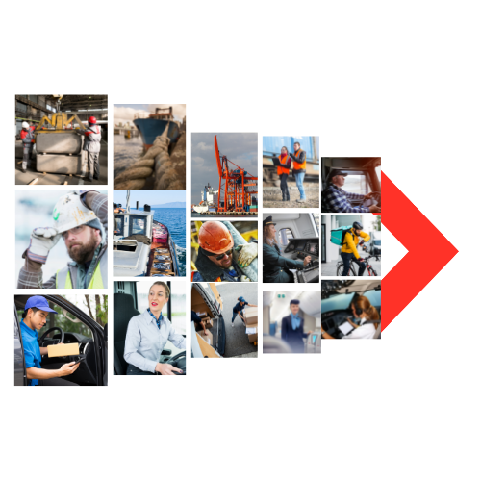
OUR CHALLENGES
30 YEARS OF ESTABLISHMENT OF AN INTERNAL TRANSPORT MARKET FOR ALL TRANSPORT MODES, STEP BY STEP
LIBERALISATION + PRIVATISATION OF (PUBLIC) SERVICES
OUTSOURCING + MULTIPLE LAYERS OF SUB CONTRACTING
SOCIAL DUMPING + BOGUS SELFEMPLOYMENT
RACE TO THE BOTTOM OF WORKING CONDITIONS
INCREASED SAFETY AND SECURITY PROBLEMS
TODAY: SUBSTANTIAL WORKERS SHORTAGE

Slide 6
Transport SERVICES ARE TOO CHEAP
Covid raised awareness that transport workers are essential workers; that transport services are essential services
But there is no fair price for transport labour
Too cheap transport services resulted in an unsustainable transport system
environmental costs are not properly internalized, but also for labour there is no fair price paid
Sustainable transport = environmental + social sustainability
Social sustainability: fair pay and working conditions transport workers – no to social dumping

Slide 7
GREEN DEAL
CLIMATE LAW
Minus 55% CO2 by 2030
Carbon neutral by 2050
SUSTAINABLE AND SMART MOBILITY STRATEGY
82 actions 2021-2023
Greening transport
Digitalisation&Automation
Resilient & safe & social
FIT FOR 55 PACKAGE
+
EFFICIENT AND GREEN MOBILITY PACKAGE *
December 2021
*TEN-T, ITS, new EU urban
mobility framework,
rail passengers + freight
corridor initiatives
+ Council Recommendations
to address social and
labour aspects of the climat
transition

Slide 8
SUSTAINABLE AND SMART MOBILITY STRATEGY - What is it about?
Commission’s transport policy work program for the next years (following White Papers from 2001, 2011)
Basically: strategy to implement the transport related climat goals of the GREEN DEAL for Europe (Paris Agreement)
GREEN DEAL: CO2 emmissions - 55% by 2030, cabon neutral continent by 2050
TRANSPORT: - 90% of transport related CO2 emissions by 2050 (1990 basis)

Slide 9
SUSTAINABLE AND SMART MOBILITY STRATEGY - What is it about?
10 Flagships, 14 Milestones, 82 Action Points (2021 – 2024)
Sustainable mobility: greening transport through technology, alternative fuels, investment in charging stations, inreasing offer of alternative transport modes, internalisation of external costs (polluter / user pay principles)
smart mobility: digitalisation & automation
resilient mobility: internal market, passengers, transport workers, safety & security

Slide 10
SUSTAINABLE AND SMART MOBILITY STRATEGY - What is it about?
Milestones on reducing the current dependence on fossil fuels:
No 3) Zero-emission ocean-going vessels and large zero-emission aircraft will become market ready by 2030 and 2035, respectively.
Milestones on shifting more activity towards more sustainable transport modes:
No 4) Scheduled collective travel under 500 km should be carbon-neutral by 2030 within the EU.
Milestones on internalising the external costs of transport, including via the EU ETS:
No 10) All external costs of transport within the EU will be covered by the transport
users at the latest by 2050.

Slide 11
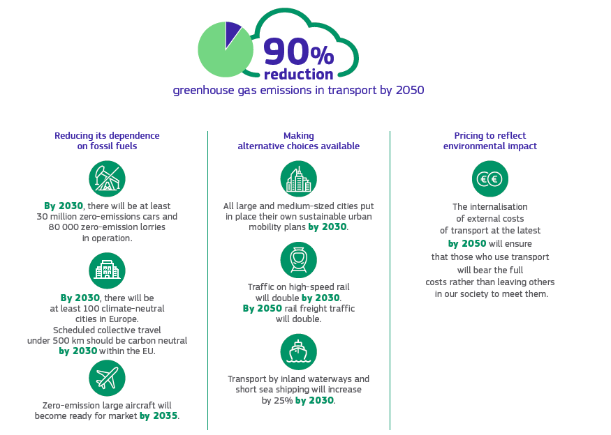

Slide 12
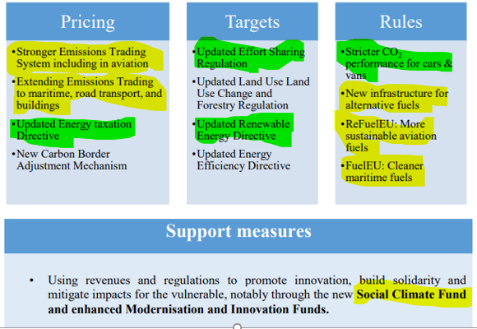
FIT FOR 55 PACKAGE - DELIVER THE GREEN DEAL

Slide 13
The « Winter Package »
BOOSTING LONG-DISTANCE AND
CROSS-BORDER passenger rail
THE NEW EUROPEAN Urban Mobility
Framework
CREATING A GREEN AND EFFICIENT
Trans-European Transport Network
REVISION OF THE INTELLIGENT TRANSPORT
SYSTEMS DIRECTIVE

Slide 14
ETF proposals in 7 policy areas
7 policy areas for action for a sustainable, fair and climate-neutral transport system of the future
Governance for an ecological and social transformation of transport and mobility
Modal shift to environmentally friendly transport modes in a sustainable multi-modal transport system
Fair investments and infrastructure policy
Fair pricing and cost sharing
A just transition framework for transport workers
Skills, training and OSH and climate policies
Adaptation to climate change and resilience: Occupational health and safety

Slide 15
We need the same level of ambition for social sustainability in order to have a true sustainable transport system
Transport social policy for true social sustainability
A fair price for transport
Strengthening social dialogue and the role collective bargaining
Make ‘just transition’ a reality

Slide 16
Social agenda for transport including at least following elements: and many others
Ensure the implementation of the principle of ‘equal pay for equal work at the same place’ for all transport modes; develop sector specific approaches such as a ‘lex specialis’ in the aviation sector, to make it applicable for highly mobile workers while taking into consideration the specificities of the different transport modes (rail, inland waterways, aviation, etc.);
Review of the ‘transfer of undertaking directive’ Directive 2001/23/EC to better protect workers; include workers’ protection and a mandatory transfer of staff in the case of change of operator due to tender procedures, that are not covered by the current legislation (e.g. in UPT, rail, ports, airports);
Propose measures ensuring fair working conditions for platform workers in transport sector; such a proposal must exclude any explicit or implicit creation of a third employment status which would treat platform workers as a special category and grant them only limited rights.
(new) Calls on the Commission for an urgent legislative proposal making due diligence compulsory for companies in order to ensure socially and environmentally sustainable supply chains; this must include both European and International supply chains, and include all workers in the supply chain, including those not directly employed by the parent company; stresses that due to the transient and highly mobile nature of their work, transport workers must be given priority and adequate protections to ensure safe and socially sustainable employment;

Slide 17
THANK YOU!

