Slide 2
ILO JUST TRANSITION GUIDELINES
Key policy areas to address environmental, economic and social sustainability simultaneously include:
I. Macroeconomic and growth policies
II. Industrial and sectoral policies
III. Enterprise policies
IV. Skills development
V. Occupational safety and health
VI. Social protection
VII. Active labour market policies
VIII. Rights – collective
IX. Social dialogue and tripartism

Slide 3
Challenges facing Aviation workers
Modal Shift
Reduction of air travel by governments
Post-COVID recovery
Cyclical nature of the aviation industry

Slide 4
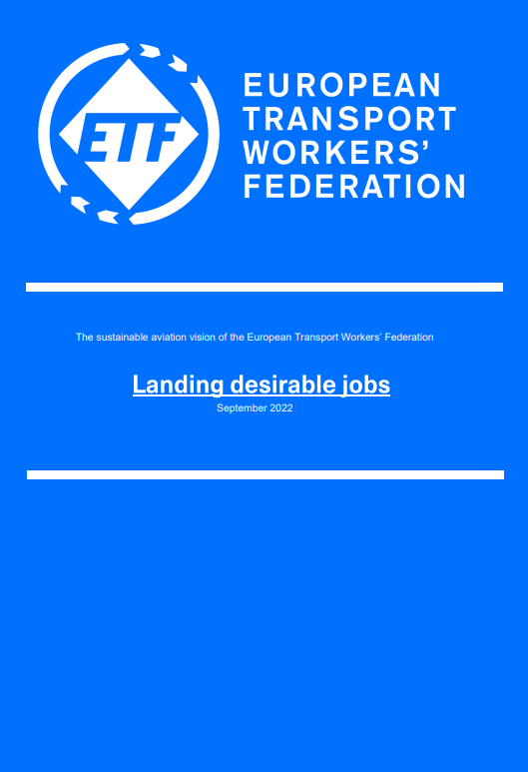
Landing Sustainable Jobs
Worker OSH
Who picks up the bill?
Green technology
Just Transition

Slide 5
Landing Sustainable Jobs – Just Transition
States should have greater democratic oversight over aviation companies
Employment/Social protection schemes
Technological Advancement
Taxation (used for JT funding)
Democratic participation of workers through Just Transition committees
Priority remains worker retention in existing role

Slide 6
Landing Sustainable Jobs – Just Transition
In cases of job loss:
Robust training programme
Worker decision on what that training is, up to an including University education
Equal pay and conditions in new role
Ensure union representation
Revise governance systems at airports
Worker Community Approach
E.g. Airport Committees

Slide 7
Landing Sustainable Jobs – Just Transition
Creation of Just Transition committees in all companies
Avoid job destruction
Plan large professional retraining
Ensure necessary funding for transition
Especially important in locations where aviation is a major employer (airport towns)

Slide 8
CONNECT WITH US
https://www.etf-europe.org/
ETF_Europe
ETF.Europe
https://www.linkedin.com/company/european-transport-workers'-federation/

