Slide 1

European Mobility and EU policy developments
12 December 2022
industriall-europe.eu

Slide 2

Outline
EU Industrial Policy & Mobility ecosystem
European Green Deal
Trade & Competition
Skills

Slide 3
Mobility ecosystem
EU 2020 Industrial Strategy: « A new industrial startegy for Europe »
  Focus on twin climate and digital transitions
  Concept of « Open strategic autonomy »
  Industrial Ecosystems (i.e. all players within a value chain)
  Long list of actions in a wide variety of domains: energy, circular economy and raw material, trade, foreign subsidies, competition law, internal market, skills, data strategy, Just transition, capital market…
  Industrial Forum to support the development of transition pathways and the analysis of strategic dependencies
2021 update of the EU Industrial Strategy
  Focus on post pandemic recovery « to learn the lessons of the crisis, strengthen our economic resilience and accelerate the twin transition while preserving and creating jobs”
  Analytical basis
    Annual Single Market Report – 1: analysis and SOP for 14 ecosystems
    Initial analysis of the EU’s strategic dependencies and capacities
  Process to co-create 14 transition pathways

Slide 4
14 Industrial Ecosystems in Europe
Passenger transport and travel
Hotels, short term accommodation
Restaurants and catering
Events, theme parks
Industrial Ecosystems for the Recovery
Tourism
Textiles
Aerospace & Defence
Health
Digital
Energy-Intensive Industries
Cultural & Creative Industries
Agri-Food
Retail
Proximity, Social Economy, Civil Security
Social enterprises, associations, cooperatives and civil security services aiming at generating a social impact, often proximity based
Newspapers, books and periodicals
Motion picture, video and television
Radio and music
Retail sales
Wholesale connected to consumers
Aircraft production
Space manufacturing and services
Defense products and technologies
Building of residential and non-residential estates
Building of roads and railways,
Building of utilities and civil engineering
Associated activates
Construction
Production of textiles, wearing
apparel, footwear, leather and, jewellery
Telecommunications
Software publishing, computer programming and consultancy
Data processing, hosting, web portals
Manufacturing of computers, communication equipment and consumer electronics
Raw starting materials (semiconductor wafers)
Semiconductor manufacturing tools
Design and manufacturing of semiconductor components
Electronics
Pharmaceuticals and other medical products
Personal protective equipment
Medical services, hospitals, nursing homes, residential care
Mobility - Transport - Automotive
Production of motor vehicles, ships and trains, and accessories
Their repair and maintenance
Transport
Raw materials
Manufacturing of products with high environmental impact: chemicals, iron and steel, forest-based products, plastics, refining, cement, rubber, non-ferrous metals, fertilisers, etc.
Plant and animal production
Processing of food
Energy -
Renewables
Electric motors, engines and turbines
Electric power generation
Manufacturing and distribution of gas

Slide 5
Industrial Forum – State of Play
Composition: 28 Member organisations (Business & industry organisations, employers, trade unions, NGOs) + 27 MS authorities + EESC and CoR as observers
3 Plenary meetings since Jan 2021 + extraordinary meeting in March
5 Task forces:
  Economic analysis (Single market and KPIs)
  Support TP development (Blueprint)
  Strategic dependencies
  cross-border and cross-ecosystem investment needs and cooperation opportunities
  Advanced manufacturing processes
Pilot ecosystems for the development of TPs: Tourism, Energy Intensive industries, Mobility, Construction, Proximity and social economy
Additional role for Industrial Forum: Monitor impact UKR war has on industry : extraordinary meeting + DG Grow survey

Slide 6
Industrial Forum
TF1
TF2
TF3
Ecosystem
SWD
Public consultation
Targeted Roundtables
Transition Pathways
Energy intensive industries
SWD: scenarios for TPs
Consultation-Survey
Transition Pathway

Slide 7
EU strategic dependencies and capacities: second stage of in-depth reviews (2022)
2021: comprehensive assessment of the EU’s strategic dependencies and capacities including a first round of in-depth reviews in six strategic areas (raw materials, active pharmaceutical ingredients, li-ion batteries, clean hydrogen, semiconductors and cloud and edge computing)
2022: reports on progress made in addressing the strategic
dependencies identified in the first round:
  Supply diversification through international partnerships (CAN, UKR, African countries)
  Existing Industry alliances : battery, H2, CRM
  New industry alliances: semi-conductors and cloud computing +IPCEIs
  EU Funding: RRF and Horizon Europe
And presents a second round of in-depth reviews covering new areas

Slide 8
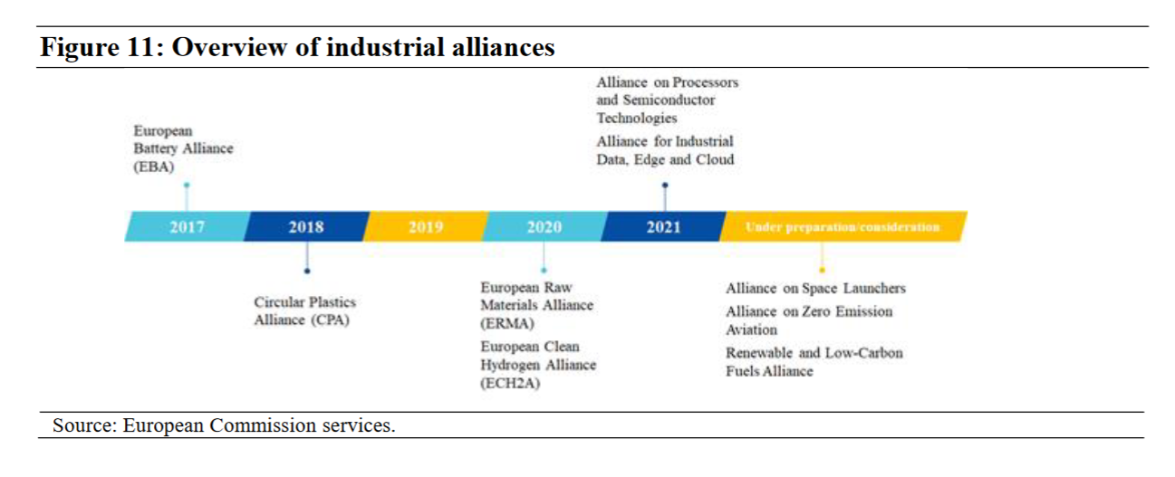

Slide 9

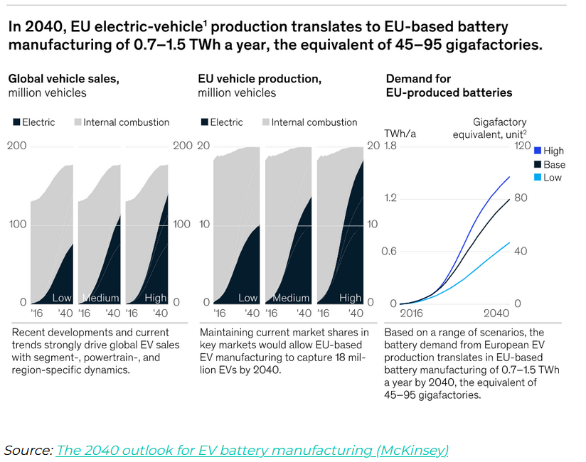
EU efforts to develop industrial supply chains
EU open strategic autonomy
Main tool is IPCEI
IPCEIs of interest for the future of the automotive industry:
  Batteries
  Hydrogen
  Micro-electronics
Risk of internal market fragmentation
Lack of social conditionalities

Slide 10
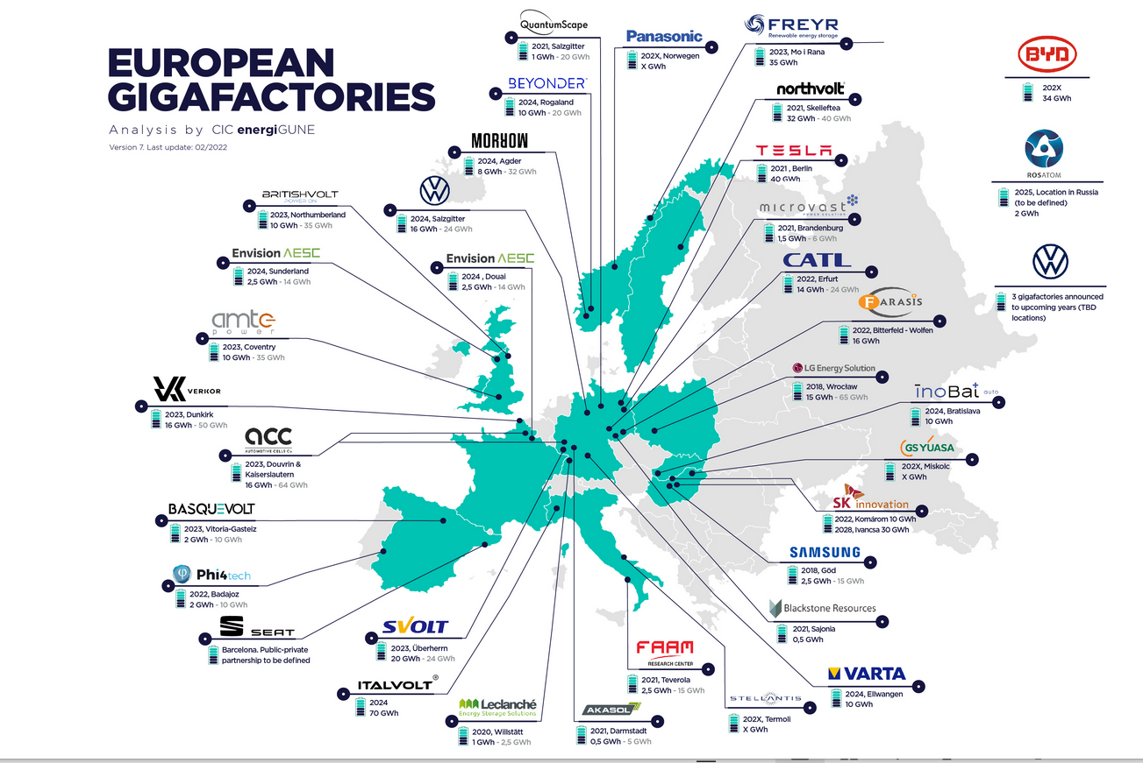
Source: https://cicenergigune.com/en/blog/gigafactories-europe-commitment-economic-recovery-battery-factories
Battery boom in Europe
Two IPCEIs of € 6.1 bn mobilising € 20 bn of investment to develop a full battery value chain in Europe
465 k jobs in 2030

Slide 11
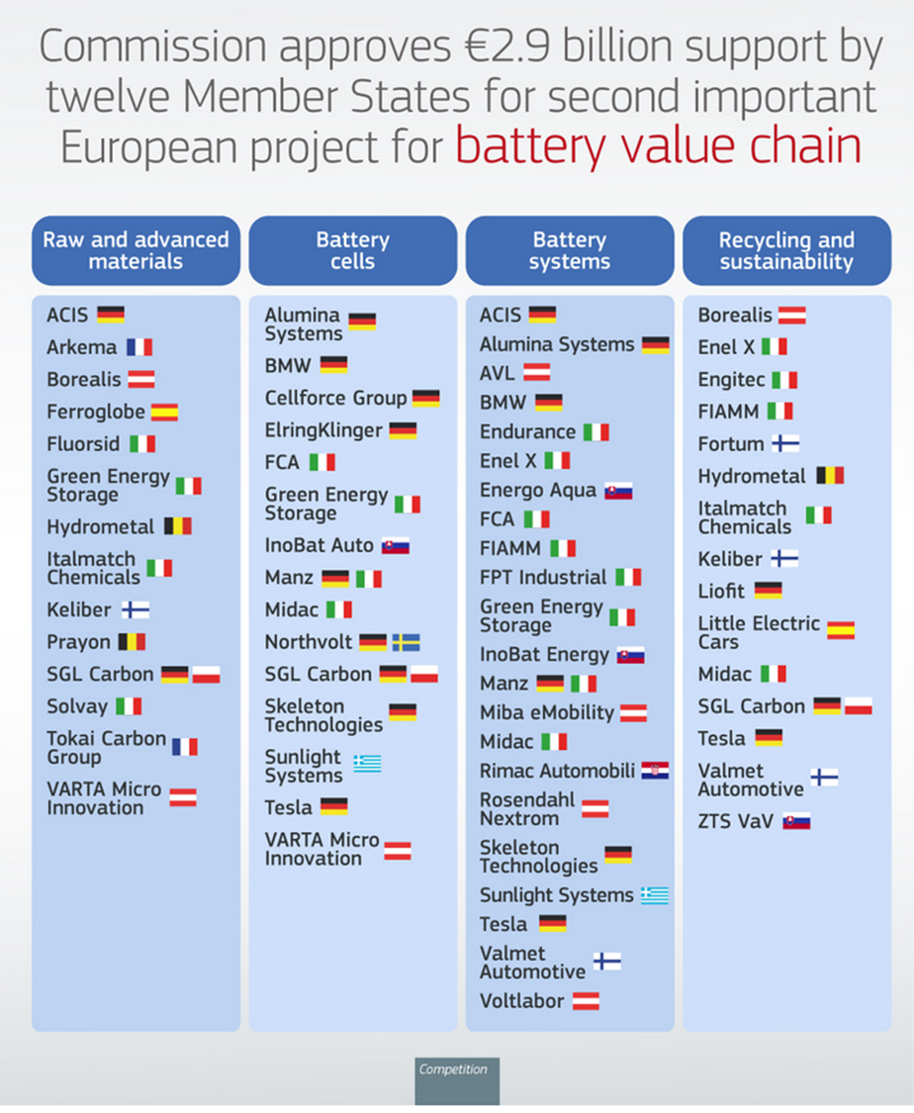
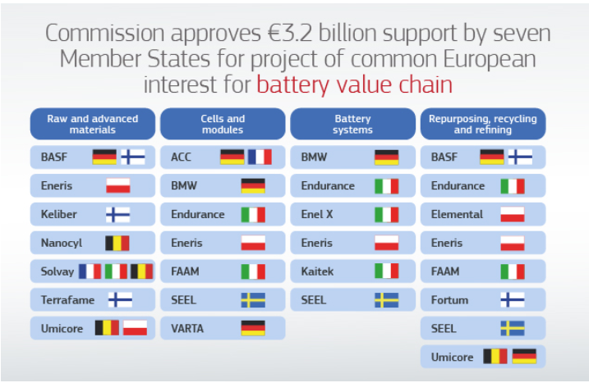
List of state aids approved under the battery IPCEIs

Slide 12
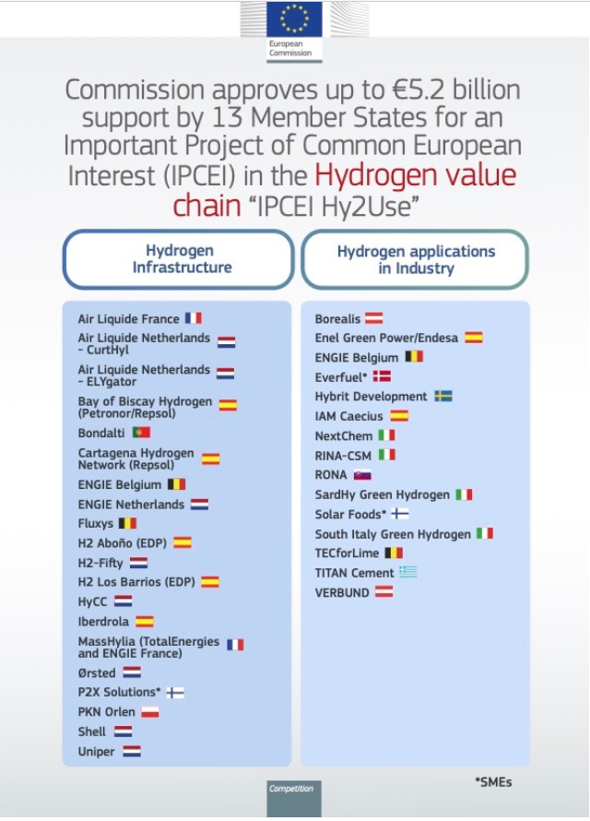
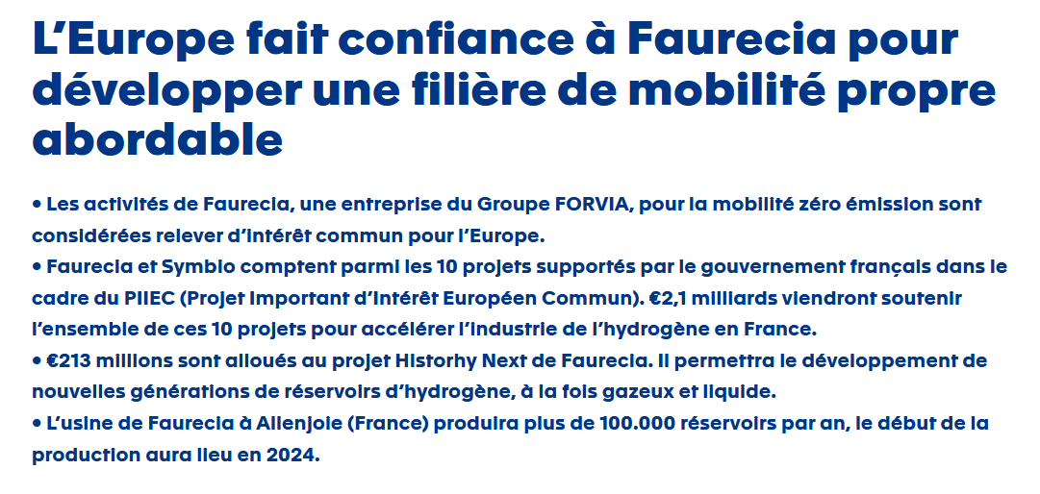
Hydrogen - IPCEIs

Slide 13
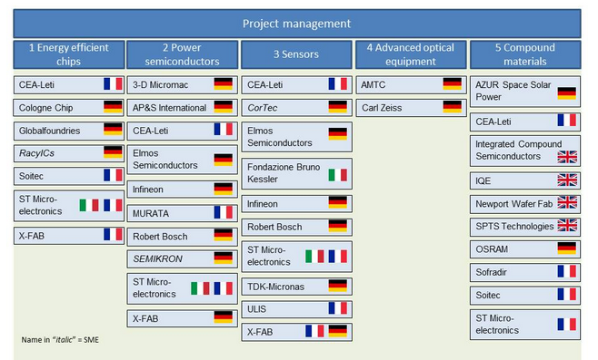
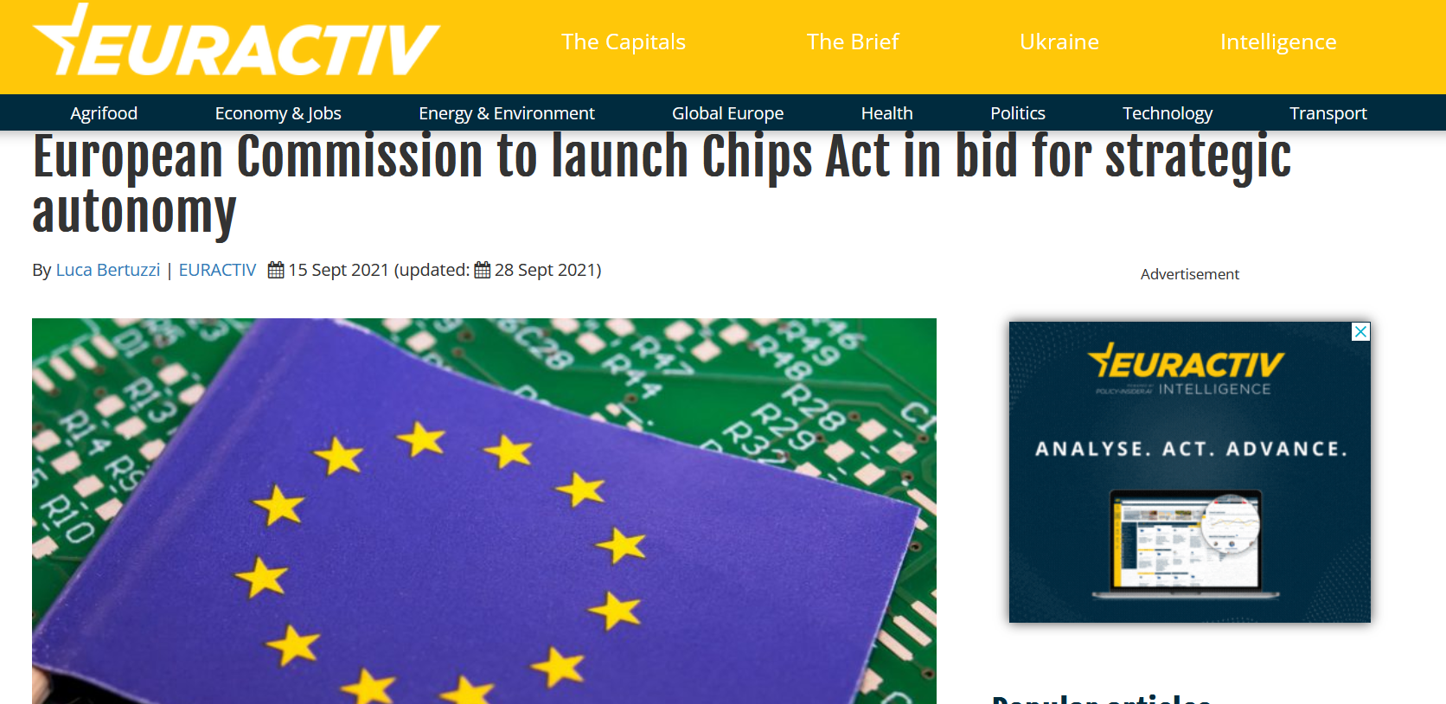
EU IPCEI - Microelectronic
https://www.ipcei-me.eu/what-is/project-structure/

Slide 14
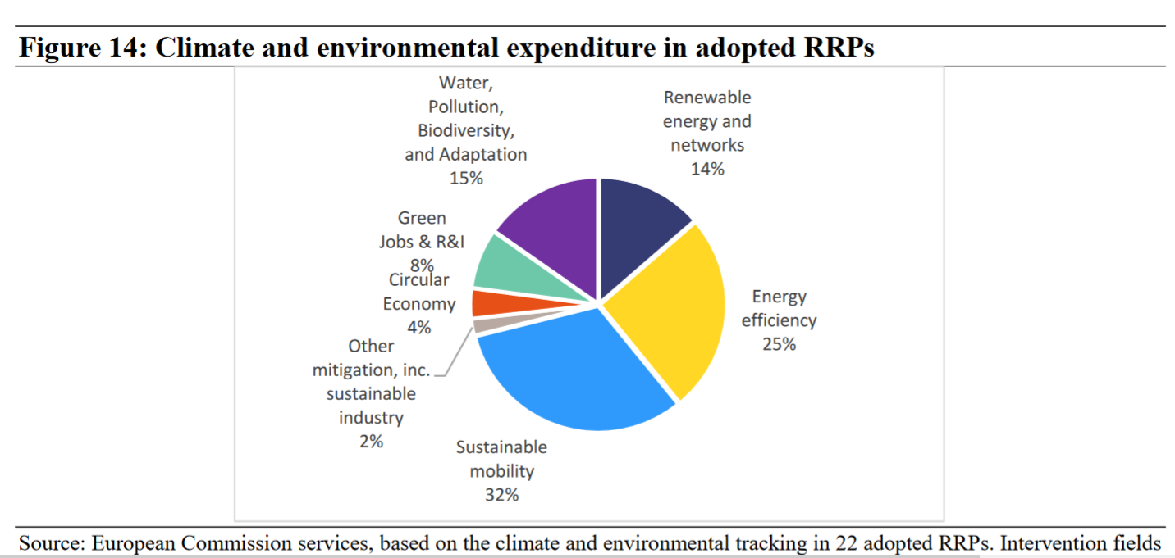
Industrial ecosystems and RRPs funding
Around 40%, EUR 177 billion, of the total allocation in Member States’ Recovery and Resilience Plans is related to measures supporting climate objectives
out of the 22 adopted RRPs so far, 12 RRPs include an investment dedicated to the Energy Intensive Industries’ ecosystem
Total digital expenditure in the adopted plans amounts to EUR 117 billion, about 26% of the total plan allocation.
Context of EU Investment gap after two decades of private investment contraction and low public investments

Slide 15
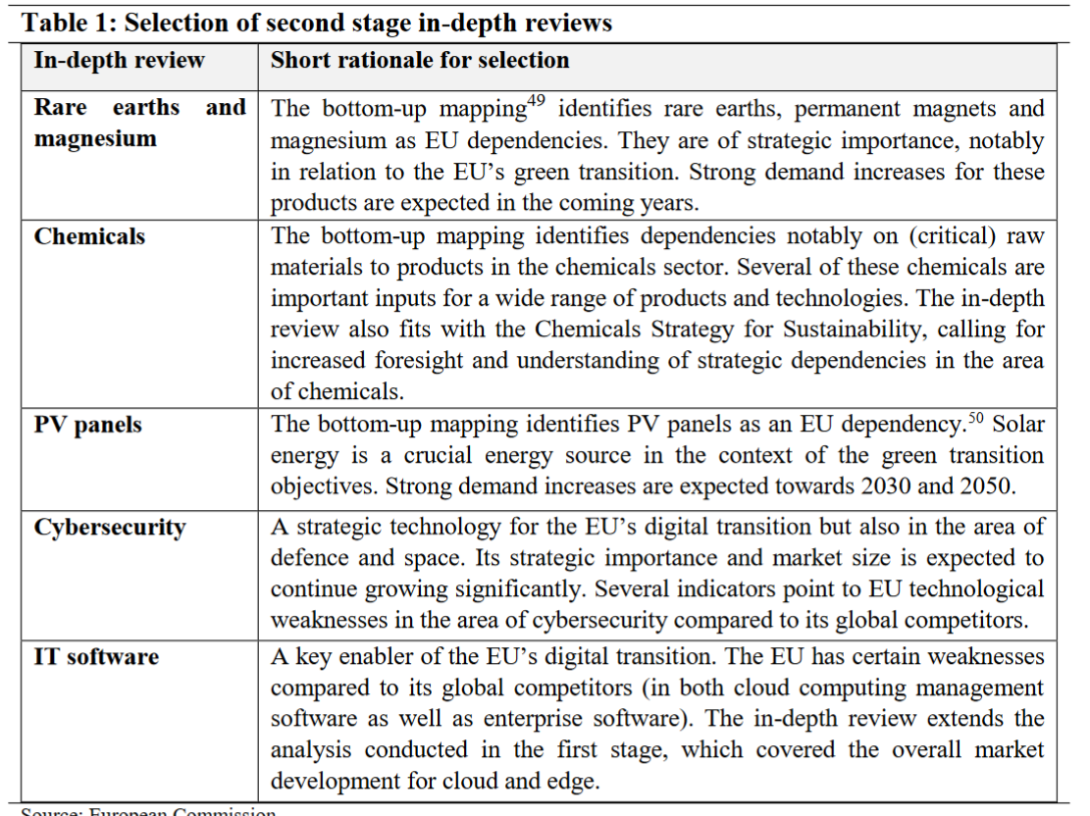

Slide 16
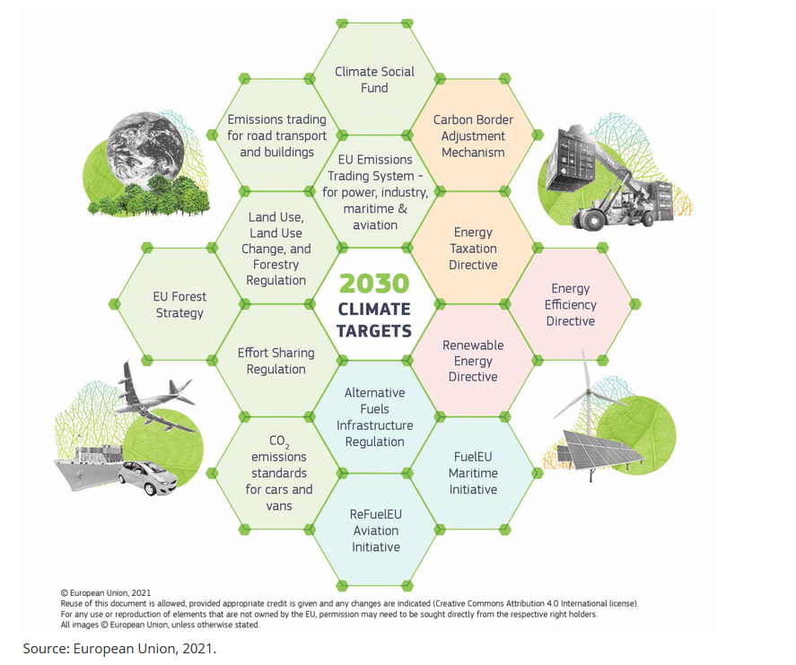
2. EU Green Deal
Paris Agreement - limiting global warming to well below 2°C, preferably 1.5°C
EU Green Deal - climate neutrality by 2050 with an ambitious action plan
EU climate law also sets a 55% greenhouse gas emission reduction target by 2030
‘Fit for 55% -Package’ (14 July 21) revises essential legal base in the field of energy, transport and climate – 13 proposals
+ additional proposals: 3rd Energy Package for Gas, Reducing Methane emissions in the energy sector, Energy Performance of Buildings, Council Recommendation social dimension(14 December 21)
Council and EP have reached respective positions; Trilogues going on (Nov 22)

Slide 17





Fit for 55 – Fit for a Just Transition?
Climate Ambition
European Climate Law – 2050 Climate Neutrality
-55% GHG reductions by 2030
Revision EU ETS
CBAM
ETS2 for Buildings and Transport
CO2 Standards for cars and vans
Alternative Fuels Infrastructure
Regulation
Energy Taxation Directive
Energy Efficiency Directive
Renewable Energy Directive
Effort Sharing Regulation
LULUCF Regulation
3rd Energy Package for Gas
CO2 Standards for heavy vehicles
*enforceable legislation and funding programmes
*soft law, strategies, recommendations, non-enforceable
Just Transition Initiatives
Just Transition Mechanism, Just Transition Fund 17.5 bn EUR
Modernisation Fund
NextGenerationEU and RRF
Climate Social Fund 72.5 bn EUR
Minimum Wage Directive - 80% CB coverage
European Pillar of Social Rights, Action Plan and headline targets
Strong social Europe for Just Transitions
Council Recommendation on the Social Dimension of the green transition
Just Transition Platform and Coal Regions Platform
Industrial Ecosystems Transition Pathways

Slide 18
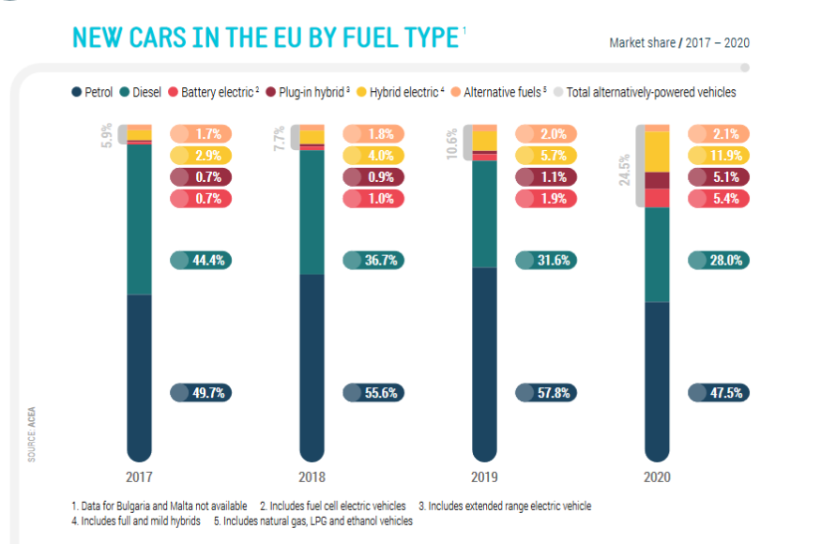
Towards zero emission and circularity - Policy
Revision of EU Regulation setting CO2 emission standards for passenger cars and Light Commercial Vehicles
From 1 January 2035, EU fleet-wide target equal to a 100 % reduction (vs 2021)
no later than 2025 EC report setting out a methodology for the assessment and the consistent data reporting of the full life-cycle CO2 emissions of passenger cars and light commercial vehicles
Alternative Fuel Infrastructure Regulation
Ecodesign: proposals by 31 December 2023 for the establishment of minimum ecodesign requirements for all new passenger cars and light commercial vehicles, including energy efficiency, durability and repairability requirements for essential parts such as lights, electronic components and batteries, minimum requirements for the recovery of metals, plastics and critical raw materials.
EURO VII- 7
Carbon pricing and Energy Taxation Directive
EU Regulatory framework for batteries
https://www.acea.auto/files/ACEA_Pocket_Guide_2021-2022.pdf

Slide 19
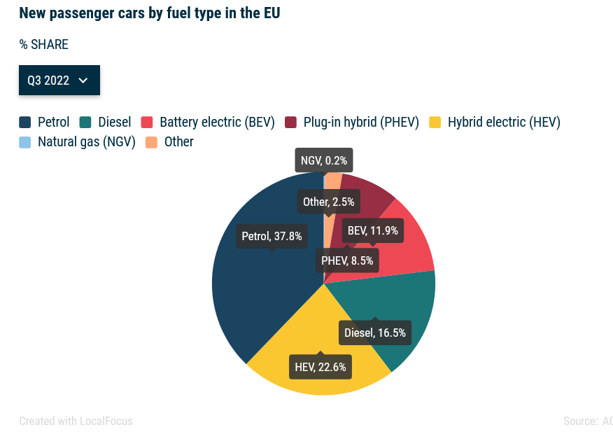
Electrification ongoing
Electrified vehicles (BEVs+ HEVs + PHEVs) = 43% of new registrations in Q3 2022
Diesel- and petrol-powered vehicles still dominate the market, with a combined share of 54.3%
Electrified vehicles only a limited share of existing fleet (246.3 million cars on the road in total EU27 – 2020) : BEVs 0,5%, PHEV 0,6%, HEVs, 1,2%; https://www.acea.auto/files/ACEA-report-vehicles-in-use-europe-2022.pdf#page=14

Slide 20
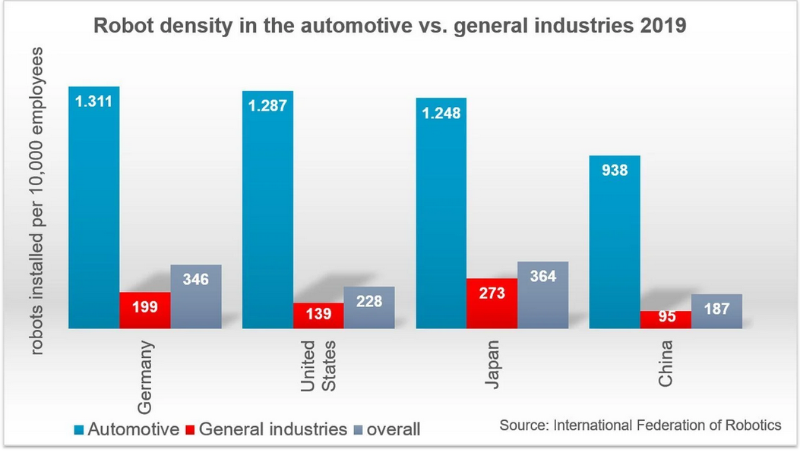
Trends in automotive
Automation/robotisation
Capital concentration: mergers and acquisitions, shared platforms, alliances
Shifting profit sources: from volumes to IT and services (autonomous driving, connected vehicles, car sharing, data …)
Digitalisation of sales and maintenance → restructuring of dealer/repair networks (e.g. Stellantis « agency model »)
Uncertainty regarding future sales volumes:
  Cost of new vehicles vs stagnating purchasing power (low wages, precariousness)
  Change in mobility patterns
Supply disruptions: chips, wires …
Sales volumes decreasing but OEM’s turnover increasing (2021 vs 20)
https://ifr.org/ifr-press-releases/news/us-robot-density-in-car-industry-ranks-7th-worldwide

Slide 21
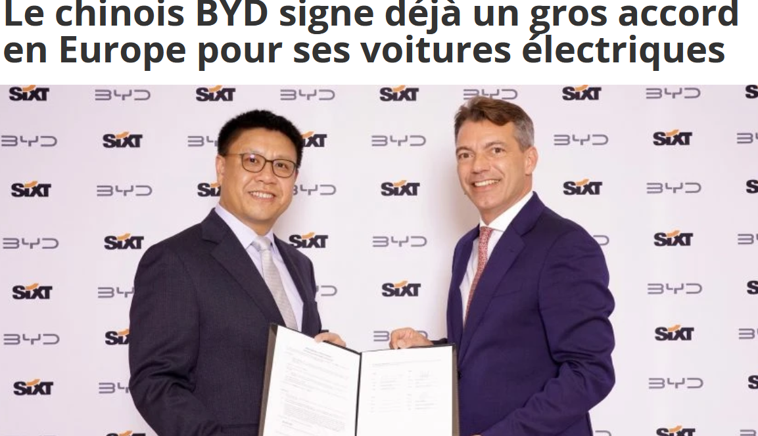
3. Trade and competition
Global level playing field and due diligence are issues in all 4 sectors
Europe forecasts to import 800 k Chinese built cars by 2025 → EU could become a net importer of cars by 2025 (PWC 2022)
US Inflation Reduction Act
  Massive incentives to attract green tech investments
  Clean Vehicle Credit up to 7,5k USD for EVs assembled in North America
  Sourcing requirements for batteries prohibiting components coming from « problematic countries »
Battery supply chain: « China produces three-quarters of all lithium-ion batteries and is home to 70% of production capacity for cathodes and 85% for anodes » (IEA 2022)
Foreign State-owned compagnies → EU Regulation

Slide 22
EU Regulation on foreign subsidies
A notification-based tool to investigate concentrations involving a financial contribution by a non-EU government, where the acquired company, one of the merging parties or the joint venture generates an EU turnover of at least €500 million and the transaction involves a foreign financial contribution of at least €50 million;
A notification-based tool to investigate bids in public procurements involving a financial contribution by a non-EU government, where the estimated contract value is at least €250 million and the bid involves a foreign financial contribution of at least €4 million per third country; and
A general tool to investigate all other market situations, where the Commission can start a review on its own initiative (ex-officio) or it request an ad-hoc notification for smaller concentrations and public procurement procedures.

Slide 23
4. Skills
Rail supply –Staffer
Automotive Skills Alliance
Pact for skills for European shipbuilding
Pact for skills for Defense and Aerospace

Slide 24
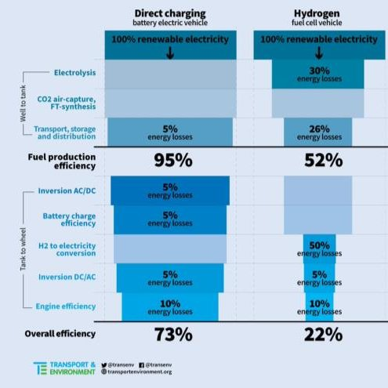

Slide 25
