Slide 1
BUILDING A JUST TRANSITION TOWARDS A SMART AND SUSTAINABLE MOBILITY
Second online workshop for the Aviation Sector
23 March 2023
Spin360 Team

Slide 2
AGENDA OF TODAY
TIME | TOPIC
9.30 – 9.40 | Welcome remarks
9.40 – 10.00 | Project presentation and in depth results
10.00 – 10.45 | Panel 1 Alternative aviation fuels: overcoming the challenges - perspectives from stakeholders
10.45 – 11.00 | Q&a session and discussion
11.00 – 11.15 | Break
11.15 – 12.00 | Panel 2 The impact of the green transition on workers in the aviation sector: skills needs, attractiveness of the sector and changes to working conditions
12.00 – 12.15 | Q&a session and discussion
12.15 – 12.30 | Closing remarks, wrap up and next steps

Slide 3
PROJECT PRESENTATION AND IN-DEPTH RESULTS

Slide 4
PROJECT DEVELOPMENT - KEY STEPS
Launch event
Research activity: mapping the impact on employment, skills and working conditions for building a Just Transition for mobility
Validation, collection of evidence and reality-checking through workshops/roundtable
First workshop (done 31 January 2023) → discussion on what Just Transition means for Aviation
Second workshop (present) → presentation of in-depth results and collection of sectoral expertise
4. Final conference

Slide 5
PROJECT DEVELOPMENT
MARITIME
AVIATION
RAIL
ROAD
JUST TRANSITION
EMPLOYMENT
M
TS
M
TS
M
TS
M
TS
SKILLS
M
TS
M
TS
M
TS
M
TS
WORKING CONDITIONS
M
TS
M
TS
M
TS
M
TS
*M= Manufacturing
*TS= Transport Service
Notes:
Va lasciata?

Slide 6
WHAT WE DID UNTIL NOW…
UNDERLINED THE MAIN TRENDS OF THE SECTOR REGARDING EMPLOYMENT, WORKING CONDITIONS AND SKILLS AS BASIS FOR DISCUSSION
UNDERSTOOD SUCH SECTORAL BIG PICTURE IN THE FRAMEWORK OF THE JUST TRANSITION
CONDUCTED A FIRST DISCUSSION AND VALIDATION OF RESULTS
GATHERED NEW PIVOTAL POINTS ON SPECIFIC JUST TRANSITION IMPACTS, CHALLENGES AND STRATEGIES FOR THE SECTOR

Slide 7
… AND WHAT WE WILL DO NOW
PRESENTING THE PIVOTAL POINTS EMERGED DURING THE PREVIOUS INTERACTIVE DISCUSSION
COLLECTING FURTHER EXTERNAL EXPERTISE AND BEST PRACTICES
STARTING DEFINING WHICH CONCLUSIONS AND RECOMMENDATIONS WE CAN DRAW TO ENSURE A JUST TRANSITION
→ FINAL PROJECT REPORT

Slide 8
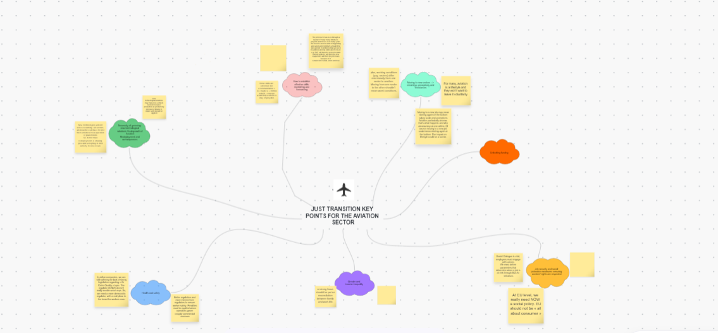
MAIN PIVOTAL POINTS EMERGED DURING OUR PREVIOUS DISCUSSIONS

Slide 9
PROMOTING A JUST TRANSITION
EMPLOYMENT
MAIN POINTS EMERGED:
NECESSITY OF GREENING: NEW TECHNOLOGICAL SOLUTIONS VS DEGROWTH OF AVIATION
REDEPLOYMENT AND CONSEQUENCES
New technological solutions may lead to a decrease in workers, as automation may be more common in the aviation sector
Planet limit and degrowth of aviation

Slide 10
PROMOTING A JUST TRANSITION
EMPLOYMENT – FIRST RECOMMENDATIONS
TECHNOLOGICAL SOLUTIONS HAVE TO BE IMPLEMENTED ALWAYS KEEPING IN MIND THE JUST TRANSITION, BY AVOIDING JOB LOSSES AND PRIORITIZING THE WORKERS’ WELLNESS.
STATES SHOULD GIVE A SOCIAL PROTECTION FOR WORKERS THAT WERE LAID OFF.
PLANET LIMIT IS A PROBLEM, BUT IT CAN BE MARGINALISED WITH THE CHOICE OF MORE EFFICIENT ROOTS AND WITH THE REDUCTION OF CARGO JETS, AS THEY ARE MORE POLLUTING.

Slide 11
PROMOTING A JUST TRANSITION
SKILLS
MAIN POINTS EMERGED:
SKILLS MONITORING AND FORECASTING
MOVING TO NEW SECTORS → RETRAINING: PERCEPTIONS AND RESISTANCES
UNLOCKING FUNDING
Workforce planning is very important at a company level
Poor perception of other transportation sectors, lack of will in moving to a new industry due to factors such as different skills required and lower salary
Fundings are a big concern for everyone

Slide 12
PROMOTING A JUST TRANSITION
SKILLS – FIRST RECOMMENDATIONS
NECESSITY OF UNDERSTANDING THE REAL IMPACT OF THE GREEN TECHNOLOGIES ON JOBS IN TERMS OF UPSKILLING AND RESKILLING.
COMMITTES COULD BE A POWERFUL TOOL TO BETTER PLAN THE WORKFORCE AND TO UNDERSTAND THE PERCEPTION OF JOBS IN TERMS OF UPSKILLING AND RESKILLING.
ANY CHANGE OF SECTOR, IF NECESSARY, MUST BE MADE CONVENIENT AND ATTRACTIVE, THE WORKER MUST HAVE THE SAME WAGE THAT HE/SHE HAD IN THE AVIATION INDUSTRY, AND RESKILLING MUST BE ASSURED AND NOT BE DONE AT THE WORKER'S EXPENSE.
NECESSITY TO BETTER UNDERSTAND THE DISTRIBUTION OF THE EU FUNDING FOR THE AVIATION SECTOR.
NECESSITY TO UNDERSTAND HOW COMPANIES REINVEST THEIR PROFITS
ANY FUNDING GIVEN SHOULD HAVE A CONDITION APPLIED, FOR EXAMPLE TO AVOID SOCIAL DUMPING.

Slide 13
PROMOTING A JUST TRANSITION
WORKING CONDITIONS
MAIN POINTS EMERGED:
JOB SECURITY AND SOCIAL PROTECTION MEASURES: ENSURING WORKERS’ RIGHTS ARE RESPECTED
GENDER AND INCOME INEQUALITY
HEALTH AND SAFETY
There is a strong need to give space to the workers’ opinions
Bad conditions for women in the transport sector in general
Air cabin quality issue, dangerous for the health of employees

Slide 14
PROMOTING A JUST TRANSITION
WORKING CONDITIONS – FIRST RECOMMENDATIONS
WORKERS SHOULD BE ABLE TO IMPLEMENT A CONSTRUCTIVE DIALOGUE WITH TRADE UNIONS IN ORDER TO EXCHANGE POSSIBLE OPINIONS. SOCIAL DIALOGUE IS VITAL FOR EMPLOYERS.
A SOCIAL POLICY IS ALSO STRONGLY NEEDED AT A EUROPEAN LEVEL.
STRONG NEED TO SPREAD INFORMATION ON THE IMPORTANCE OF GENDER AND WAGE EQUALITY.
NECESSITY TO PROMOTE A BETTER WORK-LIFE BALANCE.
NEED FOR PENALTIES APPLIED WHEN HEALTH AND SAFETY STANDARDS ARE NOT RESPECTED.
NEED TO REINFORCE THE LEGISLATION REGARDING THE HEALTH AND SAFETY STANDARDS FOR THE «AIR QUALITY IN THE CABIN» TOPIC.

