Slide 1
Aviation Just Transition Roundtable
The Impact of Green transition on workers
Michaela Grimley
March 2023

Slide 2
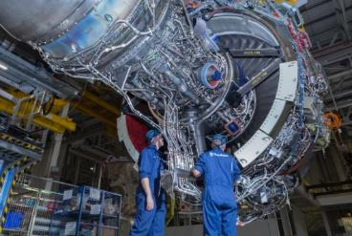
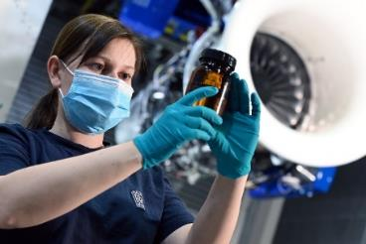
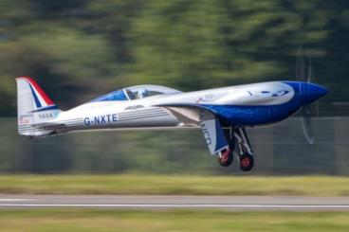
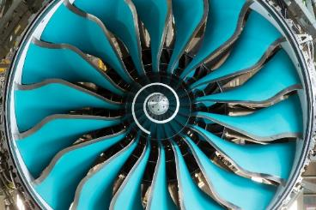
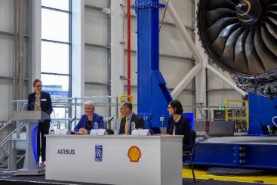
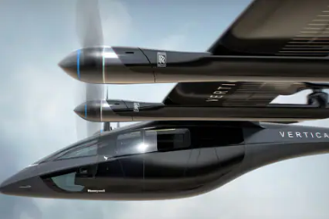
Net Zero pathway for aviation: Three major pillars to decarbonisation
Step change in efficiency of gas turbines
Leading SAF demonstration and adoption
Developing third generation technologies
We play a vital role in the decarbonisation of our industry.
The transition to net zero represents a tremendous opportunity for Rolls-Royce.
Gas turbine technology demonstrators
100% SAF testing programme
‘Spirit of Innovation’ speed record
UltraFan Demonstrator engine 2022
Influencing industry thinking
Electrified products

Slide 3
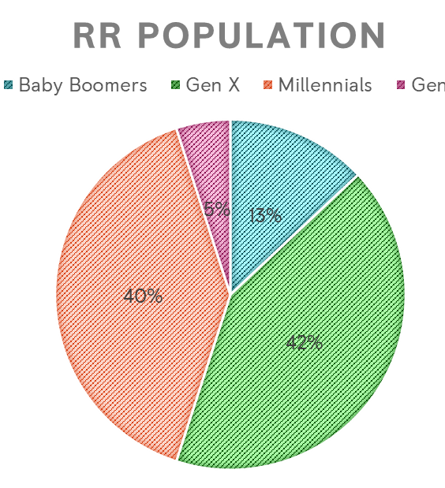
75% of our workforce will be Millennials by 2030
Source: U.S. Bureau of Labor Statistics

Slide 4
Changing the Perception
COP 26
From engine compatibility with lower carbon alternative fuels
and the electrification of flight; to building small modular nuclear
power stations and microgrids to provide power in new ways;
the potential of net zero for our future is enormous.
We all have an important role to play is achieving net zero – both
in the workplace and at home
Inspiring the next generation in STEM

Slide 5
Developing Skills in RR
Skill interest
Skills can be seen as the new currency in the workplace
They are the connection between Talent, Recruitment and Learning
Skills

Slide 6
What is a “Gig”?
1-5 hours a week or short term project
Balanced with their role
Support individual’s development
Broader access to talent

