Slide 1

Just Transition for the Aviation Sector: Where Are We Now?
JT4 Mobility 31 January 2022
industriall-europe.eu

Slide 2

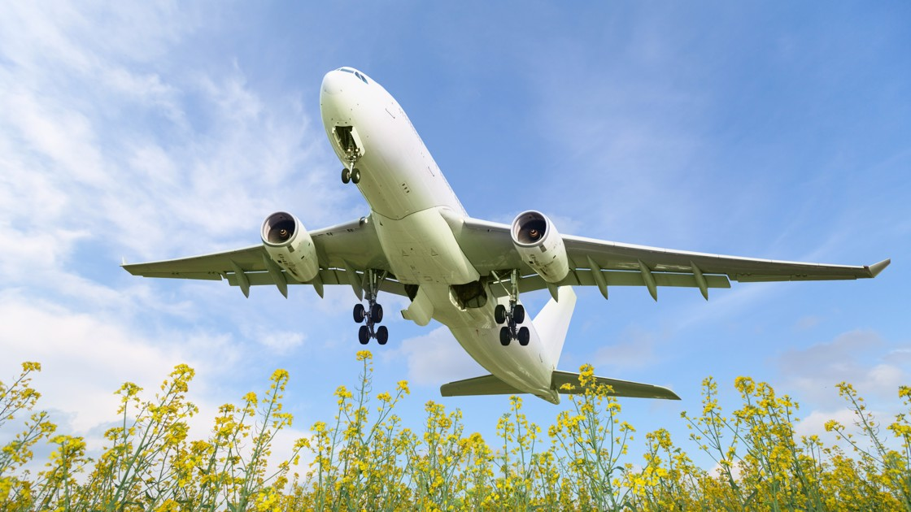
Increased focus on decarbonisation at EU level
EU files:
  Sustainable Aviation Fuels (SAFs)
  EU Emissions Trading System (ETS)
European Aviation Roundtable: ongoing demand for EU Pact for Sustainable Aviation.
Two new EU Alliances:
EU Alliance for Zero Emission Aviation: working groups now established.
Renewable and Low-Carbon Fuels Value Chain Industrial Alliance: working groups have started.

Slide 3

Decarbonisation at International Level
Toulouse Summit (04/02/22):
  Toulouse declaration: includes Just Transition, social dialogue and re-/up-skilling of workers
ICAO 41st General Assembly (September 2022):
  Joint working paper with IAG, EFT and ITF
  ICAO States agreed to a net zero goal by 2050 for the aviation industry.
  But not binding – how to increase international commitments?

Slide 4
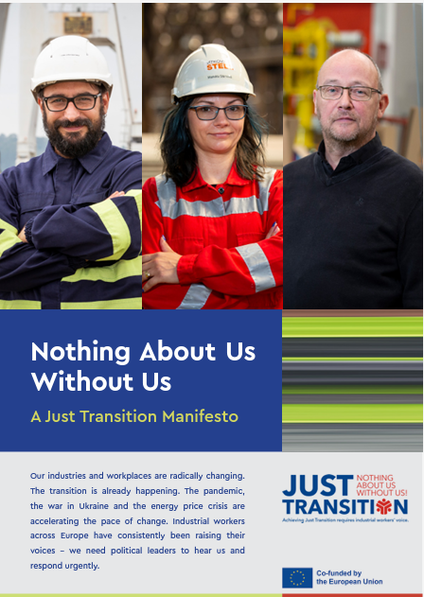
Just Transition Manifesto and Website
Just Transition Manifesto launched May 2022
  High level event with Commission and MEPs
  Just Transition website: sector/country info
Main demands:
An industrial policy fit for ambitious climate goals and good quality jobs
Funding the transition
Stronger collective bargaining and social dialogue
A toolbox of workers’ rights and companies’ duties to anticipate and shape the change
Tackling new skills needs and a right to quality training and life-long learning for every worker

Slide 5
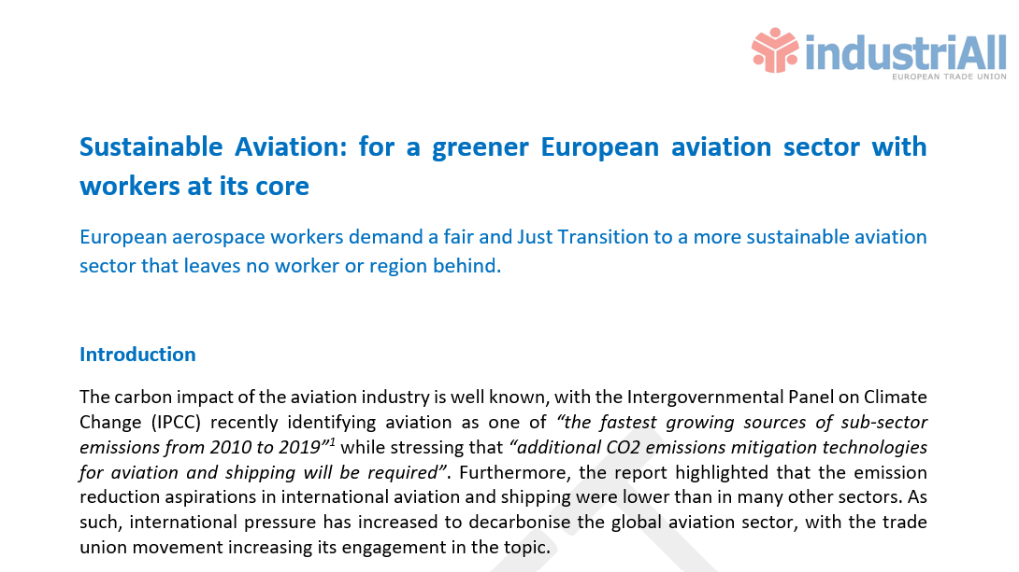
IAE Sustainability Paper: in progress
  Outlines current situation and future challenges
  Focuses on CO2 emissions
  Summarises key pieces of EU legislation and EU initiatives
  Stresses the need for a global approach
  Highlights the potential impact on workers
  Sets out demands for:
      EU policy makers
      National governments and public authorities
      Aerospace companies, airlines and airports
    Discussed at last Aviation Sectoral Network meeting in Toulouse and in editing phase

Slide 6
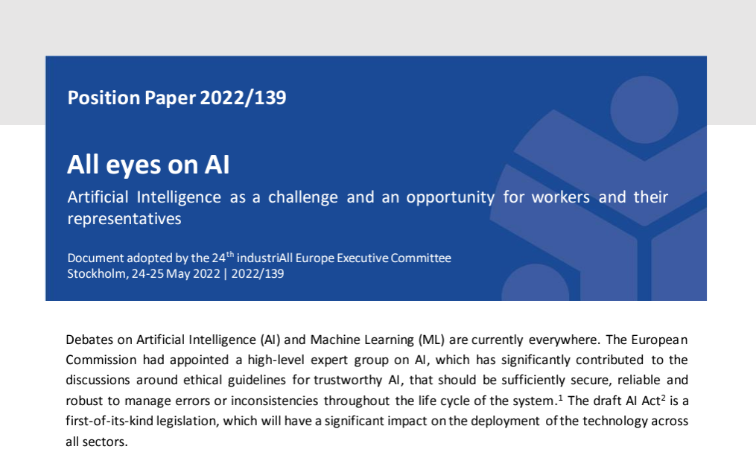
Digital transition: impact on the workforce
    Cannot forget digital transition.
    Automation/robotisation important for manufacturing but:
      Impact on current processes?
      Impact on job numbers/types?
      Skilling needs?
      How can workers benefit from increased productivity?
      Storage/use of data?
    Increased social dialogue needed:
      Workforce planning
      Anticipation of change
      Job-to-job transitions
      ….

Slide 7

IAE/ETF work on JT: next steps
Already have good basis: Toulouse declaration and ICAO working paper
Previously identified joint demands:
  Ensure environmentally, socially and economic connectivity in Europe
  Foster social sustainability
  Adequate social dialogue at all stages
  Reskilling and upskilling
  Initiatives for regular & constructive dialogue
  Development of sectoral roadmaps
Proposal: build on the above and include examples of best practice?

Slide 8
Questions?

