Slide 1

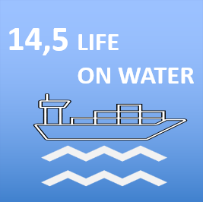
How ensure social standards in a Just Transition for Professional Mariners
Maritime Workshop
Bilbao, Spain
15 June 2023
Odd Rune Malterud - orm@dnmf.no
Assistant Director & Technical Manager Norwegian Union of Marine Engineers
Chair ITF Maritime Safety Committee

Slide 2
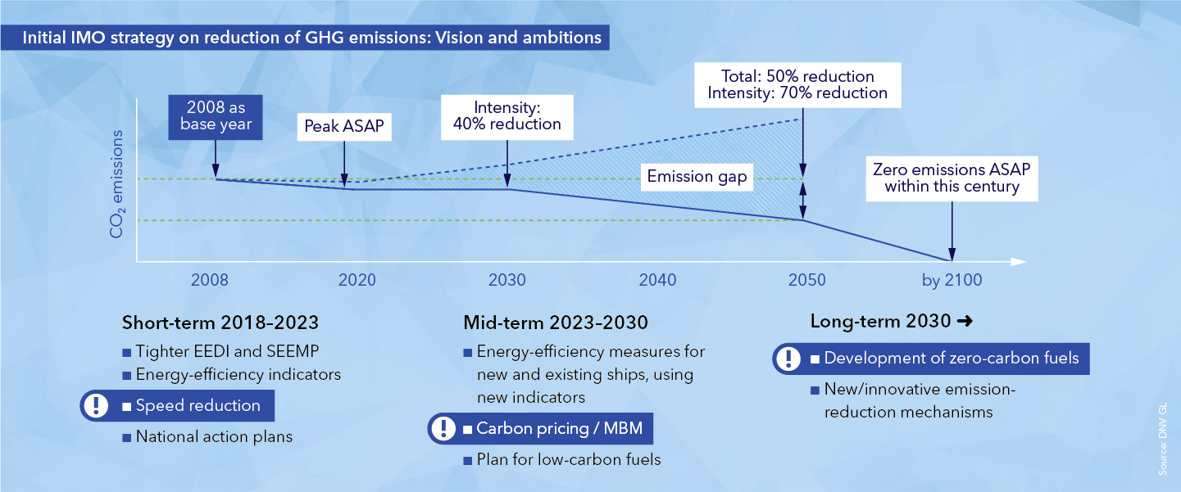
The political situations - without impact assessment!
Roadmap for developing a comprehensive IMO Strategy on reduction of GHG emissions from ships (as amended MEPC 74, 2019)
Competence before 2030 - needed!

Slide 3
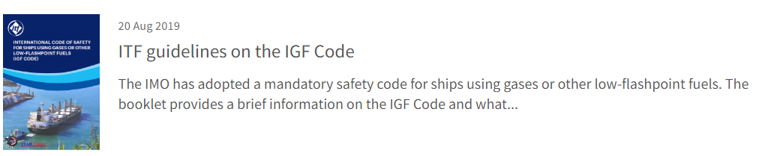
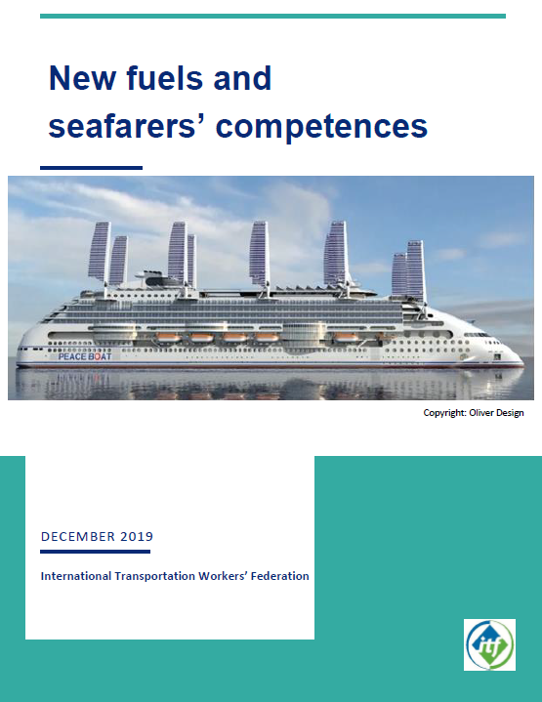
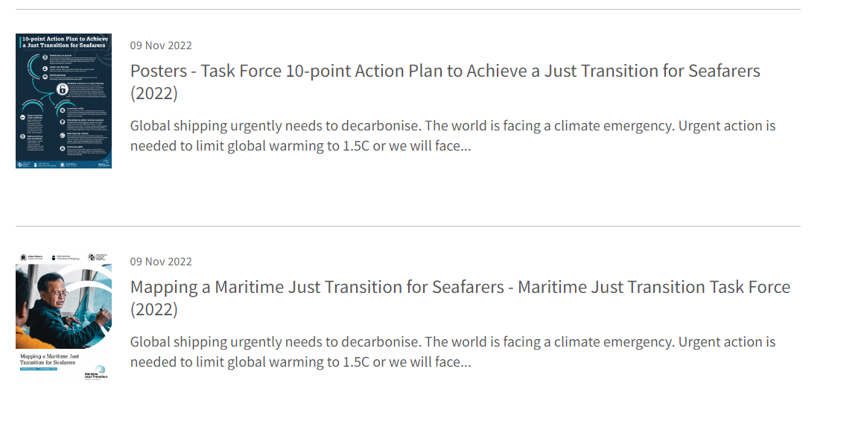
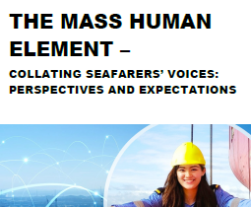
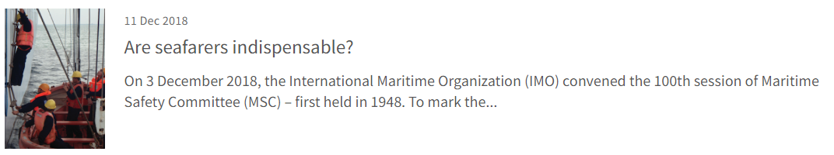
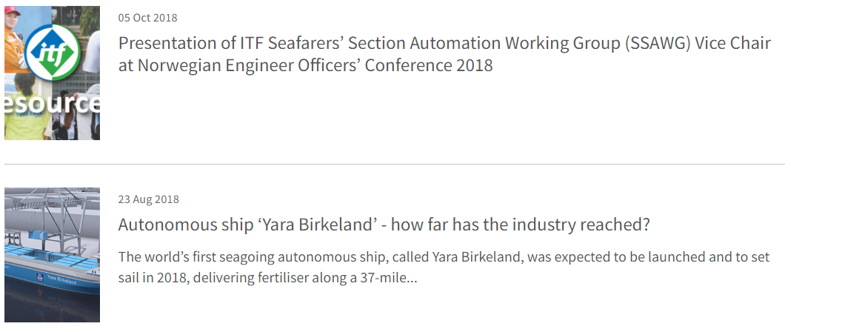
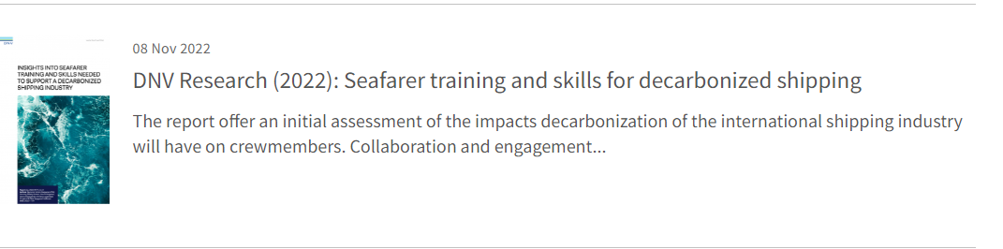
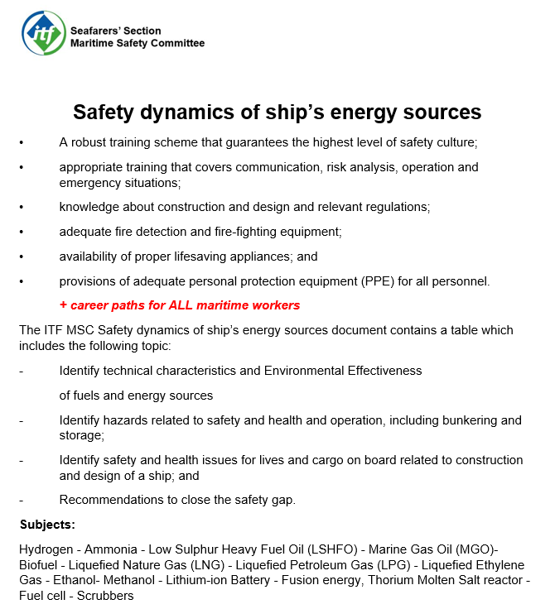
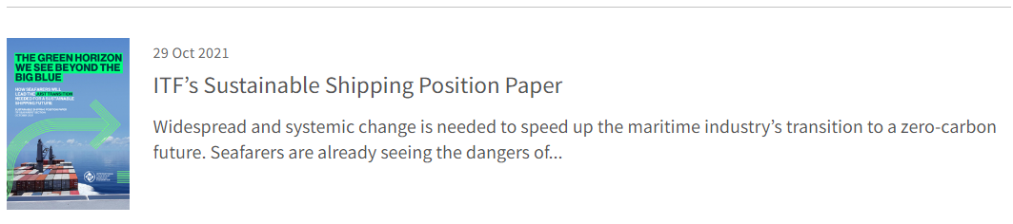
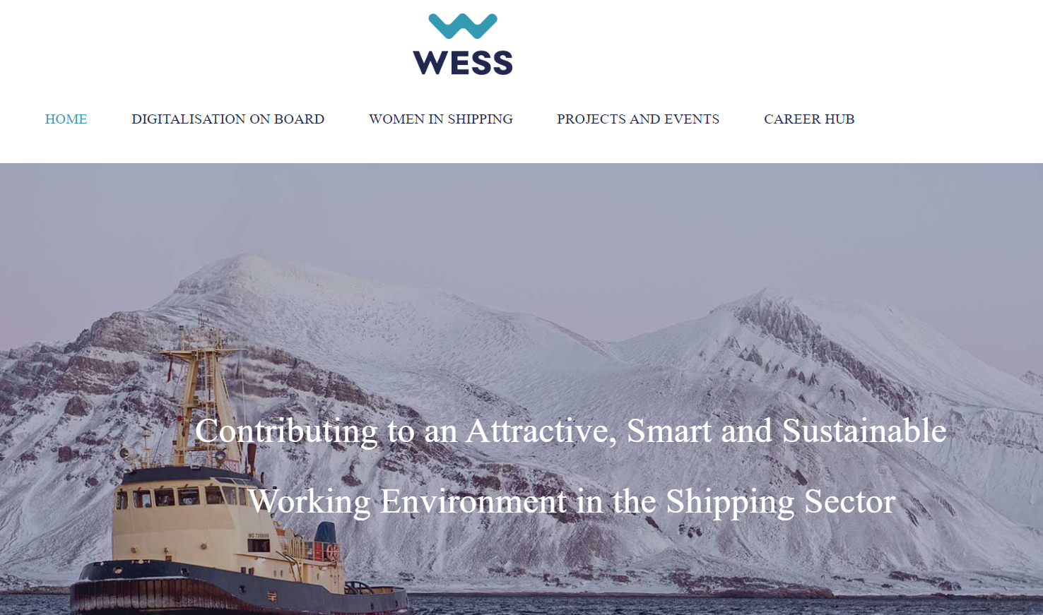
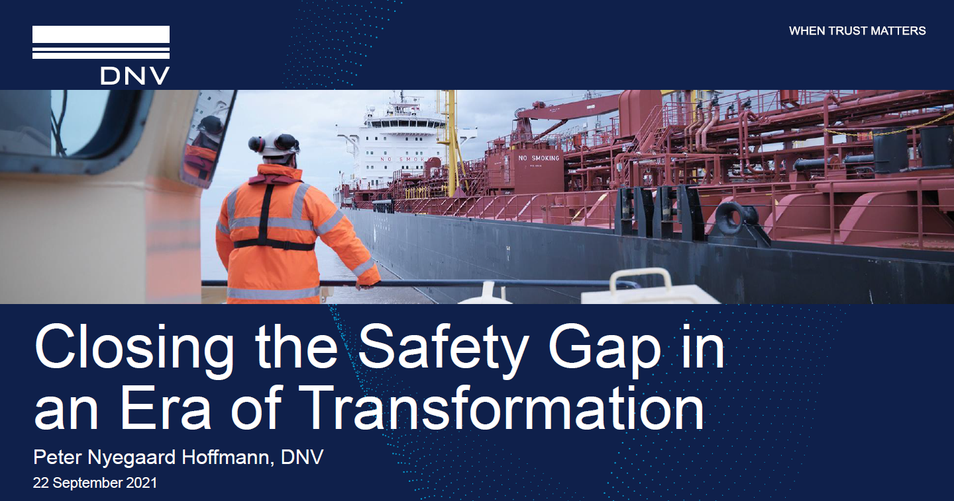
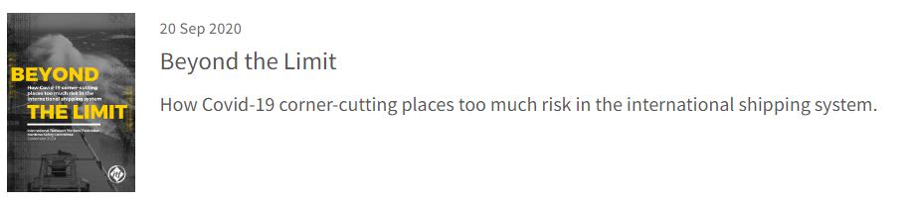
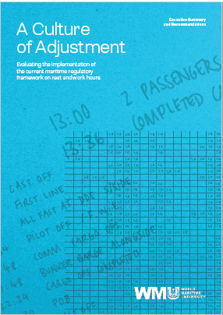


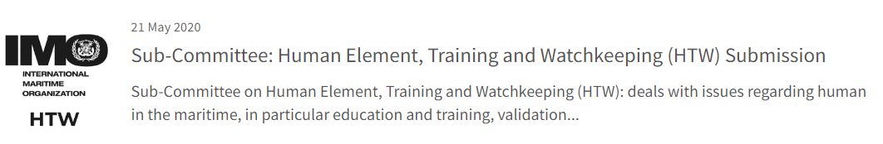
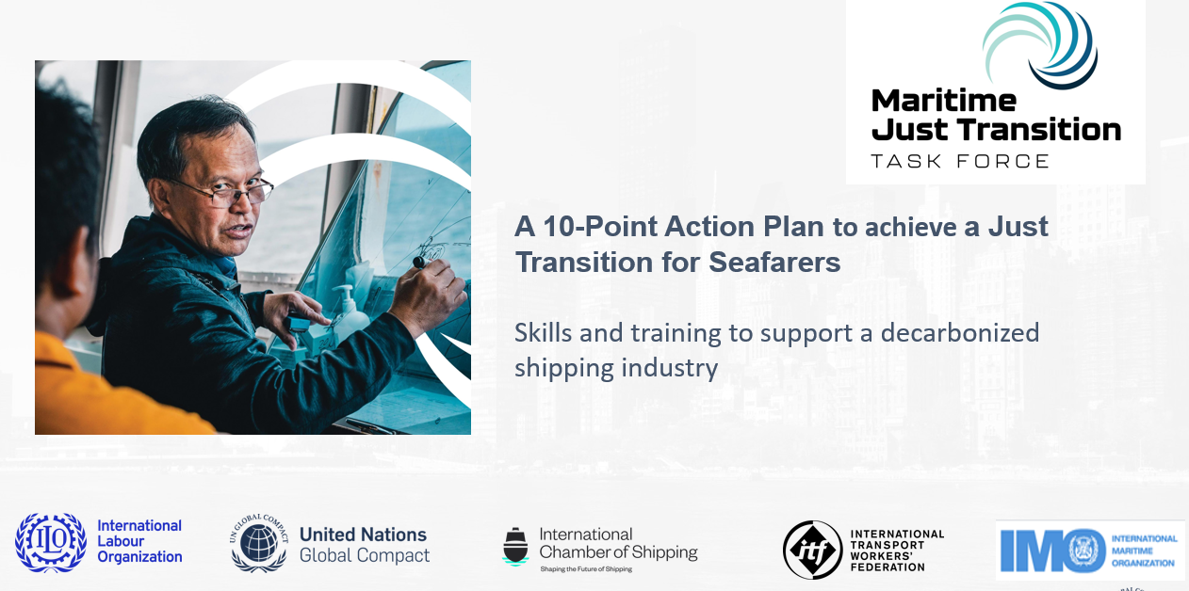
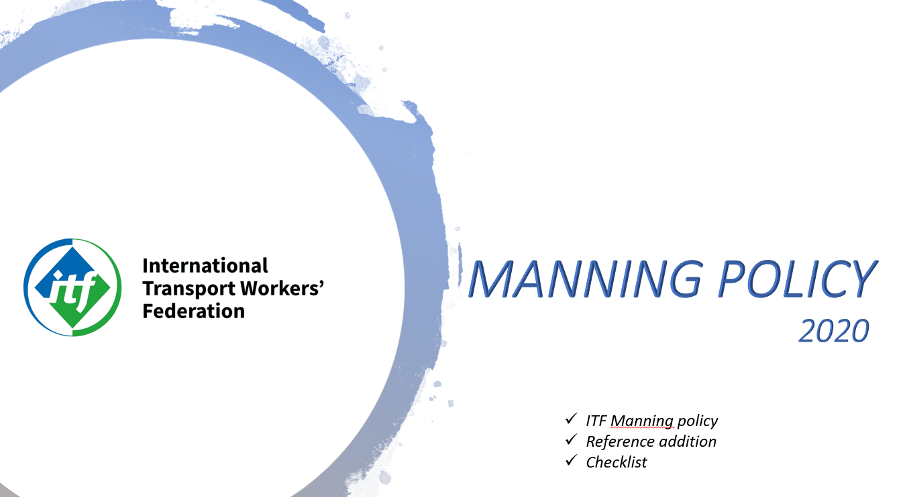
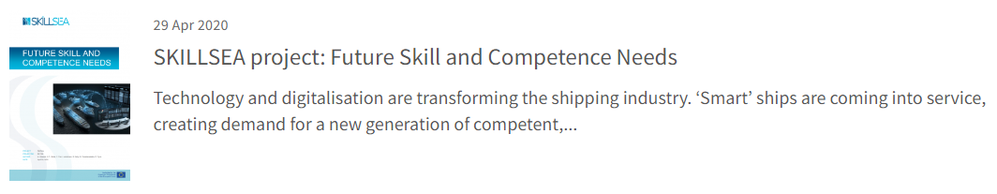
Reports & Publications
Background

Slide 4
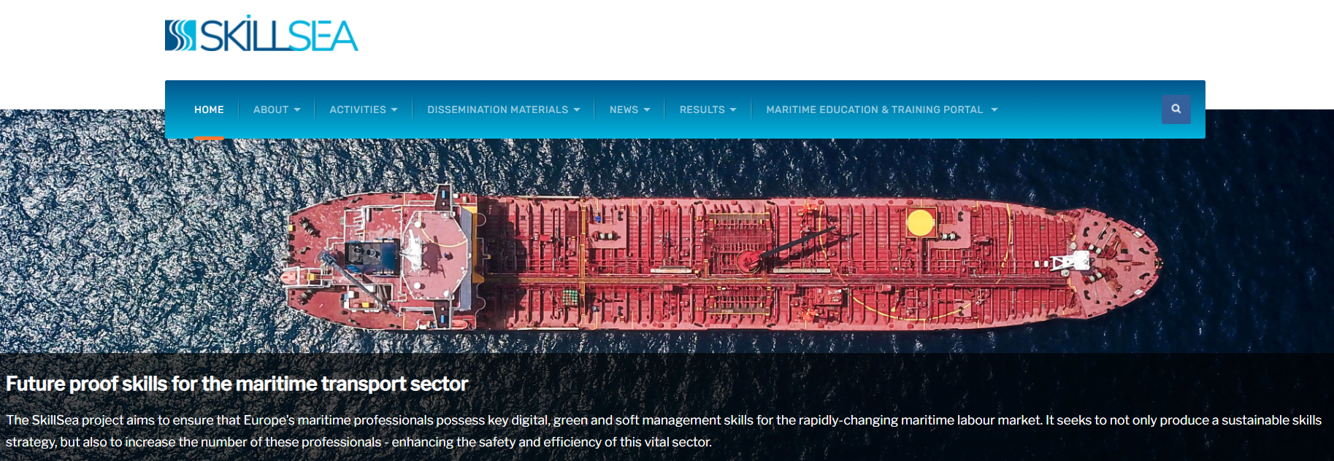
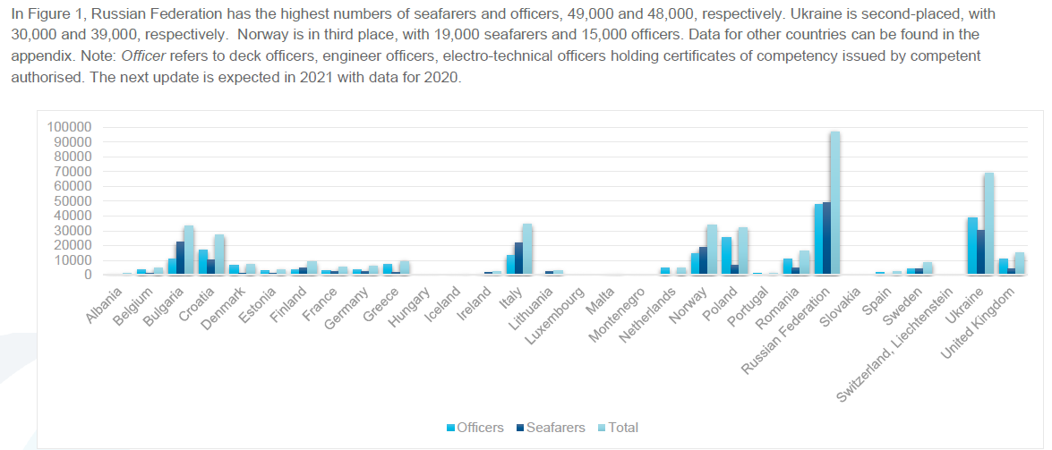

• Sustainability
• Collaboration of clusters
• Digitalisation
https://www.skillsea.eu
All in all, the maritime professionals (both seagoing and shore-based) need in-depth understanding of the complex systems onboard to be able to serve the needed redundancy of all systems.
BIMCO/ICS MANPOWER REPORT PREDICTS POTENTIAL SHORTAGE OF ALMOST 150,000 OFFICERS BY 2025

Slide 5
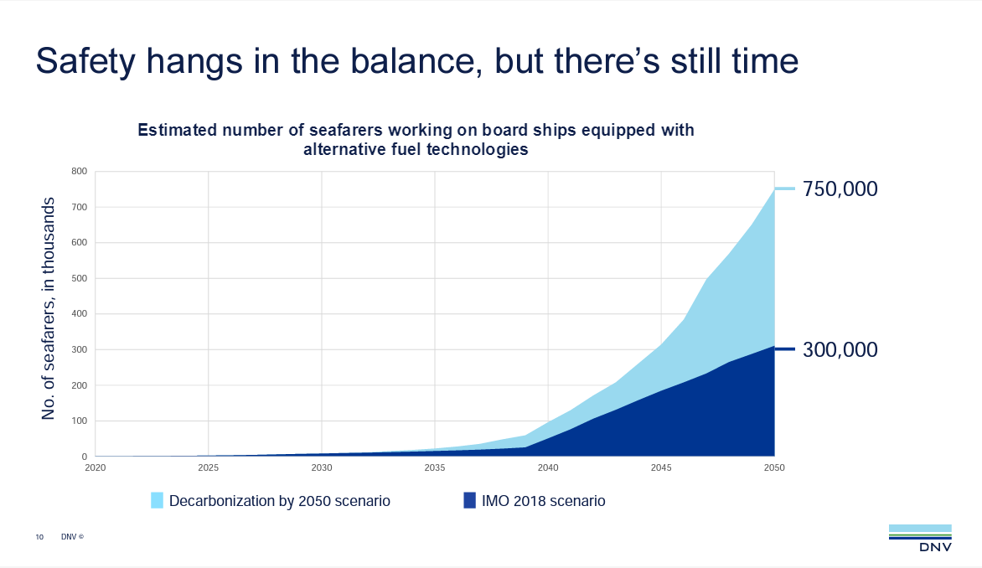

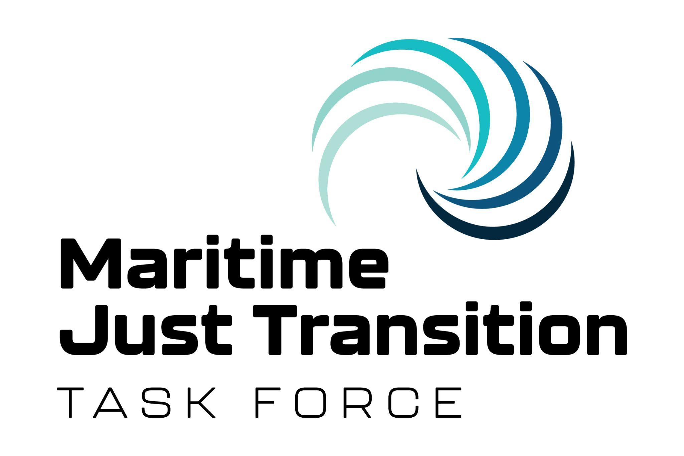
As shipping decarbonizes, training of seafarers must happen in parallel
The competence needed to reach the Goal

Slide 6
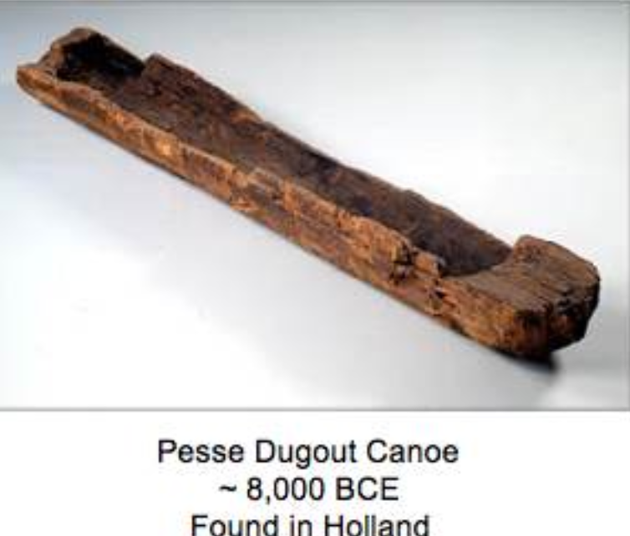
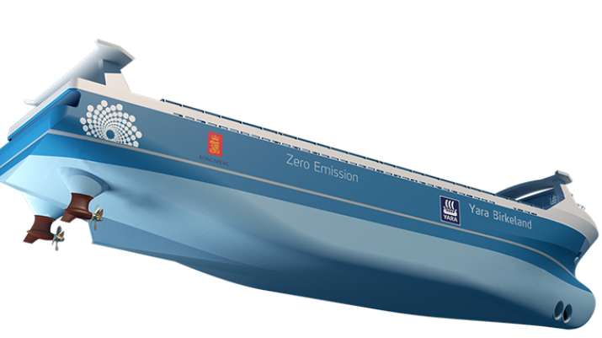
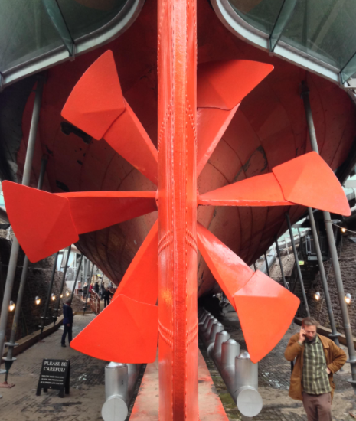
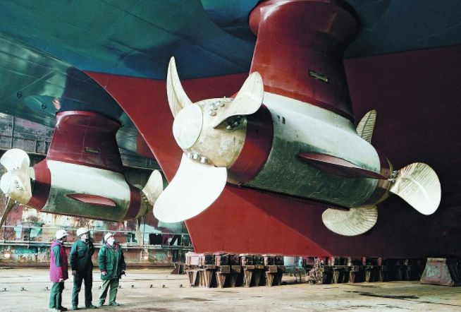
Environment and issues affecting seafarer safety
No innovative news - it’s only the hull & propellers design changed, to complying with marine environment, ships operation, maintenance, and navigation
New types of energy sources for ships' propulsion, maneuvering and operation with innovative engine technologies to improve the protection of the marine environment have led to New Environmental Regulations, while Human Element SAFETY aspects have been overlooked.
The regulatory regime must fully take into consideration the safety aspects for maritime workers and its practical viability for shipboard working and living ecosystems.
Engineer officers and crew will face the greatest safety challenges with energy sources for propulsion such as high temperature, high pressure, high voltage, toxicity and corrosivity. Furthermore, manoeuvring, maintenance, explosion hazards and firefighting are also challenges in terms of safety and competence.
Energy source storage, fuel efficiency, bunkering, charging, construction, evacuation design, firefighting, and Search and Rescue (SAR) must also be considered to close the safety and competence gaps.
Safety dynamics of ship’s energy sources

Slide 7

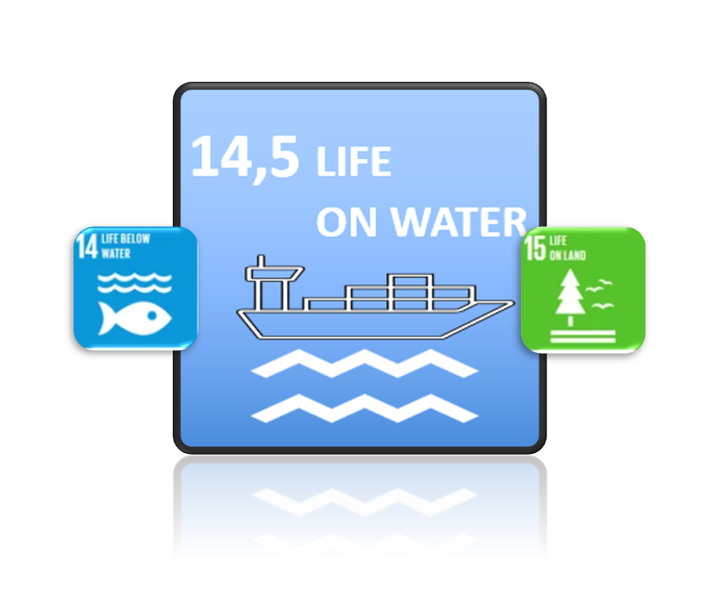



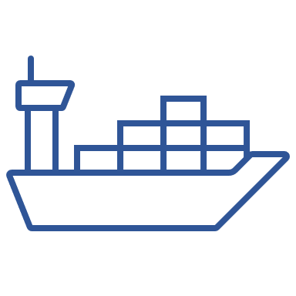











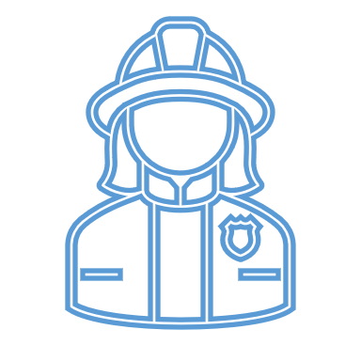
The context between regulations, political decisions and the work force
Safety & Security
Ensure inclusive and equitable quality education and promote lifelong learning opportunities for all
SOLAS
STCW
Strengthen the means of implementation and revitalize the Global Partnership for Sustainable Development
MARPOL
MLC
UNCLOS

Slide 8
UNCLOS ARTICLE 94 Duties of the flag State
1 Ocean,1 Law
- for ALL
Every State shall effectively exercise its jurisdiction and control in administrative, technical and social matters over ships flying its flag. In particular, every State shall:
(a) maintain a register of ships containing the names and particulars of Ships flying its flag, except those which are excluded from generally accepted international regulations on account of their small size; and
(b) assume jurisdiction under its internal law over each ship flying its flag and its master, officers and crew in respect of administrative, technical and social matters concerning the ship.
3.Every State shall take such measures for ships flying its flag as are necessary to ensure safety at sea with regards, inter alia, to:
(a) the construction, equipment and seaworthiness of ships;
(b) the manning of ships, labour conditions and the training of crews, taking into account the applicable international instruments;
(c) the use of signals, the maintenance of communications and the prevention of collisions.
4. Such measures shall include those necessary to ensure:
(a) that each ship, before registration and thereafter, at appropriate intervals, is surveyed by a qualified surveyor of ships, and has on board such charts, nautical publications and navigational equipment and instruments as are appropriate for the safe navigation of the ship
(b) that each ship is in the charge of a master and officers who possess appropriate qualifications, in particular in seamanship, navigation, communications and marine engineering, and that the crew is appropriate in qualification and numbers for the type, size, machinery and equipment of the ship;
(c) that the master, officers and, to the extent appropriate, the crew are fully conversant with and required to observe the applicable international regulations concerning the safety of life at sea, the prevention of collisions, the prevention, reduction and control of marine pollution, and the maintenance of communications by radio.
5. In taking the measures called for in paragraphs 3 and 4, each State is required to conform to generally accepted international regulations, procedures and practices and to take any steps which may be necessary to secure their observance.

Slide 9
International Standard for the safe Management and operation of ships and for pollution prevention (ISM Code)
Implement – Practice – Maintain – Training – Communicate – Development
Safety and Security for Human and Environment
SOLAS Chapter IX
The purpose is to provide an international standard for the safe management and operation of ships and for pollution prevention.
..take the necessary steps to safeguard the shipmaster in the proper discharge of his responsibilities with regard to maritime safety and the protection of the marine environment.
..need for appropriate organization of management to enable it to respond to the need of those on-board ships in order to achieve and maintain high standards of safety and environmental protection.
Recognizing that no two shipping companies or shipowners are the same, and that ships operate under a wide range of different conditions, the Code is based on general principles and objectives, which include assessment of all identified risks to one Company’s ships, personnel and the environment and establishment of appropriate safeguards.
..Clearly, different levels of management, whether shore-based or at sea, will require varying levels of knowledge and awareness of the items outlined.
.. In matters of safety and environment protection it is the commitment, competence, attitudes and motivation of individuals at all levels that determines the end result.
6. RESOURCES AND PERSONNEL
6.1 The Company should ensure that the master is:
.1 properly qualified for command;
.2 fully conversant with the Company's SMS; and
.3 given the necessary support so that the master's duties can be safely performed.
6.2 The Company should ensure that each ship is:
.1 manned with qualified, certificated and medically fit seafarers in accordance with national and international requirements; and
.2 appropriately manned in order to encompass all aspects of maintaining safe operation on board.*
* Refer to the Principles of minimum safe manning, adopted by the Organization by Resolution A.1047(27)
1.2.3 The safety-management system should ensure:
.1 compliance with mandatory rules and regulations; and
.2 that applicable codes, guidelines and standards recommended by the Organization, Administrations, classification societies and maritime industry organizations are taken into account

Slide 10
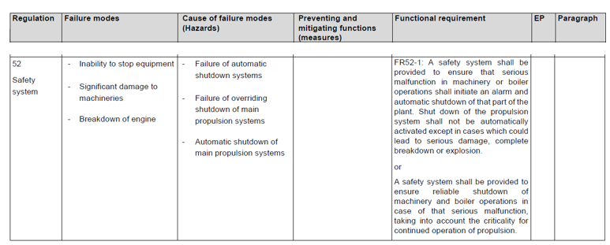
* Alternative design and arrangements for SOLAS chapter II-1
Team Opportunity
In relation to regulatory gaps on energy sources for propulsion and manoeuvring, or ships with reduced, zero crew or remotely controlled ships, the ISM Code 1.2.3 and 6.2.2 require the participation of the Chief engineer in the team* to ensure that technical competence on all operational safety aspects - regarding construction and engineering in order to obtain the necessary certificate for the ship expected operation.
The Risk and Hazard analysis must consider UNCLOS 94 and the Chief engineer's responsibility to comply with SOLAS and MARPOL specific emission requirements in relation to the ship specific construction, design, characteristics for all energy sources on board, including environmental efficiency, as well ensure that all equipment and competence to safeguard the ships, the human and the environment is present - under all conditions, to avoid loss of life and criminalisation.
* 4 - Design team 4.1 A design team acceptable to the Administration should be established by the owner, builder or designer and may include, as the alternative design and arrangements demand, a representative of the owner, builder or designer, and expert(s) having the necessary knowledge and experience in safety, design and/or operation as necessary for the specific evaluation at hand. Other members may include marine surveyors, ship operators, safety engineers, equipment manufacturers, human factors experts, naval architects and marine engineers.
Why don't we practice this safety regulations?
SDC 9/ WP.4 01.23
Hazard: something that could potentially cause harm. Risk: the degree of likelihood that harm will be caused.

Slide 11



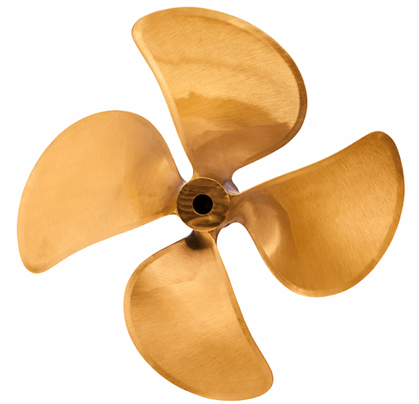
Specific and technical regulation to protect the maritime environment
International Convention for the Prevention of Pollution from Ships MARPOL
Protocol I - Provisions concerning reports on incidents involving harmful substances (in accordance with Article 8 of the Convention)
Article I Duty to report
1. The Master or other person having charge of any ship involved in an incident referred to in Article II of this Protocol shall report the particulars of such incident without delay and to the fullest extent possible in accordance with the provisions of this Protocol.
ROLE OF CHIEF ENGINEER IN IMPLEMENTATION OF MARPOL 73/78
MARPOL 73/78 deals with pollution caused by merchant vessels. The Chief Engineer has huge responsibility that vessel is complying with all the regulations of MARPOL.
Certificates
Energy Efficiency Design Index (EEDI), Energy Efficiency Existing Ship Index (EEXI) ,IOPP Certificate (MARPOL I) NLS Certificate (MARPOL II) ISPP Certificate (MARPOL IV) Garbage Certificate of Compliance (MARPOL V) IEE Certificate (MARPOL VI) ,IAPP Certificate (MARPOL VI) EIAPP Certificate (MARPOL VI and NOx Technical Code) for marine diesel engines
RECORD KEEPING
SURVEYS
CONTROL OF OPERATIONAL POLLUTION
    BUNKERING
RECEPTION FACILITIES
EMERGENCY PREPAREDNESS

Slide 12
Maritime Labour Convention 2006 (MLC 2006)
Tripartite regulations - developed for protect the human environment
MLC Standard A2.7 – Manning levels
Each Member shall require that all ships that fly its flag have a sufficient number of seafarers on board to ensure that ships are operated safely, efficiently and with due regard to security. Every ship shall be manned by a crew that is adequate, in terms of size and qualifications, to ensure the safety and security of the ship and its personnel, under all operating conditions, in accordance with the minimum safe manning document or an equivalent issued by the competent authority, and to comply with the standards of this Convention.
MLC Standard A2.8 - Career and skill development and opportunities for seafarers’ employment
Each Member shall have national policies that encourage career and skill development and opportunities for seafarers, in or- to provide the maritime sector with a stable and competent workforce.
2. The aim of the policies referred to in paragraph 2. 1 of this Standard shall be to help seafarers strengthen their competencies, qualifications and employment opportunities. 3. Each Member shall, after consulting the ship owners' and seafarers' organizations conetacerned, establish clear objectives for the vocational guidance, education and training of seafarers whose duties on board ship primarily to the safe operation and navigation of. the ship, including ongoing training.
Guideline B2.8 Guideline B2.8.1 Measures to promote career and skill development and employment opportunities for seafarers.
Measures to achieve the objectives set out in Standard A2.8 might include: agreements providing for career develop- and skills training with a shipowner or and organization of shipowners promoting employment Through the establishment and maintenance of registers or lists, by categories, of qualified seafarers; or promotion of opportunities, both on board and ashore, for further training and education of seafarers to provide for skill develop ferment and portable competencies in order to secure and retain decent work, to improve individual employment prospects and meet the changing technology and labour conditions of the maritime industry

Slide 13
Safety, security in technical, operational and human levels Challenges
External environment is in focus - internal environment forgotten!
- especially for the engine crew and emergency personnel who will operate and process all types of “green energy”
Safety Cultur, Risk & Hazard Understanding
New Energy Sources
GHG
Competense
Certification
Manning
Fatigue, Mental Health
Design, Weight, Safe Storage, Stability
Fire & Explosion Barriers
General Operation and Scrubbers
  Internal air and contact contamination
  Extended maintenance
  Pressure & Temperature
High Voltage, Presure and Temperatur
Toxid
Break down
Fire Fighting Systems - Evacuation Systems
Bunker – Charge
Derating
Criminalisation
Flash Point
Frankenstein Fuel (Chemicals & Plastic)
Ballas water (Chemicals)

Slide 14
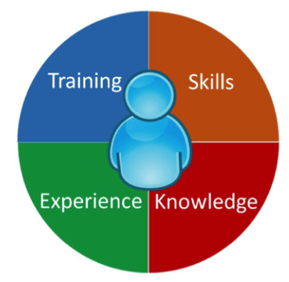
Mandatory absolute minimum competence
  STCW / STCW – F
Standard Training - Vessel Specific Training - Familiarization
Hardware Software Customizations
Education / Competence like now (STCW)
- with further education as:
Energy and environmental competence
    Characteristics
    Construction & Design
    Environmental effectiveness
    Fire and explosion risks
    Health and safety issues
    First Aid knowledge
    UNCLOS, SOLAS, MARPOL, Polar Code
Communication, Risk & Hazard analysis, operation and emergency situations
Analyze digital information (instead of senses they use onboard)
Override the logarithms and operate the ship manually
Simulator operations
Simulator use of failure mode and effects analysis (FMEA)
Multidisciplinary communication
Leadership
Cyber security
Condemnation of terrorism

Slide 15
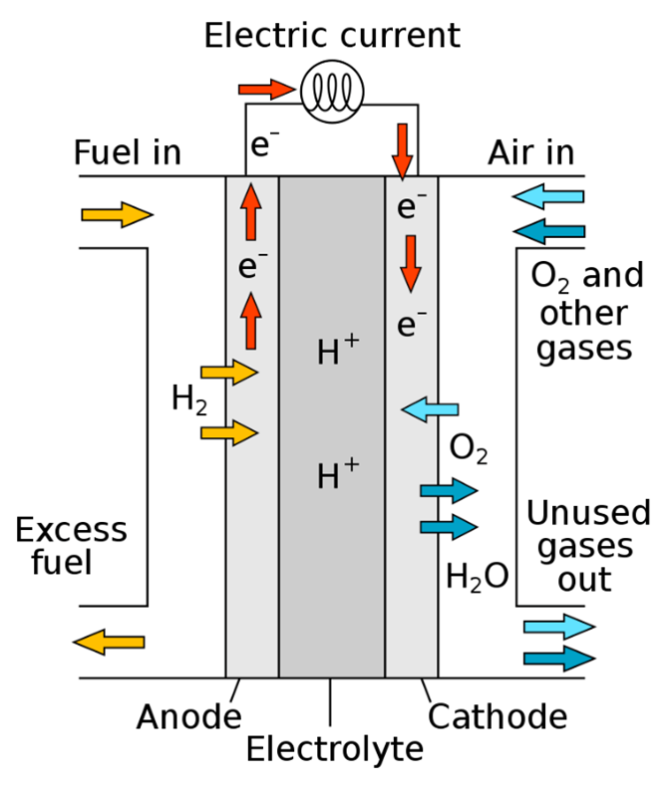
Safety dynamics of ship’s energy sources
The purpose of this document is to highlight the imminent need to put in place measures for those involved in direct on-the-job operations and provide recommendations to close the safety and competency gaps that may exist.
When introducing alternative energy sources, the following are crucial:
• A robust training scheme that guarantees the highest level of safety culture;
• appropriate training that covers communication, risk analysis, operation and emergency situations;
• knowledge about construction and design and relevant regulations;
• adequate fire detection and fire-fighting equipment;
• availability of proper lifesaving appliances; and
• provisions of adequate personal protection equipment for all personnel.
What information available?
Characteristics
Construction & Design
Environmental effectiveness
Fire and explosion risks
Health and safety issues
Recommendations

Slide 16
Safety dynamics of ship’s energy sources
Energy sources covered
Hydrogen
Ammonia
Low Sulphur Heavy Fuel Oil (LSHFO)
Marine Gas Oil (MGO)
Biofuel
Liquefied Nature Gas (LNG)
Liquefied Petroleum Gas (LPG)
Liquefied Ethylene Gas
Ethanol
Methanol
Lithium-ion Battery
Fusion energy-Thorium Molten Salt reactor
Fuel cell
Scrubbers

Slide 17
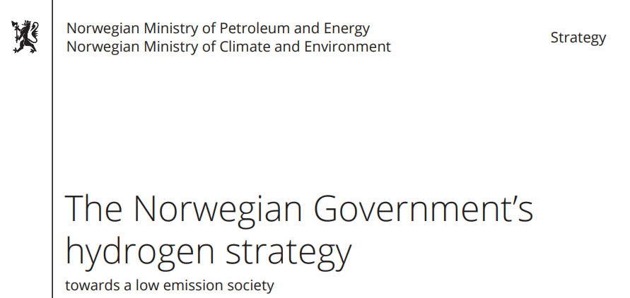
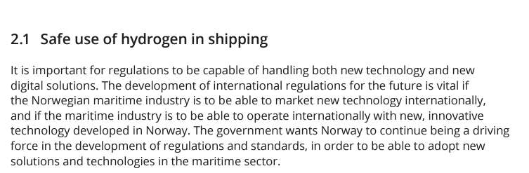
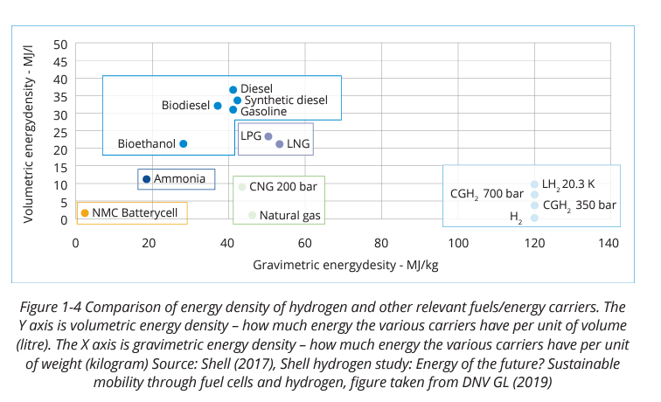
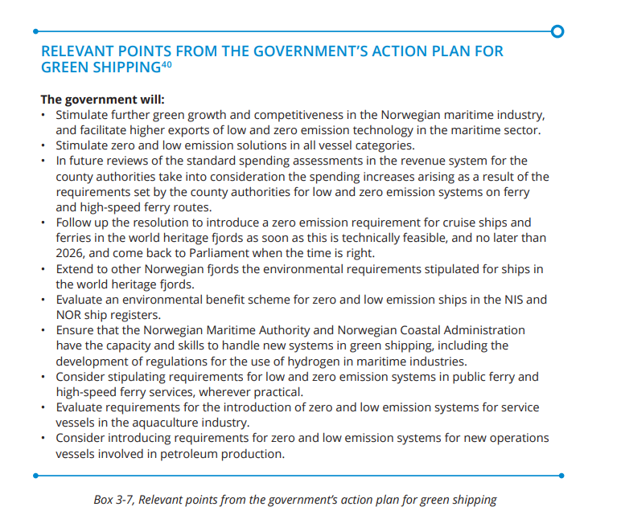
https://www.regjeringen.no/contentassets/8ffd54808d7e42e8bce81340b13b6b7d/hydrogenstrategien-engelsk.pdf
17.08.20
Competence training for maritime workforce?
Hydrogen has been used as an energy source for over 50 years, but not on ships that have completely different external factors such as salt, vibration, temperature, humidity and an infrastructure together with other energy sources and systems!
Hydrogen has an energy density of 33 kWh per kg, while batteries struggle to reach 0.3 kWh/kg. The disadvantage is of course that very large tanks are needed even to store a few kg of hydrogen. More than 50 percent disappears from electricity via hydrogen to electricity again. In practice, hydrogen is not more energy efficient than fossil fuels in a piston engine.

Slide 18
The political decision
- must always include the technical SAFETY facts
Many countries already have implemented and use high technology, automation, and new types of energy source for ship's propulsion, maneuvering and operation - based on political goals.
To achieve the regulatory objective of Safety and Security for Human and Environment a common understanding and implementation of regulations and policy where all aspects of maintaining safe operations on board are practiced in such a way that everyone can return home safely and healthy - are urgent needed
The context between regulations, political decisions and the work force shall as a minimum include UNCLOS Article 94, International Standard for the safe Management and operation of ships and for pollution prevention, Maritime Labour Convention 2006 and Standard Training - Vessel Specific Training - Familiarization (STCW)
Alternative design and arrangements for SOLAS chapter II-1, whit Risks and Hazard analysed based on the technical characteristics of the energy sources on board, using acceptable and recognized risk analysis techniques based on maritime competence for use in marine environments. Loss of function, component damage, toxic, corrosive, fire, explosion and electric shock should as a minimum be considered in the TEAM.
Risks that cannot be eliminated must be reduced to the technically possible minimum. Details of risks, and the ways in which they are reduced, must be documented to the satisfaction of the administration and form the basis for competence training, personal protective, medical equipment, construction and design.
Recommendation;
Use current regulations and technical competence – IMPLEMENT don't wait until the IMO has developed the regulations, - influence them!

Slide 19
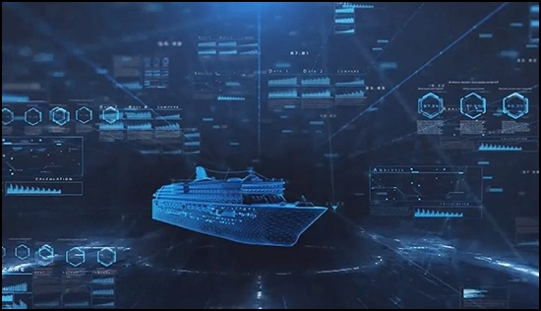


Safety
The circle
- to achieve the common GOLD
Employment Opportunities Education/Training
Security
Smart Ships
Intelligent Human
New Energy
Effectiveness
Marine environment
Ship-shore interface
Pilotage
Interactions with ports
Just Transition
Relocation
Sustainable Manning

Slide 20

In fact, the shipping industry deal with all this
To achieve common goals, ensure sustainable manning
Competence will ensure social standards!
orm@dnmf.no

