Slide 1
New risks associated with the twin transition
Panel 1 - “Just Transition, social standards, and best practice”
Building a Just Transition Towards a Smart and Sustainable Mobility
Maritime Workshop, Bilbao, 15 & 16 June 2023
William Cockburn
Interim Executive Director

Slide 2
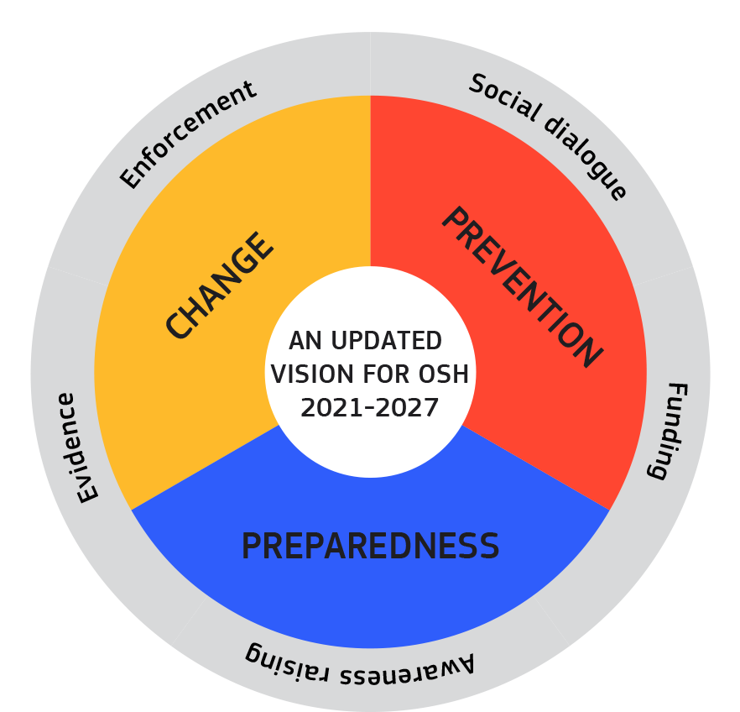
Anticipating and managing change
Drivers of change
  Green transition
  Digitalisation
  Ageing workforce
  Alternative forms of employment
  Shifting patterns of employment
  New risks?
Trends in OSH outcomes
  Injuries
  Ergonomics-related illnesses
  PSR-related illnesses
  Illnesses related to dangerous substances
  Illnesses related to physical agents

Slide 3

Green transition
Risks arising from climate change mitigation
  Refitting of buildings
  Recycling and waste treatment
  New technology
Risks arising from environmental effects of climate change
  Geographical spread of diseases and vectors
  Extremes of temperature
  Natural disasters
  Uncertainty and unpredictability

Slide 4
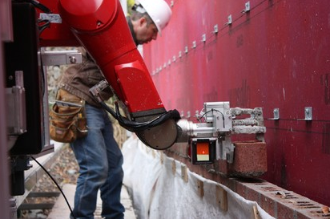
Digitalisation
Automation – advanced robotics and AI
AI-based worker management
Digital platform work
Remote work
Advanced OSH monitoring

Slide 5
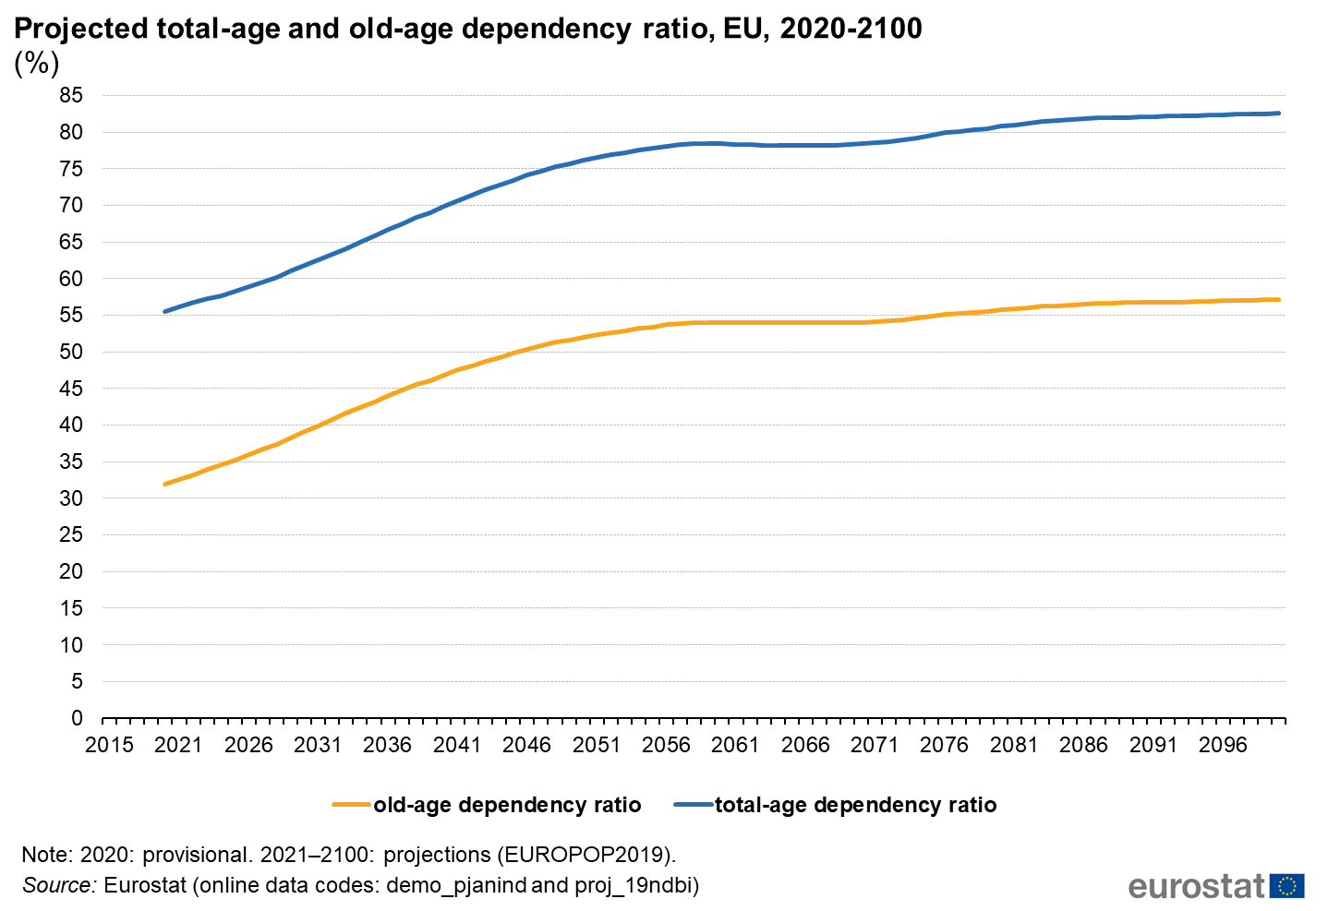
Ageing workforce
Longer working life + exposures
Age-related vulnerabilities
Caring responsibilities

Slide 6
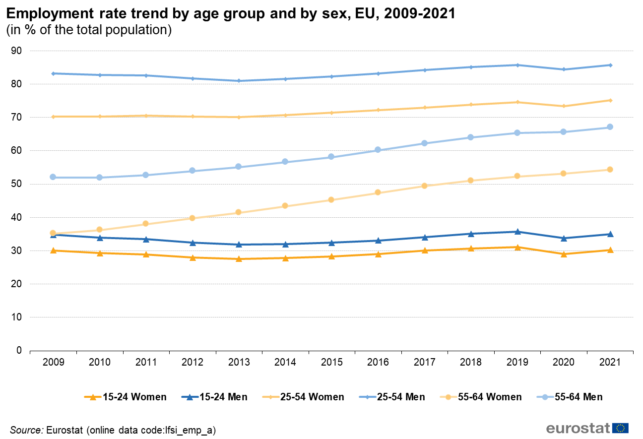
Women’s employment

Slide 7
Alternative forms of employment
Temporary agency
Seasonal work
Self-employed
Platform work and bogus self-employment
Subcontracting chains
  Poorer risk prevention
  Many not covered by OSH legislation
  Precarious employment
  More likely to suffer other disadvantages

Slide 8
Shifting patterns of employment
EUROSTAT, share of employment in selected sectors 1996 and 2019 (%)
Increasing service sector jobs
Outsourcing or re-shoring

Slide 9

Contributing to a strong evidence base – surveys, foresight, monitoring
Workplace survey, ESENER – 2009, 2014, 2019 and next edition in 2024
  45,000 interviews with person responsible for OSH investigating prevention in practice
Workers’ Exposure Survey on cancer risk factors 2022
  Six Member States (IE, DE, FR, FI, ES and HU), findings in 2023
Joint SLIC survey of labour inspectors 2021
  Pilot survey of 2,091 inspectors on high-risk occupations, COVID-19 and seasonal workers
OSH-Pulse 2022 – Flash Eurobarometer survey
  25,683 interviews with EU-27 workers on OSH and digitalisation, psychosocial risks and mental health and workers’ views on health and safety
Foresight exercises since 2008
  OSH + Green jobs, OSH + Digitalisation, OSH + Circular economy
  Expert reviews and articles
EU OSH Information System + OSH Barometer
  16 indicators drawing on 125 datasets
  OSH in the EU – state and trends report

Slide 10

Contributing to a strong evidence base – OSH Overviews
Musculoskeletal disorders (2017-2021)
  Prevalence, costs, demographics
  Chronic MSDs, static postures, rehabilitation and return to work, psychosocial link, telework
Digitalisation (2020-2023)
  Automation (robotics and AI), AI-based worker management, online platforms, monitoring systems
Supporting compliance (2020-2023)
  Enforcement, prevention services, social reporting, supply chains and business incentives
Psychosocial risks and mental health (2022-2025)
  Scoping phase in 2021
Health and care sectors (2023-2026)
  Scoping phase in 2022
Circulatory diseases (2024-2027)
Describing the state of knowledge
Reviewing policy and practice
Exploring the role of intermediaries
Identifying prevention measures at the workplace

Slide 11
Research conclusions and policy pointers
Need to focus on the ‘hard to reach’
  MSEs as ‘learners’, ‘reactors’ and ‘avoiders’
  Self-employed and false self employed
Regulation fit for purpose… but not only
  Collective agreements
  Awareness raising
  Guidance and tools
  Support and access to expertise
  Inspection and enforcement
Importance of an ‘orchestrated’ approach
  Tailored approach
  Exploiting employers’ ‘contact points’
Essential role of social dialogue and worker representation on OSH
  Genuine participation at workplace level
  Examples of good practice
  Participation in policy making and regulation

Slide 12


Maritime transport
Long working hours
Isolation
Dangerous substances
Confined spaces
Slips trips and falls, collisions
Migrant workers
Digitalisation

Slide 13
ESENER secondary analysis on transport sector – Water transport
Large and varied array of activities with unique OSH challenges:
  Isolation (long periods at sea),
  Difficult communication and management challenges, especially on safety (cross-cultural differences)
Main psychosocial issues in water transport are:
  Work-related stress: depression, burnout syndrome, weather conditions.
  Working times: erratic, very long work schedules that cause fatigue.
  Situations of harassment and bullying.
  Accidents on board: witnessing another person experience a severe accident can induce stress-related illnesses such as post-traumatic stress disorder.
  Remote and isolated work: loneliness, homesickness, separation from family.
  Shared spaces: lack of privacy

Slide 14





Find out more:
Thank you
Multilingual website: https://osha.europa.eu
Monthly e-newsletter OSHmail: https://osha.europa.eu/en/news/oshmail
Publications: https://osha.europa.eu/en/publications
Social media:

