Slide 1
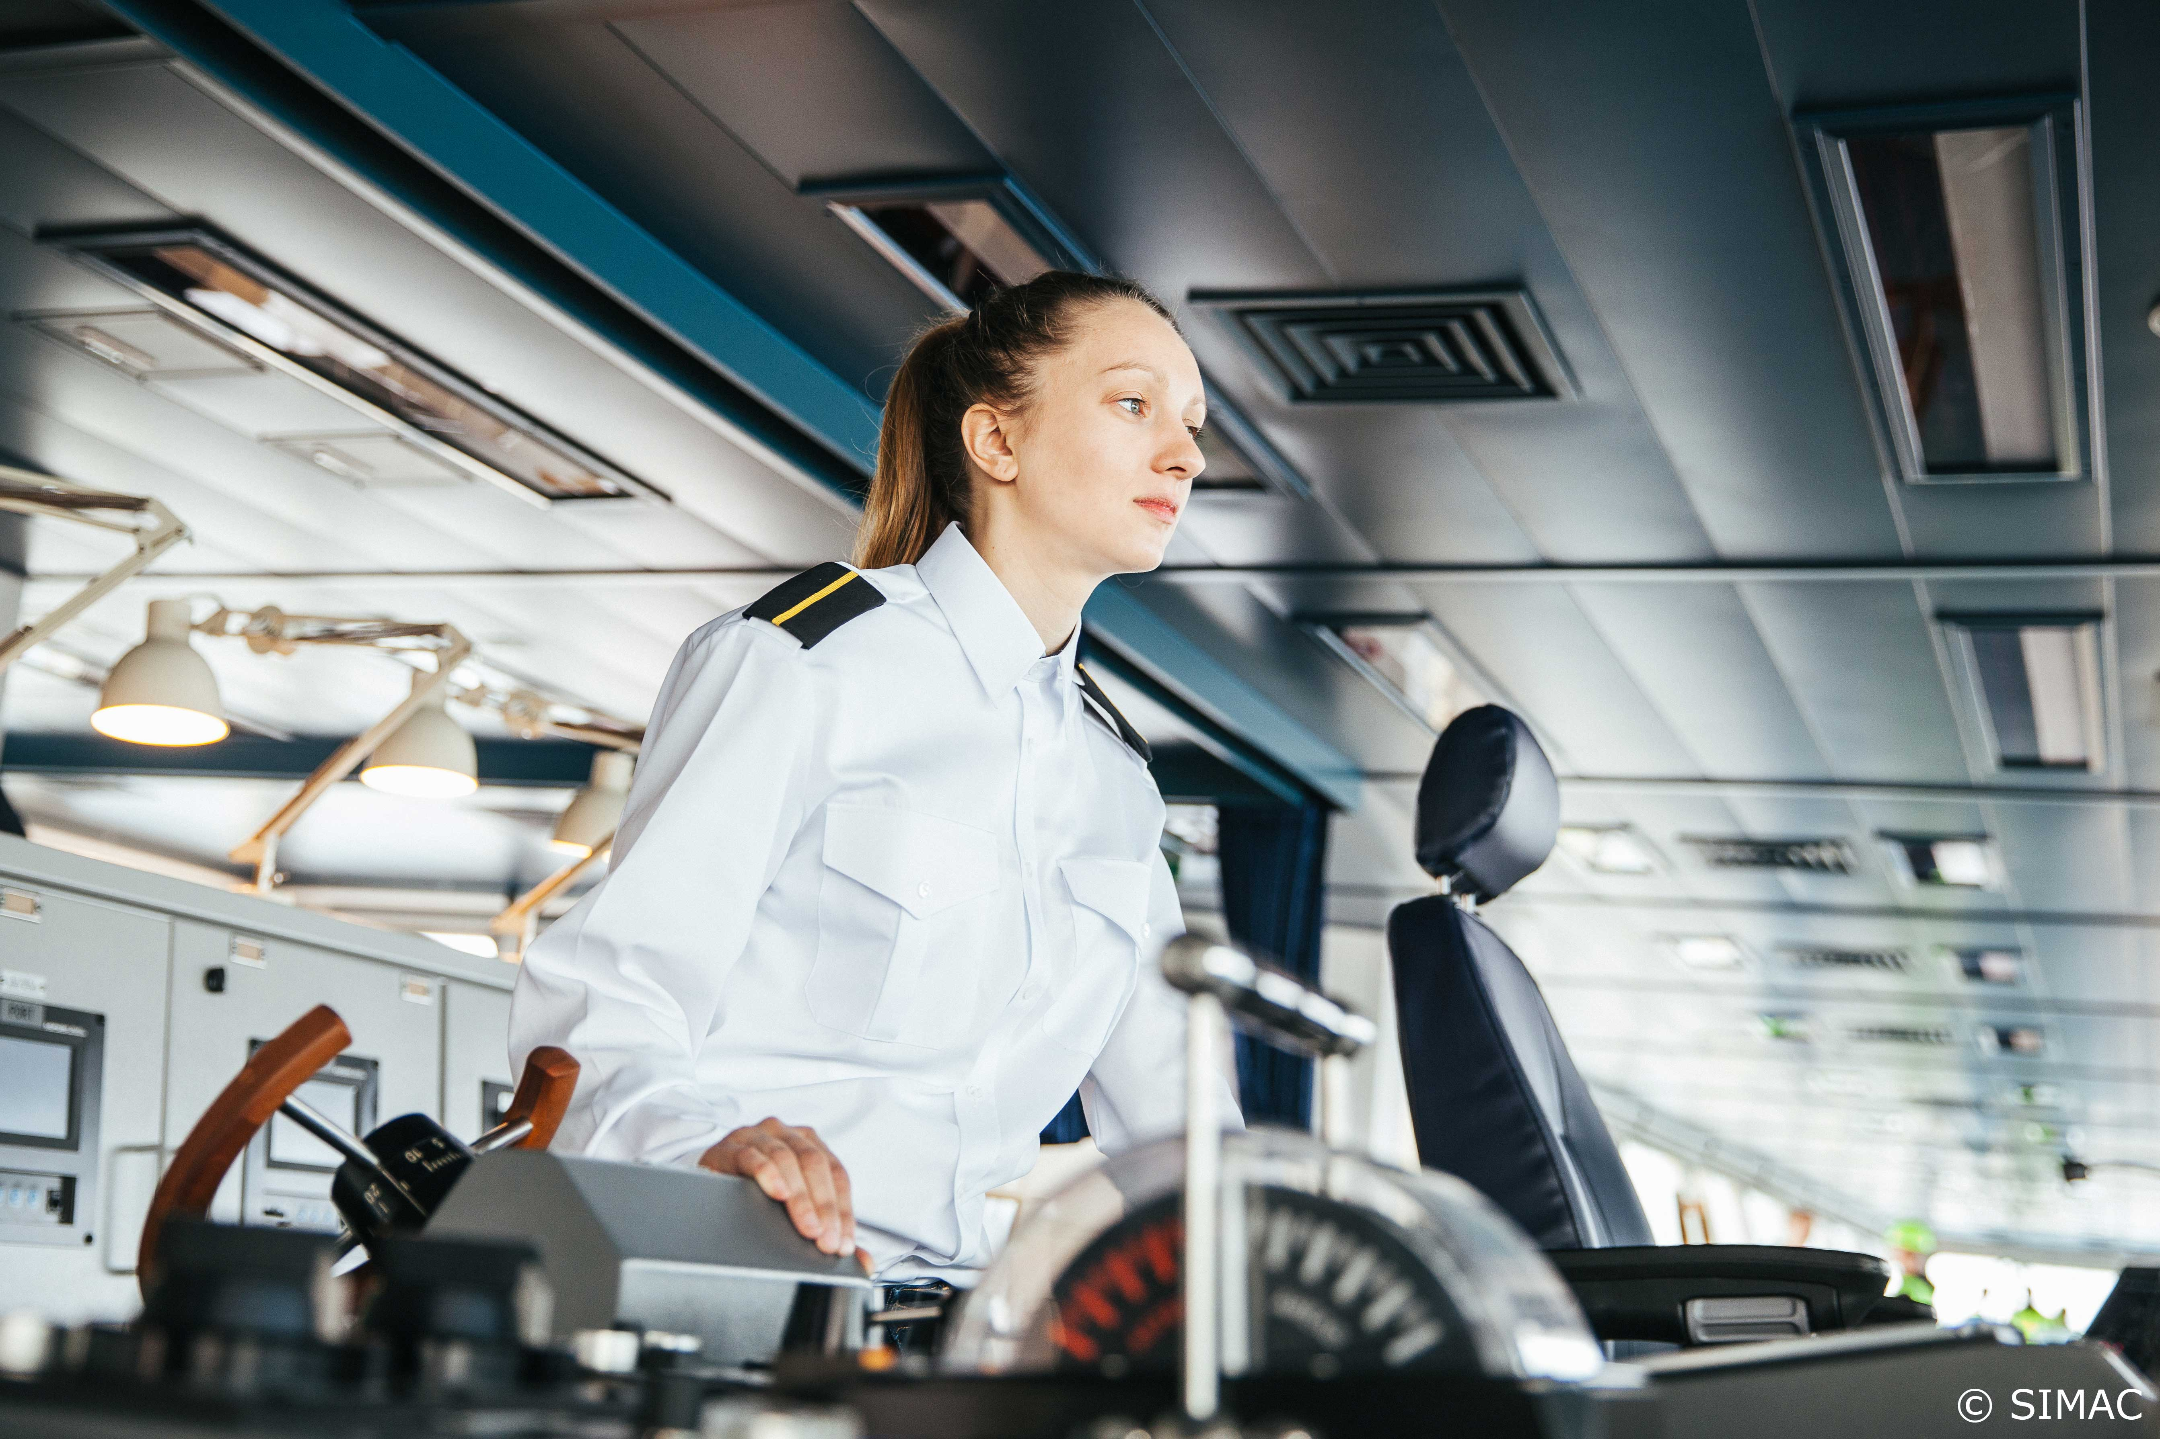
Project SkillSea
Future-proof skills for the maritime transport sector

Slide 2
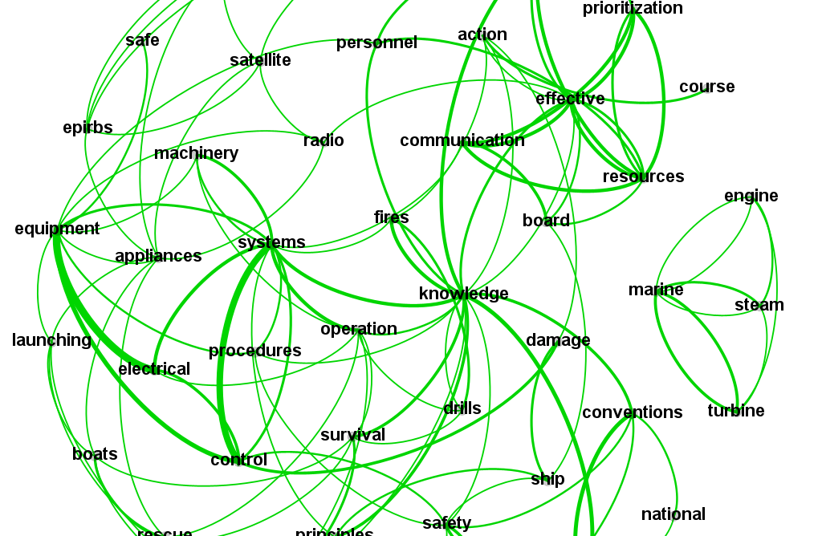
SkillSea WP.1 & WP.2
Alco Weeke, technical project leader
Notes:
Challenges
Current and future shortage of maritime professionals
Changes
Mobility issues
Communication issues
Core skill sets
Digital skills
Green skills

Slide 3
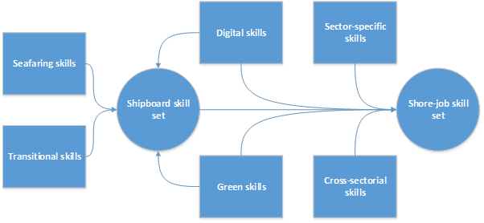
SkillSea - Challenges
Time

Slide 4
SkillSea - Goals
To minimise the current and future shortages of maritime professionals
  to match education with the demands of the industry
To promote cooperation platforms between knowledge providers, regulators and industry
  to discuss skills gaps/needs and tools
  to anticipate changing needs
To fully utilise mobility potential
  horizontal, vertical and geographical
1
Literature review
Industry perspective
MET perspective
Identification of skill standards
Current skills identification
Employee survey
Analysis, results and outcomes
2
3
4
5
6
7
Notes:
Document and literature review
Projects and studies, legal documents, articles, educational programs, …
Stakeholder survey
Questionnaires
Semi-structured interviews
Focus groups
Analyses
Skill standards
Lexical analyse
Technology developments
Trends and drivers
…

Slide 5
SkillSea WP.1 – Current skill needs
What we learned
STCW Convention requires only the basic levels of “knowing”, i.e. KUPs
  Higher-level capabilities (analysis, synthesis and evaluation) are not required
  Recently developed expertise is missing (digital and green skills, transversal skills, …)
  Expertise required for shore-based positions missing completely
Maritime education and training are highly diversified
    In scope, academic approach, level, depth, modes of delivery, …
    By providers, their goals, experience, knowledge and proficiency, …
Technology development continuously challenges knowledge providers

Slide 6
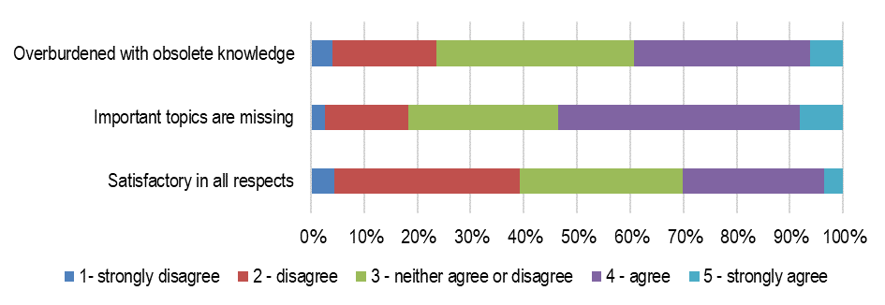
SkillSea WP.1 – Current skill needs
Seafarers’ position on professional education and competencies as outlined in the STCW Convention

Slide 7
SkillSea WP.1 – Filling the skill gap

Slide 8
SkillSea WP.1 – Future skill needs - Approach

Slide 9
SkillSea WP.1 – Current skill needs
Gaps to be closed
Notes:
Main directions
Digital transformation
Sustainability and decarbonisation
Labour market changes
Demography and innovation

Slide 10
SkillSea WP.1 – Future skill needs
What we learned
Labour market changes
  Emphasis on cooperation and networking (social skills)
  Trend towards flexible contracts and assignments (freelancers)
  New blends of skills will be required
Demography and innovation
  Emphasis on the new business models and ability to adjust to these models
  Ability to adapt to the ever-changing working environment

Slide 11
SkillSea WP.1 – Changes in occupational profiles
Shipboard positions
  Gradual change in skills and demands
  Emphasis on life-long learning
Shoreside positions
  Emphasis on horizontal and vertical mobility
  Upsurge of new occupational profiles
      (beyond those already described)
Gap closing
  On-demand training (re-training)
  Higher standards in education
  Adapted education programmes

Slide 12
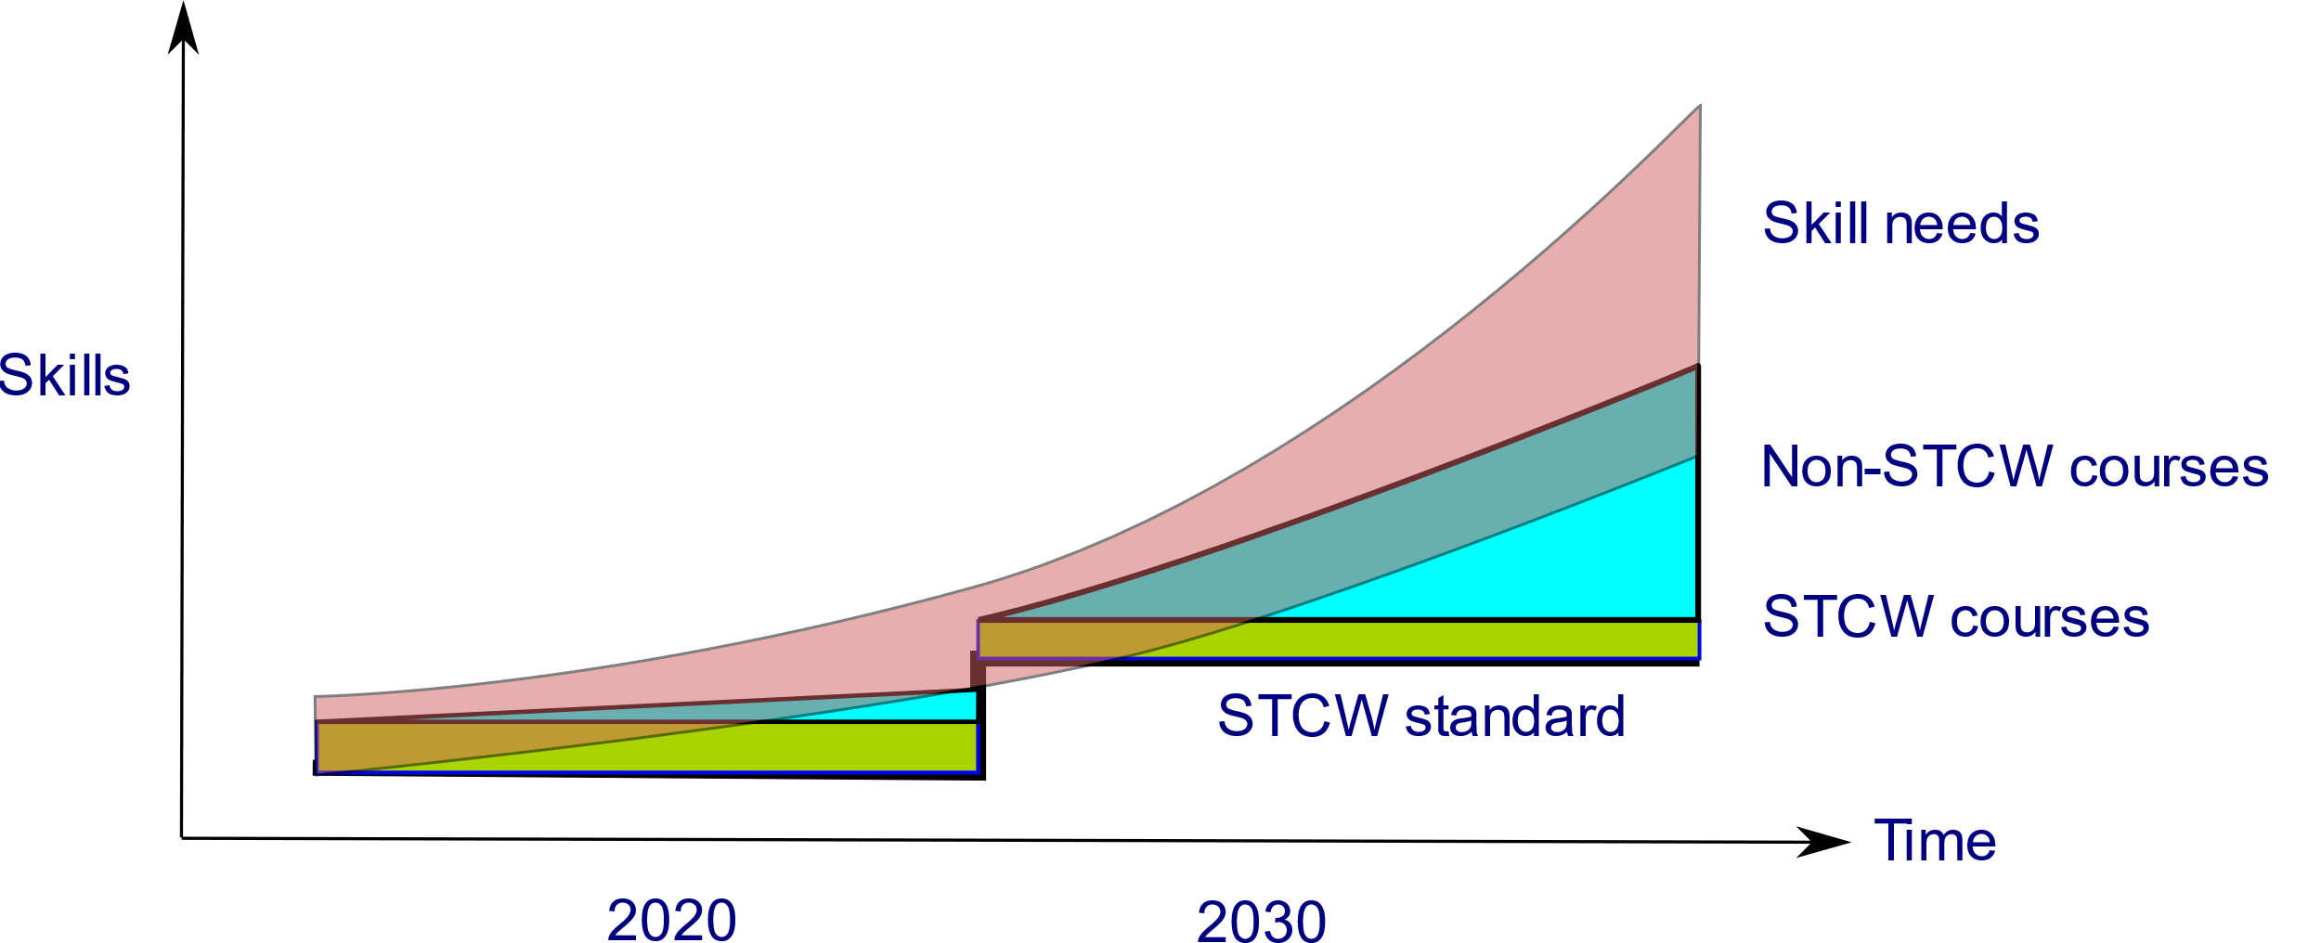

Slide 13
SkillSea WP.2 – A possible solution
Harmonised subjects
    Green Skills I: Energy-Efficient Ship Operation
    Green Skills II: Vessel Performance Management Systems
    Digital Skills I: Information Infrastructure
    Digital Skills II: Maritime Cybersecurity
    STEM: Operating in green and digital shipping
    Innovation and Intrapreneurship
    Leadership: Teamwork, leadership, culture
    …
Harmonised training
  Train the trainers
  Toolbox design for educational packages
International cooperation
  Structural Cooperation
  Guide on Business/Education Partnerships
Dedicated MET programmes

Slide 14
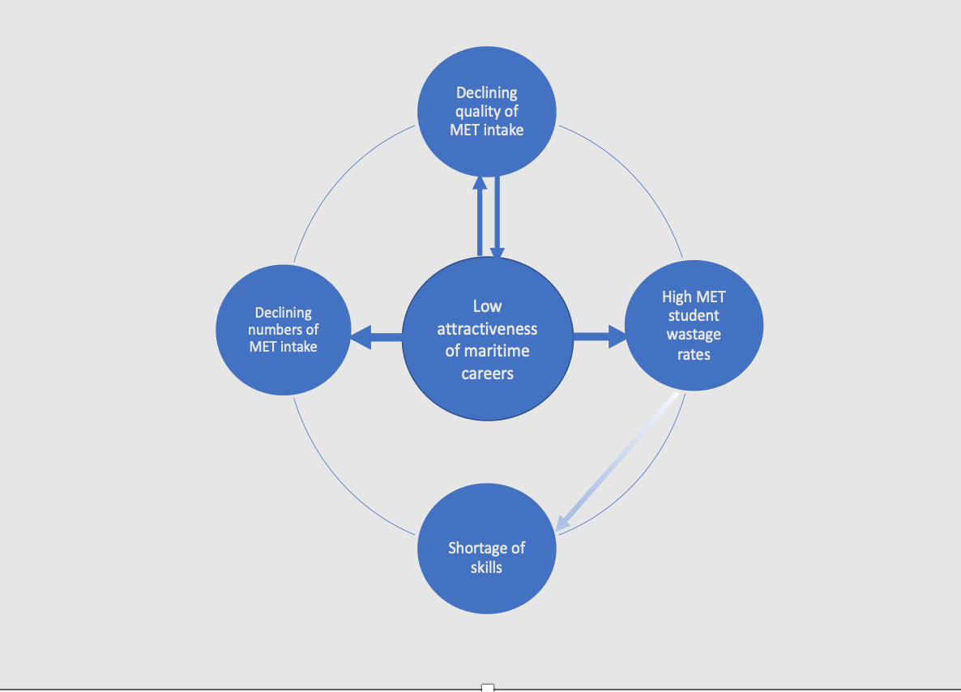
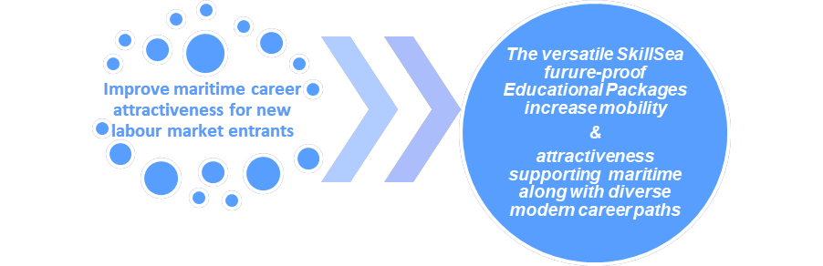
Identifying the vicious circle & devising a strategic response focusing on modern flexible skills

Slide 15
SkillSea Strategy Key Findings
Impact of new fuels & Impact of ship autonomy
Industry changes and the need for new & upgraded skills
Emerging occupational profiles
The Toolbox approach
5. Mobility and Skills
6. Improve and promote the attractiveness of the sector
7. Strategic tools
Notes:
1
Closely monitor the evolving technologies in maritime transport in order to gather the most accurate, up-to-date, unbiased view of the developments that are taking place.
Update scenarios for future development on a yearly basis.
2
Continuous identification of skills gaps by relevant stakeholders (e.g., researcher institutions, knowledge providers, maritime industry, regulators).
Stimulation of concerted action to close the gaps
3
Improve the focus on additional skills instead of the (old-fashioned) focus on new job profiles
Align ESCO system and structure with IMO decisions on STCW
Opportunities offered by digitalisation and emerging technologies should be effectively applied in the delivery of education, reskilling and upskilling to render seafarers future-ready.
4
Promote toolbox
5
Improve and promote opportunities for career mobility and progression.
Develop appropriate solutions for systemic blockages which hamper mobility.
Promote lifelong learning to foster mobility in the context of the impact of emerging trends.
Training should be generic to facilitate mobility of seafarers across a broad range of ship types and trades.
Remove (official and unofficial) obstacles restricting intra-sectoral mobility.
6
Take concerted action to improve the visibility of all the different, possible career paths of maritime professionals through public campaigns at the European level.
Improve the opportunities for women, people from minority groups, persons with working experience in other sectors, etc. to enter the maritime transport sector.
7
Strategic Tools
A Strategic Evaluation MET Tool (ST.E.ME.T) was designed to evaluate curricula suitability.
An Analytic Hierarchy Process (AHP) tool has been produced to support MET stakeholder strategic partnership form, the Stakeholder Cooperation for MET Tool - S.CO.MET.T
A Shipping Employability AHP Based Anticipating Tool (S.E.A B.AN.T) has been devised to assess the suitability of MET curricula for employability and the individual employability of maritime professionals. The specifications for a gaps-measuring mechanism have also been devised to increase employability.
Two tools have been devised to support the internationalisation process of METs. The Strategy Direction Location (STRA.D.L) can assist in locating partners according to needs. The Transfer International Tool (Trans. IT) can be used to transfer credits, accommodating the diversity of European national MET systems while being based on on EQF foundations

Slide 16
Sustainability not only for Shipping also for
MET
Formulating
Developping
Assessing
WP1
Tools WP3
Formulating
WP2
Developing
WP2
Scaling
WP4
Sustaining
WP5

Slide 17
Master
Universities have some international collaboration with other universities via research.
Bachelor
Universities of applied sciences have some collaborations with the local maritime industry via research.
Vocational
Have no collaboration via research.
Notes:
Vocationa delivering the most seafaerers

Slide 18
Social partners are already organised: ECSA / ETF
The maritime industry is partly organised by sector / subject
METs are not organised
but are the educators of the new breed as well as closing the gap of the current maritime professionals

Slide 19
Enhance Cooperation and Mobility among maritime stakeholders to support knowledge sharing and good practices
Improve the quality of training and education
Develop common learning objectives and outcomes for innovative and future skills
Monitor future developments with social partners
Promote the developed materials for the needed skills

Slide 20


Slide 21











Members MET-NET
Eugenides Foundation

Slide 22

SkillSea Strategy Key Findings – 9
A proposed European Maritime Skills Forum
Establishing a sustainable European Maritime Skills Forum (E-MSF) will assist in sharing best practices, fostering cooperation among MET providers and MET stakeholders including regulators, increasing knowledge transfer
E-MSF should be promoted as a European instrument for harvesting synergies with related sectoral projects.
24

Slide 23
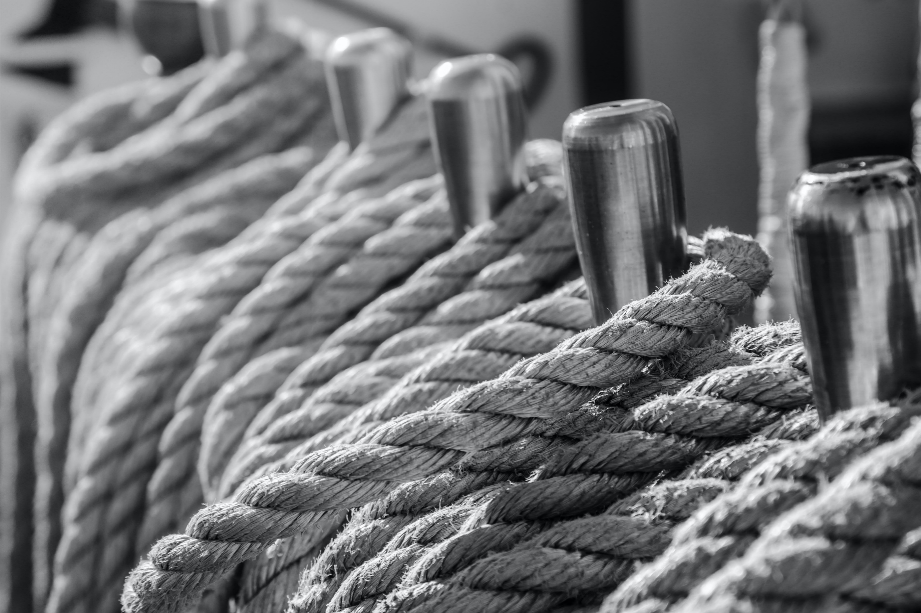
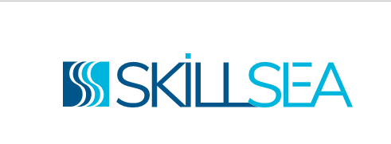
Concluding: untying the triple-knot I I
The SkillSea solution is an integrated one: it provides coordinated tools and strategies for untying the “triple-knot” of skills’ gaps, career attractiveness, and mobility of maritime professional
Such an approach is turning the challenge of sustainability and digitalisation into an opportunity for a radical new approach of maritime careers.
Notes:
On the basis of the modern skills of the futureproof Toolbox, mobility is promoted while the image of maritime careers is reversed, supported by proposed to be coordinated attractiveness campaigns, by the SkillSea-created Maritime Education and Training Network (MET-NET) for MET structural cooperation and by the SkillSea-proposed European Maritime Skills Forum (E-MSF).
New skills support mobility enhancing the attractiveness of a career in shipping, if appropriately integrated in MET provision including life-long learning.

Slide 24



Thank you for your kind attention!
Follow us!
SkillSea website: https://www.skillsea.eu/
Our social media:
Questions? Contact us at info@skillsea.eu

