Slide 1

Just Transition 4Mobility: Maritime Workshop
Social issues and challenges in the Shipbuilding sector
20/04/2023
industriall-europe.eu
Judith Kirton-Darling,
Deputy General Secretary

Slide 2

EU framework: lack of social focus
The European Union has increased the focus on decarbonisation and sustainability legislations in the framework of the European Green Deal and Eu Climate Law
NZIA silent on green vessels
  European industry very innovative but in fierce global unfair competition (IRA explicitly mentions maritime equipment sector, Asian state subsidies)
The scale of transformation underway today as a result of the accelerated twin digital and green transition demands a policy and legal framework capable of meeting the promise that no one will be left behind.

Slide 3

Skills: key demands
Revising current status and new demand of skills while addressing the current skills shortages
  Aim to attract 234.000 new talents by 2030 (Pact for Skills)
Need of a training system, in line with the digital and green transition
Raise public investment in research and development of skills
OSH training linked to new green/digital processes
USWE project in cooperation with SEA Europe: The project’s final reports set out its findings and these concrete recommendations
  Reskills 7% of employees each year (for 5 years) = 201.600 people (Pact for Skills).
  How to overcome current skills shortages while also reskilling/upskilling current workforce in new technologies.
Increase social dialogue at all levels.
31/01/23
3

Slide 4
Social issues in the sectors:
  1 million employed but uncertain times:
    o Ship orders largely in Asia
    o Collapse of the cruise ship segment still impacting
    o Importance of military orders
    o Skills shortages/ageing workforce

Slide 5
Social Standards
2013 social standards position with SEA Europe
  Difficult negotiations
  Little beyond statutory obligations
  Missing section on migrant workers – skills shortages
  Aim to negotiate a new annex
31/01/23
5

Slide 6
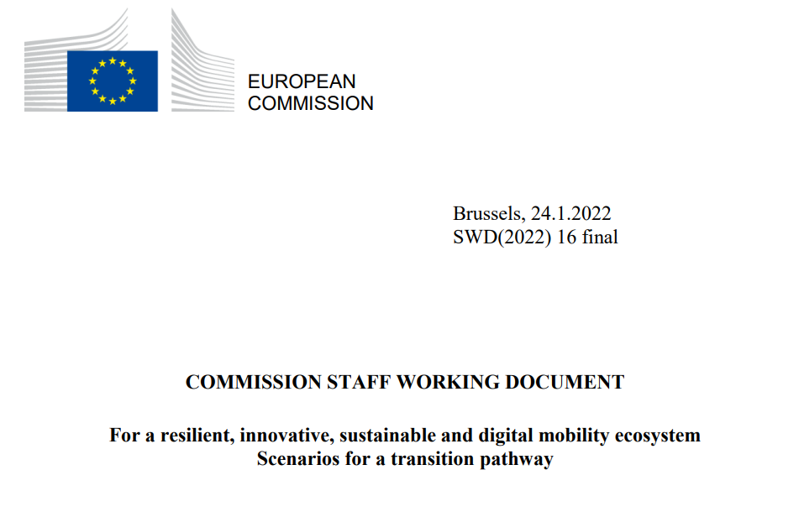
Transition Pathway for Mobility
Mobility ecosystem: maritime, road and rail
Stakeholder co-creation process: create roadmap to ensure successful transition (green and digital)
Aim: identify concerns and challenges in relation to the twin transition, as well as identifying possible areas of cooperation and common solutions
IAE concerns: more attention needed for social aspect, maritime has specific needs, must ensure a Just Transition!

Slide 7


Thank you!
Follow our website and social media:
www.industriall-europe.eu
industriAll_EU
industriAll Europe

