Slide 1
Shipping’s Energy Transition
Jacob Armstrong

Slide 2
Notes:
Time for slide: 2 seconds

Slide 3
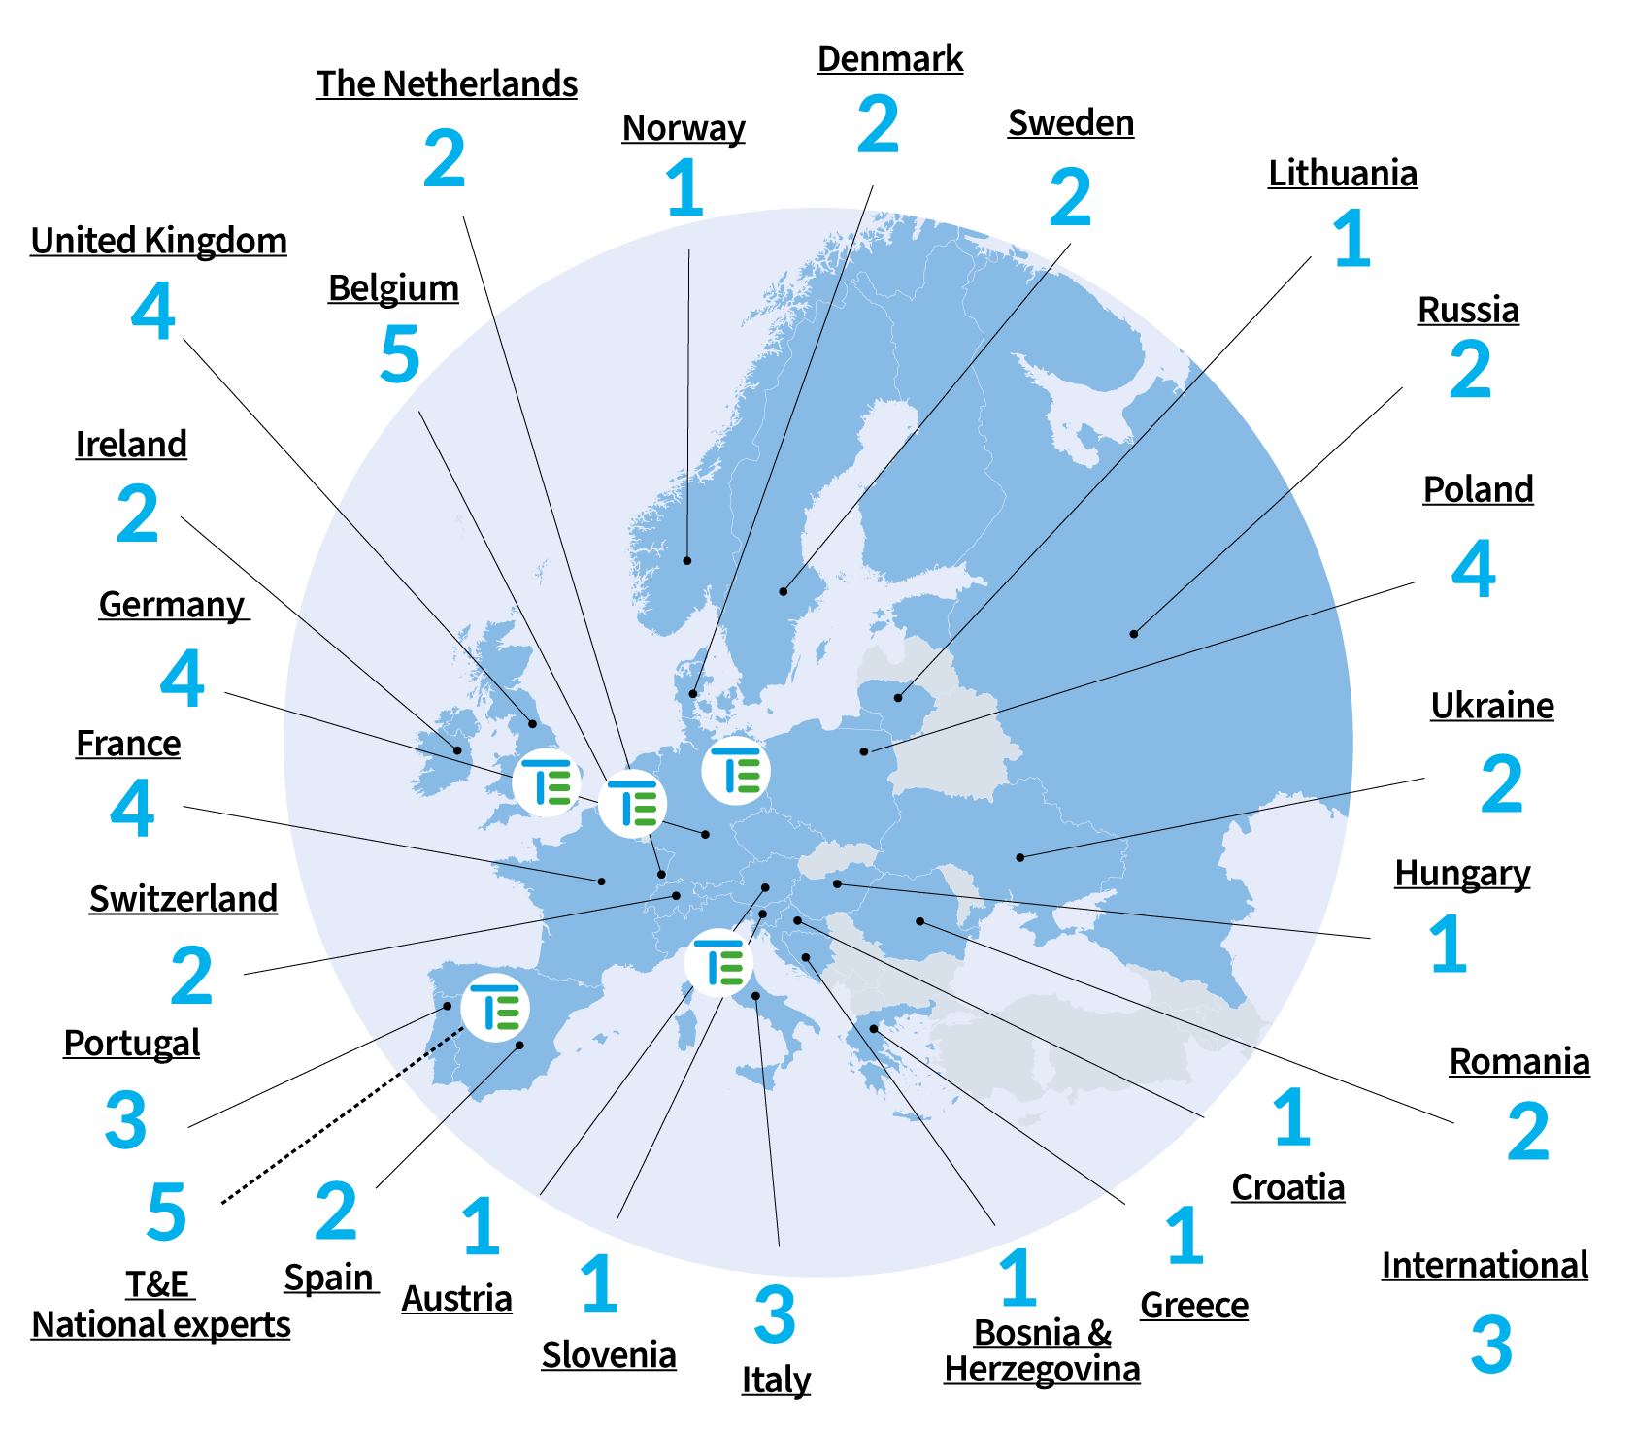
T&E:
26 Countries
61 Members
5 National experts
Fade out on click
Notes:
Time for slide: 15 seconds

Slide 4
Shipping’s energy transition
Shipping emissions: What’s the problem?
Fuels: A toxic debate?
The EU’s plan: Charting the course to zero-emission shipping

Slide 5
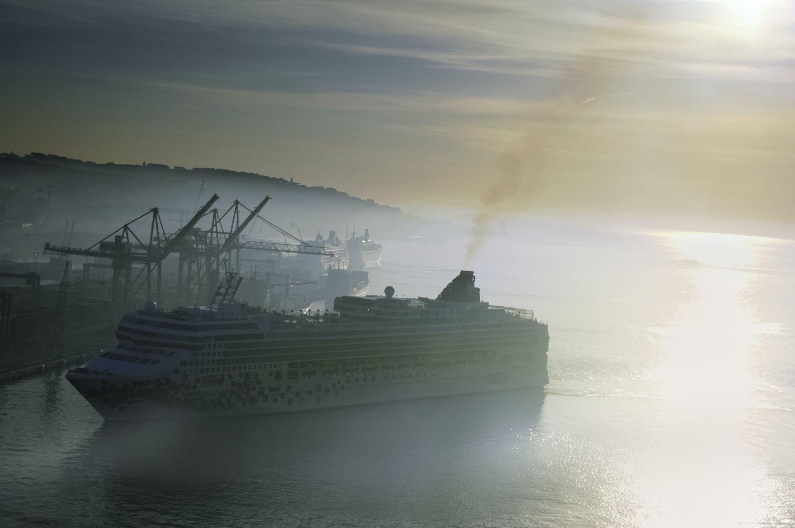
The problem
EU shipping emissions are equal to 3.5% of the EU’s total emissions...
...roughly equivalent to the entire emissions of Belgium
Photo by Eduardo Goody

Slide 6
Emissions reduction: The path to zero
Energy efficiency: fewer emissions for the same transport work
Port electrification: zero-emissions and clean air at berth
Fuel switch: zero-emission energy carriers
Notes:
Key messages:
EU shipping can decarbonise by 2050.
Energy efficiency plays an important role - speed reduction, wind-assist technologies can deliver ⅓ emissions cuts.
But to reach net-zero GHG emissions, need to switch to green fuels. E-fuels uptake possible, but need to kick-start in this decade. T&E study calculated that e-fuels can reach up to 7% of 2030 shipping demand, with efficiency measures. This corresponds to a sustainable amount of e-ammonia that can be produced in Europe by 2030: 85 PJ (4.6Mt). This means shipping needs just 7.5Gw electrolyser capacity. That sounds realistic compared to the 40GW electrolysers in Europe targeted by the EU Hydrogen Strategy by 2030.
In terms of power needs, it would require about 14.6 GW additional renewable electricity capacity; this compares to 14.7 GW of total wind capacity installed in Europe in 2020 and 220 GW total installed capacity by 2020

Slide 7
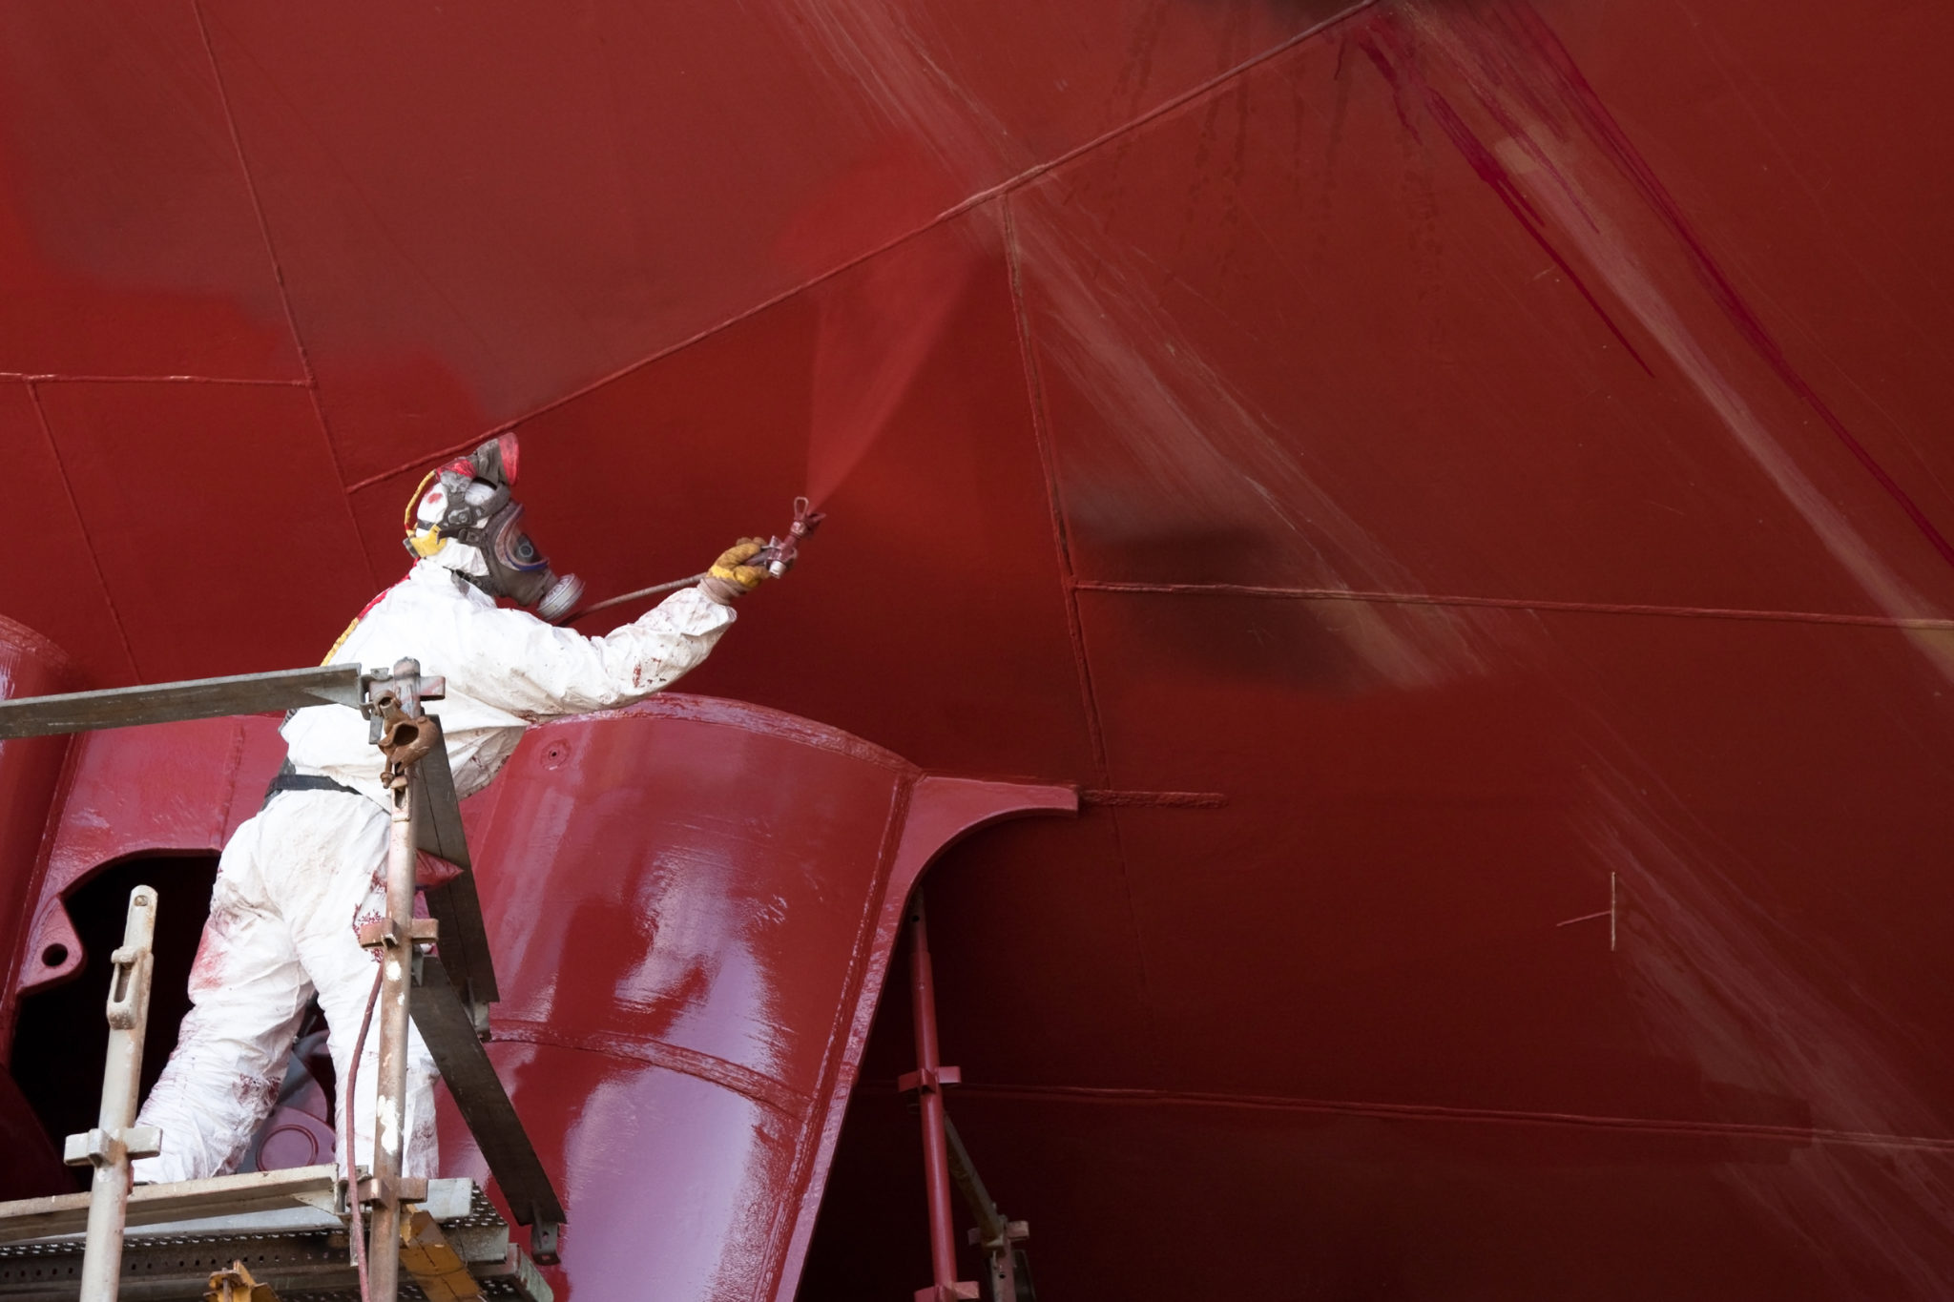
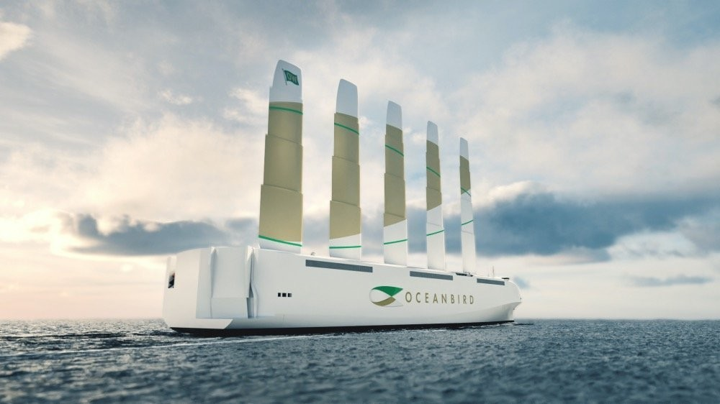
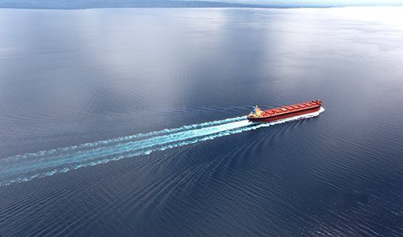
Energy efficiency: Same work, less emissions
Wind
Anti-fouling paint
Hull lubrication
Slow steaming
Notes:
Key messages:
EU shipping can decarbonise by 2050.
Energy efficiency plays an important role - speed reduction, wind-assist technologies can deliver ⅓ emissions cuts.
But to reach net-zero GHG emissions, need to switch to green fuels. E-fuels uptake possible, but need to kick-start in this decade. T&E study calculated that e-fuels can reach up to 7% of 2030 shipping demand, with efficiency measures. This corresponds to a sustainable amount of e-ammonia that can be produced in Europe by 2030: 85 PJ (4.6Mt). This means shipping needs just 7.5Gw electrolyser capacity. That sounds realistic compared to the 40GW electrolysers in Europe targeted by the EU Hydrogen Strategy by 2030.
In terms of power needs, it would require about 14.6 GW additional renewable electricity capacity; this compares to 14.7 GW of total wind capacity installed in Europe in 2020 and 220 GW total installed capacity by 2020

Slide 8
Shipping’s energy transition
Shipping emissions: What’s the problem?
Fuels: A toxic debate?
The EU’s plan: Charting the course to zero-emission shipping
Liquified Natural Gas (LNG)?
Biofuels?
Batteries?
e-fuels?

Slide 9
LNG: A problem, not a transitional solution
Methane is 80 times worse than CO₂ for global warming
Both businesses and the European Commission must urgently stop investments into LNG

Slide 10
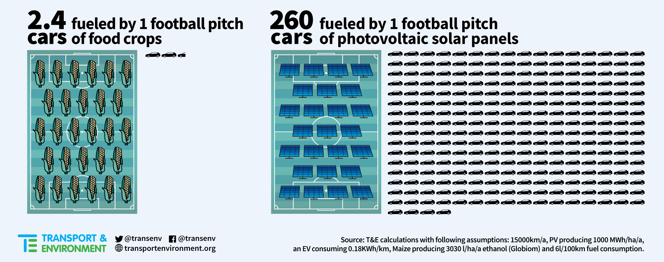
Biofuels: A costly waste

Slide 11
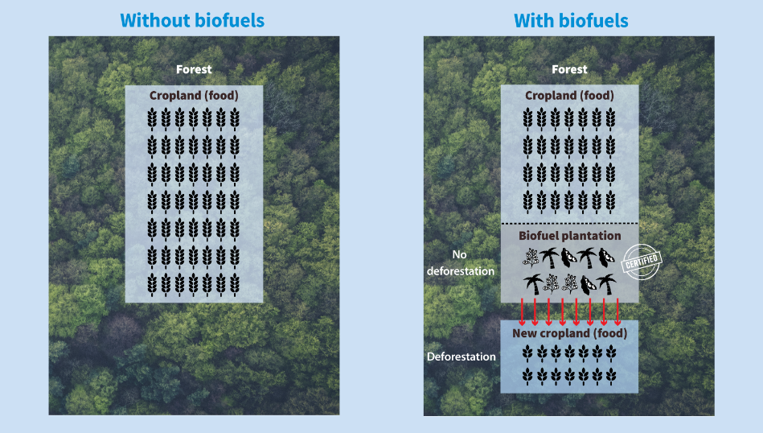

Slide 12
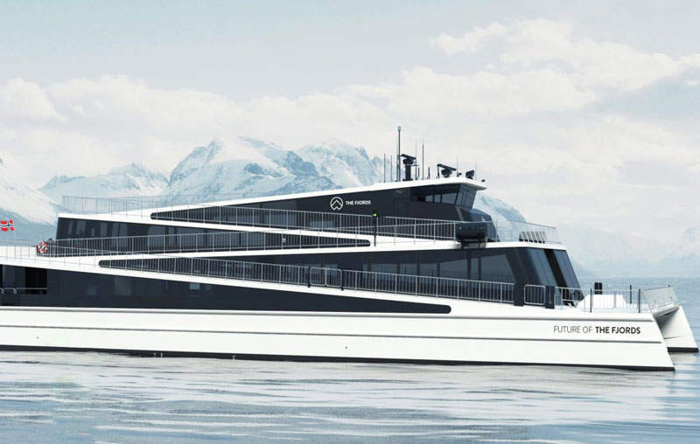
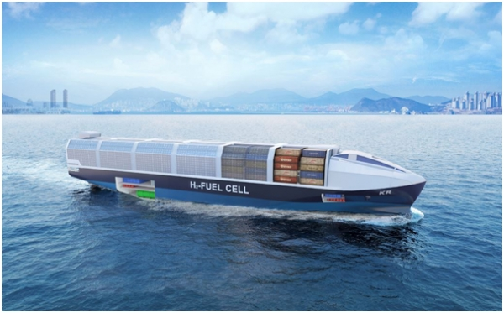
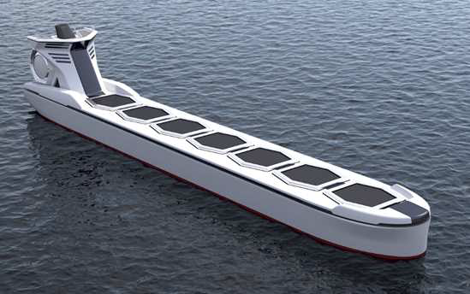
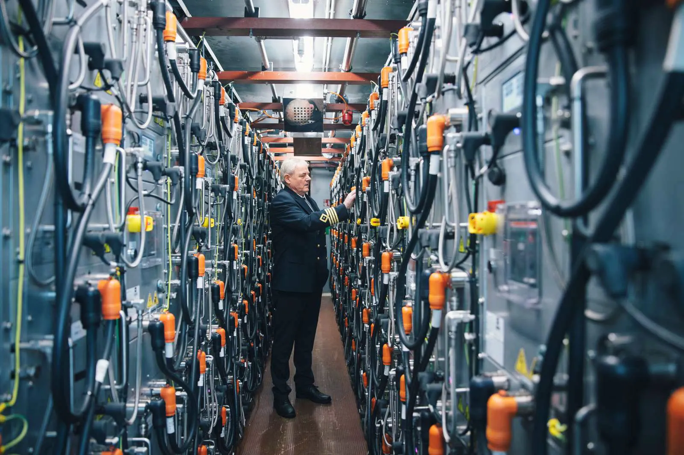
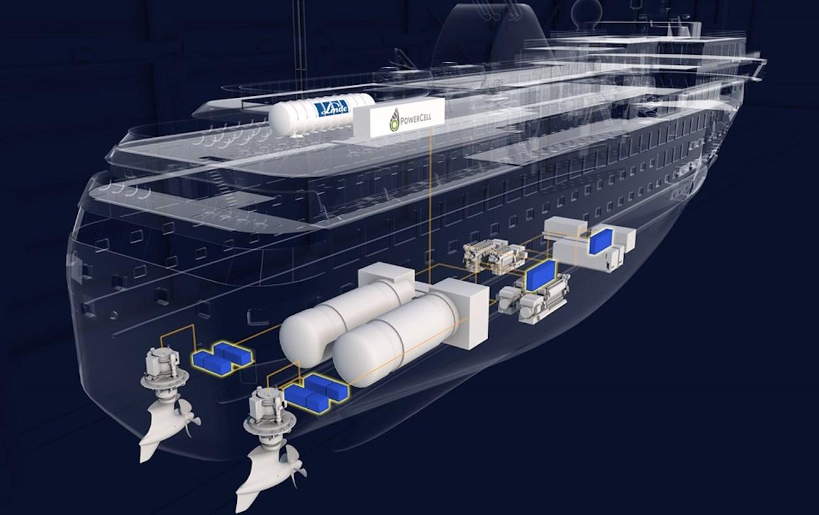
What are the scalable & sustainable technologies?
Hydrogen-derived e-fuels (ammonia/methanol)
Battery-electric
Hydrogen fuel-cells
Notes:
Battery-electric: lack of density
Hydrogen: explodes
Ammonia: toxic (but most transported molecule)
Methanol: currently very difficult, energy-intensive and expensive to source sustainable CO2. Lots moving to methanol but there is a question of herd mentality, applying with EEDI and intentions
Key points:
The solutions that we are interested in are both sustainable and scalable in each shipping segment.
Small vessels (ferries) - battery electric more suitable - already happening
Mid-size and mid distance vessels - direct use of green hydrogen more suitable - DFDS ferry with 1500 km autonomy
Largest vessels - Ammonia produced from green hydrogen.

Slide 13
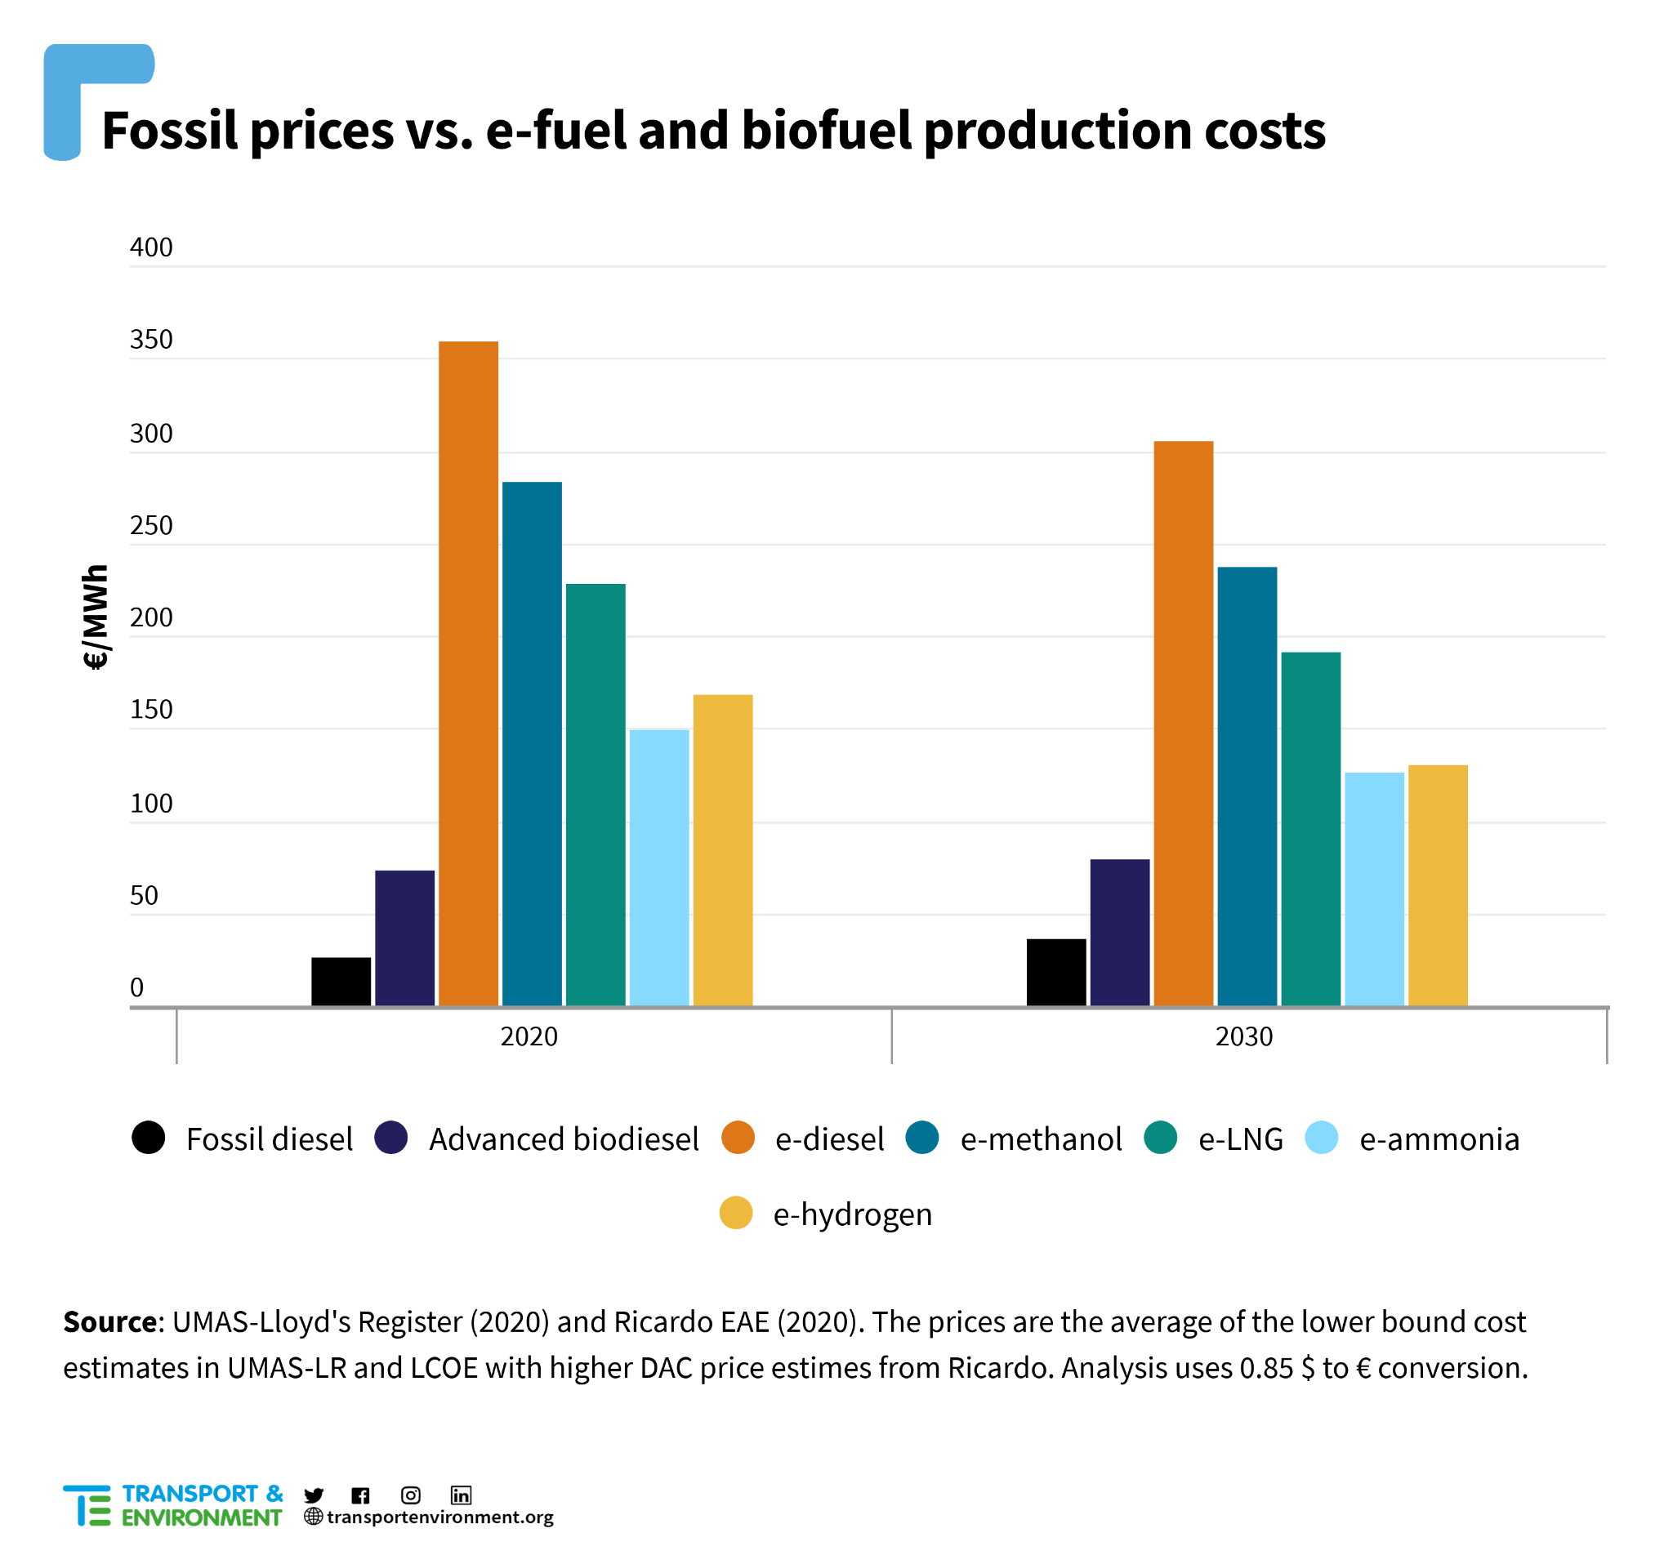
Scalable and sustainable fuels are much more expensive than their unsustainable competitors

Slide 14
Shipping’s energy transition
Shipping emissions: What’s the problem?
Fuels: A toxic debate?
The EU’s plan: Charting the course to zero-emission shipping

Slide 15
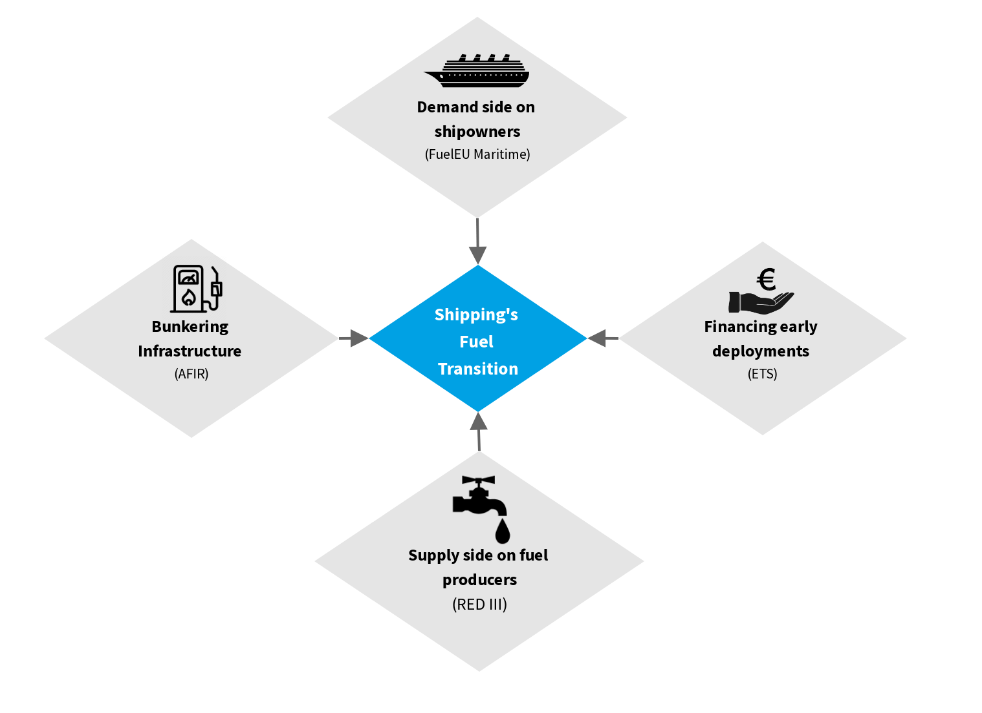
The EU’s plan
Financing and polluter pays: ETS (carbon market)
Clean fuel demand: FuelEU Maritime
Fuel producers: RED
Ports: AFIR

Slide 16
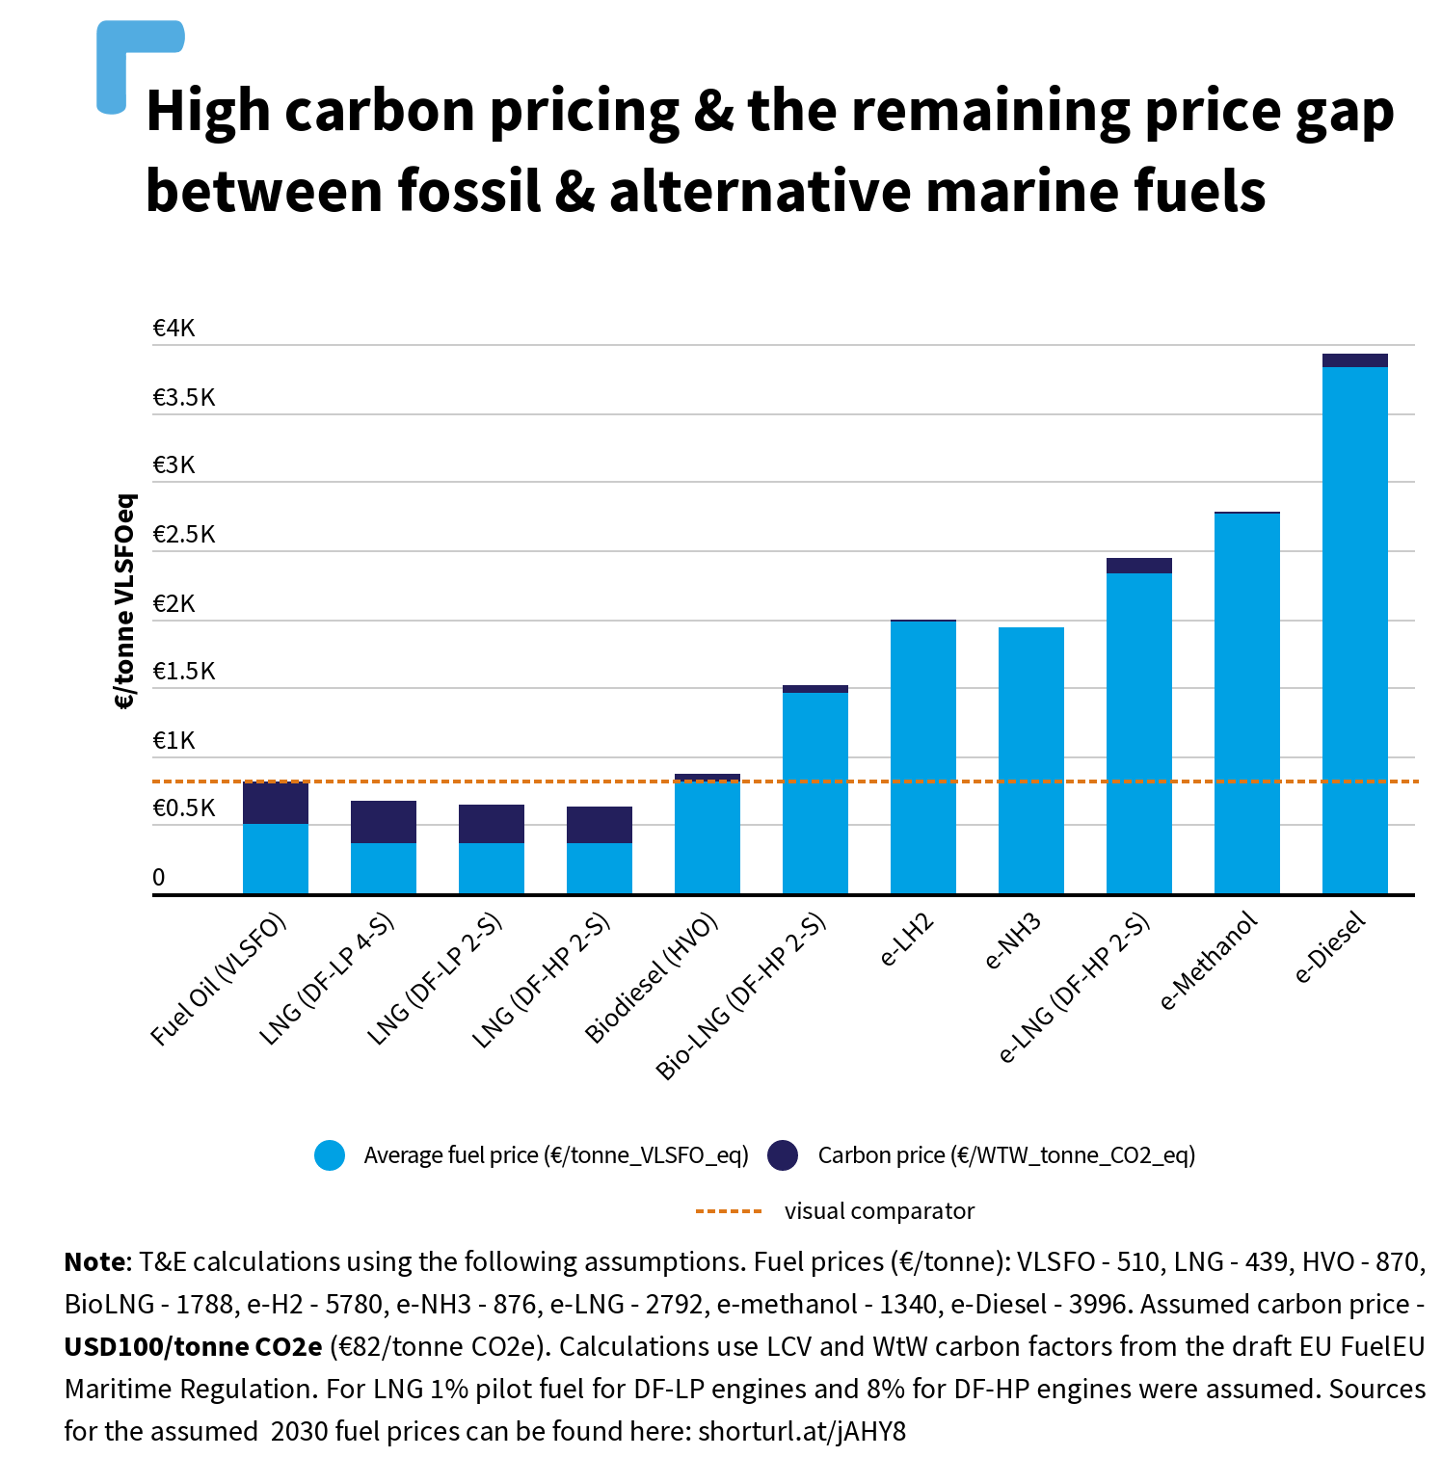
The ETS puts a price on pollution
But… carbon pricing is not a silver bullet

Slide 17
Baseline
But the Commission’s targets are not aligned with Paris Agreement goals
End goal
Notes:
Trajectory doesn’t lead shipping to climate goals

Slide 18
The EU’s Plan: supporting the right fuels
FuelEU includes targeted support for e-fuels
Battery-electric
Hydrogen fuel-cells
Green ammonia/methanol

Slide 19
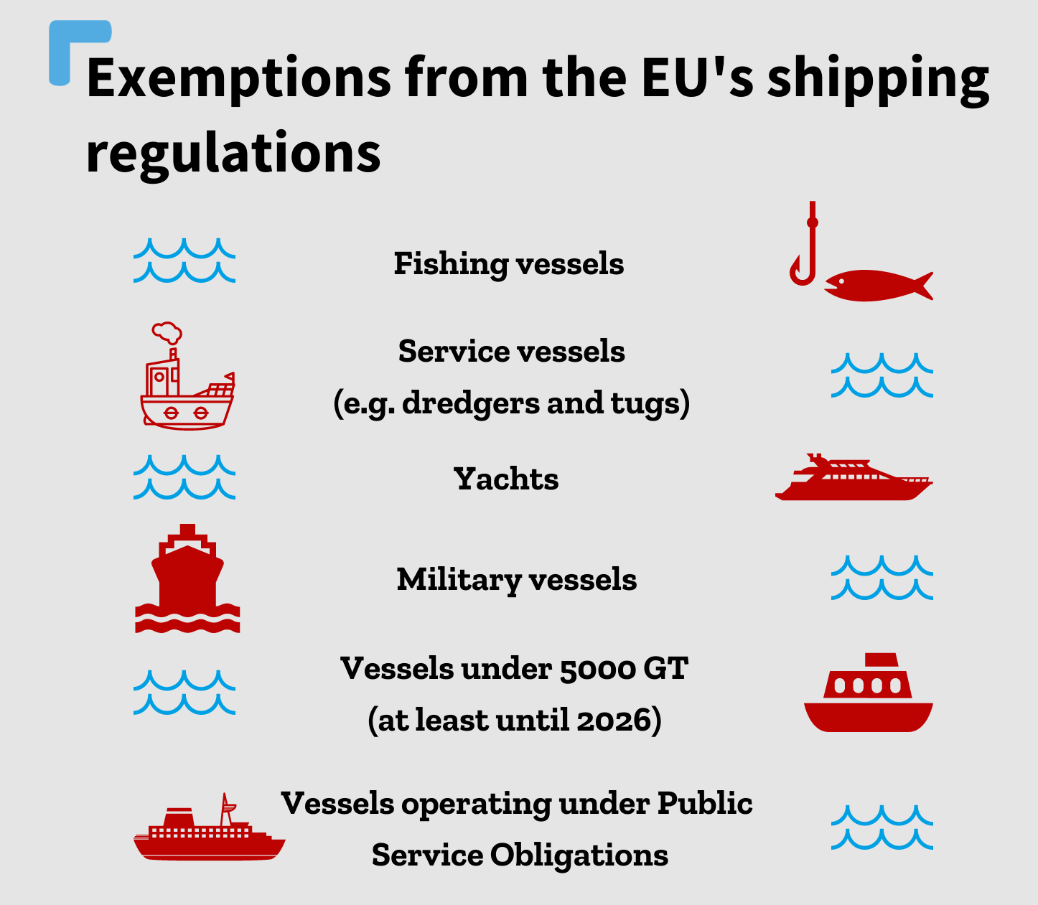
The EU’s Plan: Exemptions undermine EU’s climate objectives
EU must put in place a credible plan to phase-out fishing emissions starting with monitoring (MRV), which also protects biodiversity and takes an ecosystem approach

Slide 20
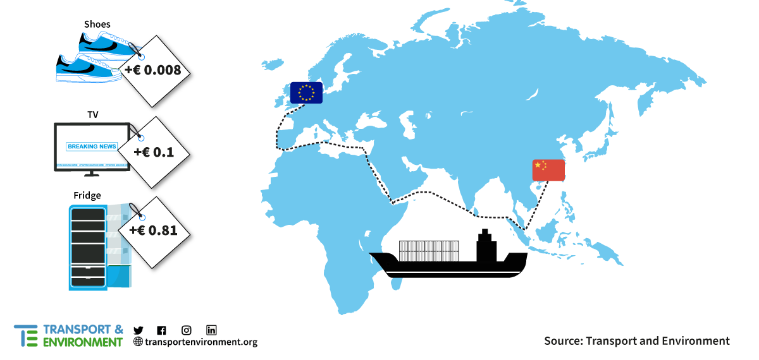
The EU’s Plan: too expensive?
Most ambitious EU shipping climate policies would add a just few cents to consumer goods

Slide 21
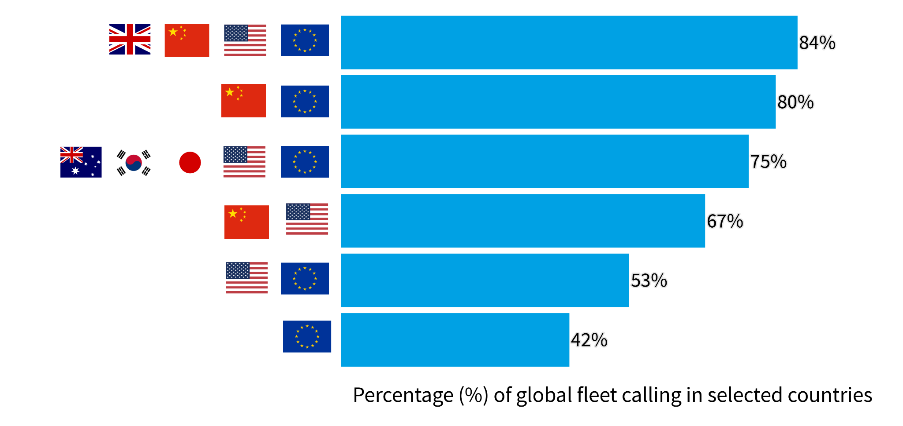
The EU’s Plan: Regional policy, global results

Slide 22
Shipping’s energy transition
The European Commission and businesses must stop support in the wrong fuels (biofuels and LNG) for all shipping and fishing vessels
The EU’s shipping climate plan is a good start with the correct signals for sustainable and scalable fuels that will have global impact
The plan must now be extended to all shipping emissions, including fishing

Slide 23
Jacob Armstrong
Sustainable Shipping Officer
Transport & Environment

