Slide 1
BUILDING A JUST TRANSITION TOWARDS A SMART AND SUSTAINABLE MOBILITY
Second Online Workshop – MARITIME SECTOR
Spin360 Team

Slide 2
AGENDA OF TODAY
TIME | TOPIC
9.30 – 9.40 | Welcome remarks
9.40 – 10.00 | Project presentation and in depth results
10.00 – 10.45 | Panel 1: Technical issues in Maritime sector: the Green Transition.
10.45 – 11.00 | Q&a session and discussion
11.00 – 11.15 | Break
11.15 – 12.00 | Panel 2: Social issues in Maritime sector: impact on workers.
12.00 – 12.15 | Q&a session and discussion
12.15 – 12.30 | Closing remarks, wrap up and next steps

Slide 3
PROJECT PRESENTATION AND IN-DEPTH RESULTS

Slide 4
WHERE ARE WE NOW?
PROJECT DEVELOPMENT - KEY STEPS
Launch event
Research activity: mapping the impact on employment, skills and working conditions for building a Just Transition for mobility
Validation, collection of evidence and reality-checking through workshops/roundtable
First workshop (done 31 January 2023) → discussion on what Just Transition means for Maritime
Second workshop (present) → presentation of in-depth results and collection of sectoral expertise
4. Final conference

Slide 5
PROJECT DEVELOPMENT
MARITIME
AVIATION
RAIL
ROAD
JUST TRANSITION
EMPLOYMENT
M
TS
M
TS
M
TS
M
TS
SKILLS
M
TS
M
TS
M
TS
M
TS
WORKING CONDITIONS
M
TS
M
TS
M
TS
M
TS
*M= Manufacturing
*TS= Transport Service

Slide 6
WHAT WE DID UNTIL NOW…
UNDERLINED THE MAIN TRENDS OF THE SECTOR REGARDING EMPLOYMENT, WORKING CONDITIONS AND SKILLS AS BASIS FOR DISCUSSION
UNDERSTOOD SUCH SECTORAL BIG PICTURE IN THE FRAMEWORK OF THE JUST TRANSITION
CONDUCTED A FIRST DISCUSSION AND VALIDATION OF RESULTS
GATHERED NEW PIVOTAL POINTS ON SPECIFIC JUST TRANSITION IMPACTS, CHALLENGES AND STRATEGIES FOR THE SECTOR

Slide 7
… AND WHAT WE WILL DO NEXT
PRESENTING THE PIVOTAL POINTS EMERGED DURING THE PREVIOUS INTERACTIVE DISCUSSION
COLLECTING FURTHER EXTERNAL EXPERTISE AND BEST PRACTICES
STARTING DEFINING WHICH CONCLUSIONS AND RECOMMENDATIONS WE CAN DRAW TO ENSURE A JUST TRANSITION FOR THE SECTOR → FINAL PROJECT REPORT

Slide 8
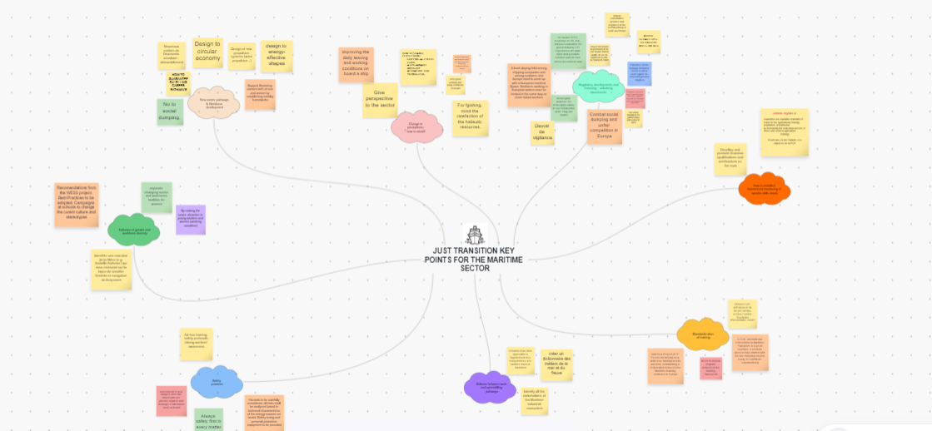
PIVOTAL POINTS RAISED DURING THE DISCUSSION

Slide 9
PROMOTING A JUST TRANSITION
EMPLOYMENT
MAIN POINTS EMERGED
CAREER PATHWAYS & WORKFORCE DEVELOPMENT
CHANGE IN PERCEPTIONS: HOW TO ATTRACT
UNCERTAINTY FOR THE FUTURE OF THE SECTOR AND AGING WORKFORCE
UNFAIR COMPETITION IN THE EU, SOCIAL DUMPING AND LACK OF CONTROLS OF SHIPS CONDITIONS
THE SECTOR HAS LOST ITS ATTRACTIVENES

Slide 10
PROMOTING A JUST TRANSITION
EMPLOYMENT – RECOMMENDATIONS
CAREERS NEED TO BE MADE ATTRACTIVE BOTH FOR WORKERS ASHORE AND AT SEA
IT IS NECESSARY TO GIVE A WIDER PERSPECTIVE OF THE SECTOR TO YOUNG PEOPLE, THERE NEEDS TO BE MORE INFORMATION ON THE REAL POSSIBILITIES OF THE JOBS IN THE MARITIME FIELD
SOCIAL DUMPING HAS TO STOP: THERE MUST BE A MINIMUM WAGE AND SPECIFIC WORKING CONDITIONS GUARANTEED FOR EXTRA EU WORKERS. SOCIAL DUMPING LEADS TO UNFAIR COMPETITION, THERE IS A NEED FOR MORE CONTROLS OF CONDITIONS ABOARD AND SOCIAL STANDARDS NEED TO BE SET
WORKERS AND FUTURE WORKERS SHOULD BE INFORMED ON THE FUTURE POSSIBLE CHANGES IN DECARBONIZATION STRATEGIES AND ALL THOSE ACTIVITIES WHICH MAY HAVE AN IMPACT ON THE EMPLOYMENT SIDE.

Slide 11
PROMOTING A JUST TRANSITION
SKILLS
MAIN POINTS EMERGED:
RISK OF EXODUS FROM THE MARITIME INDUSTRY DUE TO THE LACK OF ADEQUATE UPSKILLING
PEOPLE DON’T ENTER THE SECTOR WITH THE SAME LEVEL OF TRAINING AND SKILLS DEVELOPED
REGULATORY DEVELOPMENTS AND FINANCING – UNLOCKING INVESTMENTS FOR TRAINING
HARMONIZED MONITORING OF SPECIFIC SKILLS NEEDS
STANDARDIZATION OF TRAINING

Slide 12
PROMOTING A JUST TRANSITION
SKILLS – RECOMMENDATIONS
NECESSITY FOR A COMMON STANDARD OF SKILLS DEVELOPED AND LEVEL OF TRAINING REQUESTED AND NECESSARY SEA TIME FOR EACH WORKER TO ENTER THE MARITIME SECTOR
UPSKILLING AND RESKILLING OF WORKERS SHOULD BE GUARANTEED DURING THE TRANSITION, BUT IT SHOULD NOT BE MADE AT THE EXPENSE OF WORKERS
THERE IS THE NEED FOR A PROPER TRAINING SYSTEM TO MANAGE THE DIGITAL AND GREEN TRANSITION.

Slide 13
PROMOTING A JUST TRANSITION
WORKING CONDITIONS
MAIN POINTS EMERGED:
BALANCE BETWEEN WORK AND UP/RESKILLING PATHWAYS
SAFETY
INCLUSION OF GENDER AND WORKFORCE DIVERSITY
TRANSITION TO NEW TECHNOLOGIES COULD BE POTENTIALLY HARMFUL FOR WORKERS
OLD INFRASTRUCTURES AND CLIMATE CHANGE MAKE WORKING IN PORTS VERY CHALLENGING
STEREOTYPES PREVENT WOMEN FROM ENTERING THE SECTOR
MIGRANTS HAVE A HIGH RISK OF SOCIAL DUMPING

Slide 14
PROMOTING A JUST TRANSITION
WORKING CONDITIONS– RECOMMENDATIONS
WOMEN MUST BE INCLUDED IN THE MARITIME SECTOR, AND AWARENESS OF THEIR POSSIBILITY FOR INCLUSION SHOULD BE SPREAD WITH THE HELP OF CAMPAIGNS CONDUCTED IN SCHOOLS/INSTITUTIONS. WOMEN SHOULD HAVE A SEPARATE FACILITY AND WASHROOM.
TRAINING MUST BE IMPLEMENTED TO MAKE SURE THAT WORKERS USE NEW TECHNOLOGIES SAFELY.
WORKERS SHOULD BE INCLUDED IN THE SOCIAL DIALOGUE, AND THEY SHOULD BE REPRESENTED AT NATIONAL AND INTERNATIONAL LEVEL.
INFRASTRUCTURES NEED TO BE RENOVATED OR REPLACED FOR WORKERS TO OPERATE SAFELY.

