Slide 1
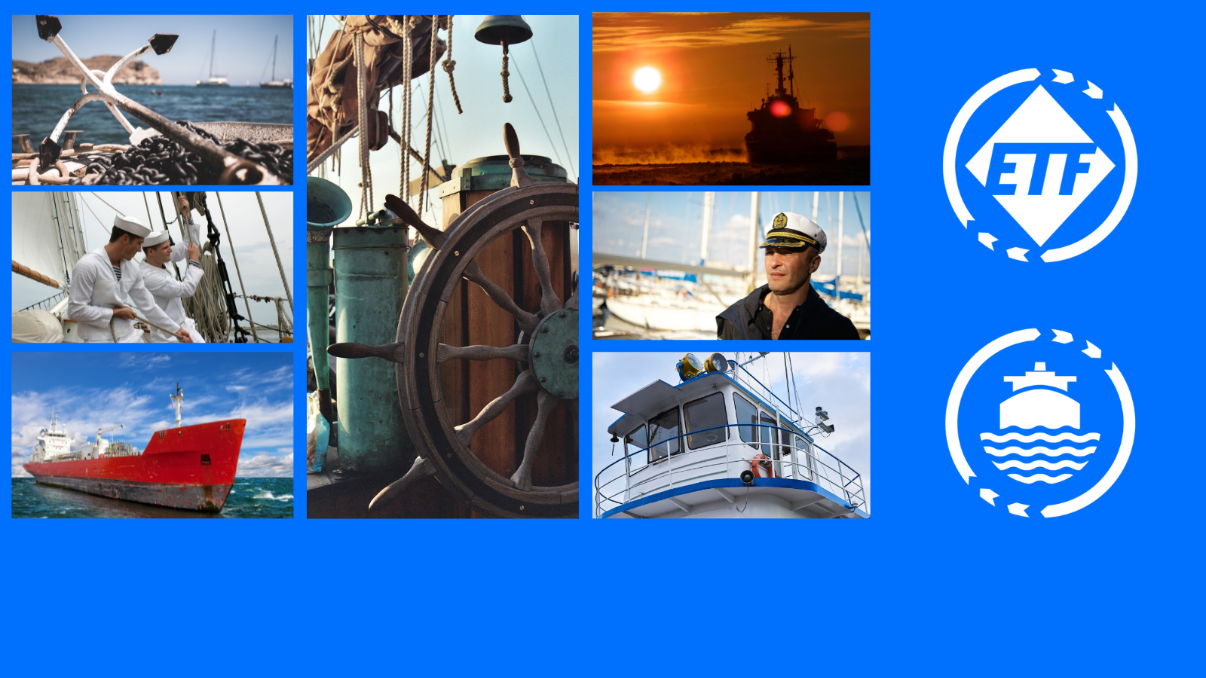
ETF MARITIME TRANSPORT SECTION
JT4MOBILITY – Online Maritime Workshop 31 January ‘23

Slide 2
CHALLENGES AND POTENTIAL PROBLEMS
Uncertainty and lack of market-ready zero emission technologies
1ST Priority: Health & Safety
Shortage of qualified European seafarers, aging of the workforce. Aged seafarers not to be left behind
Seafarers of today shall have access to upskilling, so we don’t see an exodus of skilled maritime professionals from the industry
FOC and recruitment of seafarers from 3rd countries: Risk of even more cases of social dumping
New training needs. Financing of the training:
Training at no cost to seafarers either subsidised from ship owners or provided by national educational programmes

Slide 3
COMING LEGISLATION
EU ETS Maritime: ships that call at EU ports will start to be priced (> 5000 g.t.)
Risk of reduced enclosed accommodation and recreation spaces on board
A new regulation on sustainable maritime fuels, the FuelEU Maritime
A revised directive on alternative fuels infrastructure: aims to raise the availability of liquified natural gas (LNG) by 2025 and shore-side electricity in main EU ports by 2030
A revised Renewable Energy Directive (RED III): sets up the new EU economy-wide target of a share of at least 40% of energy from renewable sources by 2030 and a new target of GHG intensity reduction of at least 13% by 2030

Slide 4
ETF INLAND WATERWAYS TRANSPORT SECTION
JT4MOBILITY – Online Maritime Workshop 31 January ‘23

Slide 5
CHALLENGES AND POTENTIAL PROBLEMS
Old fleet – retrofitting & new builds needed – lack of financial elasticity with 80% of the sector = owner operators
Uncertainty regarding the new fuel of the future
Infrastructure in bad shape – huge maintenance backlog – locks & waterworks not equipped to receive future automated systems
IWT becomes unreliable due to high/low water levels
Labour shortage
Arrival automated systems require high skilled crew members only – what with the others

Slide 6
...START OF POSSIBLE SOLUTIONS
Permanent upskilling crewmembers – via EDINNA permanent monitoring of skills & qualifications + development of course manuals + examination questions databases = maximum labour mobility within EU & beyond (Danube area)
Via CESNI – professional qualifications become pan-EU lex
New EU Crewing Regulation in the making – differentiated levels of automation meet different levels of crewing via Social Dialogue (tri-partite)
Future crew settings will include both on board & shore-based crew = shore based becomes part of IWT sector = union organising asset with huge potential

Slide 8
CHALLENGES AND POTENTIAL PROBLEMS
Ports can be front-runners in the energy transition
Offshore renewable energy will be a major driver of business and employment
New infrastructure is required/existing infrastructure to be adapted and maintained
Ports and dockers are the first hit when it comes to extreme weather (e.g. raising level of waters, weather conditions due to climate change)
Sustainability developments in each port are different, as ports differ from each other (size, cargo, geography connections by air, sea, land, or river, their industrial or merely transhipment nature)

Slide 9
POSSIBLE SOLUTIONS
Just Transition in ports should be: Safe - Equitable - Democratic
SAFE: Switching from carbon heavy bunker fuel to new energy sources such as hydrogen or ammonia is potentially dangerous for workers
EQUITABLE: Adequate training for dockers, up-skilling, re-skilling and no use of new technology as an excuse to attack dockers’ jobs or conditions
DEMOCRATIC: Workers to be represented in key bodies at international and national levels/Training must be funded by governments, employers, or both. Public, trade union, and employer-union partnered training institutions should be prioritised

Slide 11
At Stake:
Gross Tonnage limitation
Skills/Upskilling
Facilities in ports
State of the Sector
Pipeline:
EC plan to decarbonise fisheries
Our position:
Highlight contradictions and potential problems
Leverage to improve working and living conditions

Slide 12
Commonalities for all 4 Maritime Sections
Ageing Workforce (MT, IWT, Fisheries)
Consequences for reskilling?
Shortage of workers (MT, IWT, Fisheries)
Ageing vessels (MT, IWT, Fisheries)
Consequences for environmental adaptation
Social Dumping (MT, IWT, Fisheries)
The effect of extreme weather (MT, IWT, Fisheries, Ports)
Infrastructure (MT, IWT, Ports)
Growing vessel size, mismatch with infrastrcture, large-scale investment required

Slide 13
Consequences for Trade Unions
Possibly not influencing the agenda enough at National/EU/Global level
That the transition for work will come before the transition for workers happens
Loss of membership as jobs change and/or move to shore
Need to organise in non-traditional areas
Challenge of keeping the JT high on the agenda in collective bargaining
Persuading members of the need for change/adaptation – particularly with an ageing workforce

Slide 14
CONNECT WITH US
https://www.etf-europe.org/
ETF_Europe
ETF.Europe
https://www.linkedin.com/company/european-transport-workers'-federation/

