Slide 1

Just Transition
Manufacturing Workers’ Perspective in the Shipbuilding Sector
31/01/2023
industriall-europe.eu

Slide 2

EU focus on Just Transition
Just Transition is a synonym for the anticipation and management of change
The European Union has increased the focus on decarbonisation and sustainability legislations in the framework of the European Green Deal and Eu Climate Law
Fit for 55: Policy proposals to ↓ 55% net GHG emissions by 2030.
There is the need to transform our industries to follow the new development and EU requirements:
  2050: achieve climate neutrality for waterborne transport!
IAE position paper (adopted November 2021).

Slide 3
EU Decarbonisation Files of interest:
EU Emissions Trading System (ETS): extended to include maritime transport and EP proposal for an ‘’Ocean Fund’’.
FuelEU Maritime: limit GHG of energy used on-board and obligations to use on-shore power supply/zero-emission technology.
Energy Taxation Directive (ETD): introduction of a minimum tax rate on certain fuels/vessels.
Renewable Energy Directive: renewable energy target ↑40% by 2030 (currently ↑32%).

Slide 4
Importance of Digital and Green Transition
Increase in global activity/orders post-2020
But EU lagging behind in new orders (↓78%) vs China (↑110%) and S. Korea (↑78%)
  Uncertain future for the cruise ship sector.
The green and digital transition of the maritime technology sector is a great opportunity for Europe to lead in producing world-class both green and digital technology and zero-carbon, smart vessels.
  => green and digital transition important for Europe to remain competitive.
European manufacturing needs urgent diversification and investment in areas such as retrofitting, green technology and offshore renewables.
For trade union the Green and Digital Transition must be Just Transition
31/01/23
4

Slide 5
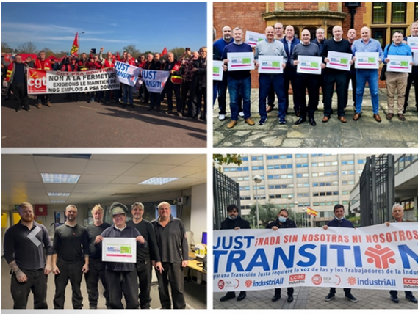
Just Transition Manifesto
IAE’s Manifesto launched in May 2022: ‘’Nothing About Us Without Us!’’
No worker or region to be left behind
Demands include granular mapping, anticipation of change, strong social dialogue and upskilling
Strong social partners plus support from policy makers it is vital
Just Transition for workers impacted by decrease in demand (e.g. cruise ships) including move into similar jobs/sectors (defence, ORE, etc).
Must take into account regional sensitivities/differences:
  Particular attention to costal regions.
31/01/23
5

Slide 6

Skills: key demands
Revising current status and new demand of skills while addressing the current skills shortages
  Aim to attract 234,000 new talents by 2030 (Pact for Skills)
Need of a training system, in line with the digital and green transition
Raise public investment in research and development of skills
OSH training linked to new green/digital processes
USWE project in cooperation with SEA Europe: The project’s final reports set out its findings and these concrete recommendations
  Reskills 7% of employees each year (for 5 years) = 201,600 people (Pact for Skills).
  How to overcome current skills shortages while also reskilling/upskilling current workforce in new technologies.
Increase social dialogue at all levels.
31/01/23
6

Slide 7

Potential Project Outcomes?
How to prevent social dumping?
How to better engage migrant workers?
Proposed measures to keep workers in work (cyclical nature).
Conduct survey on current/foreseen issues.
Identify how best to:
  upskill the current workforce
  attract new workers
  overcome current skills shortages
Develop joint demands to EU, national policy makers and employers with ETF.
31/01/23
7

Slide 8


Thank you!
Follow our website and social media:
www.industriall-europe.eu
industriAll_EU
industriAll Europe

