Slide 1
RAILWAY SECTOR: THE FUTURE OF WORK AND A WORK FOR FUTURE What is needed to meet the shortage of workers? YOUTH PERSPECTIVE
FILT CGIL
Federazione Italiana Lavoratori Trasporti
European Transport Workers’ Federation
‘Building a Just Transition Towards a Smart and Sustainable Mobility’ (JT4 Mobility)
27 June 2023
Hilton Hotel, Cologne

Slide 2
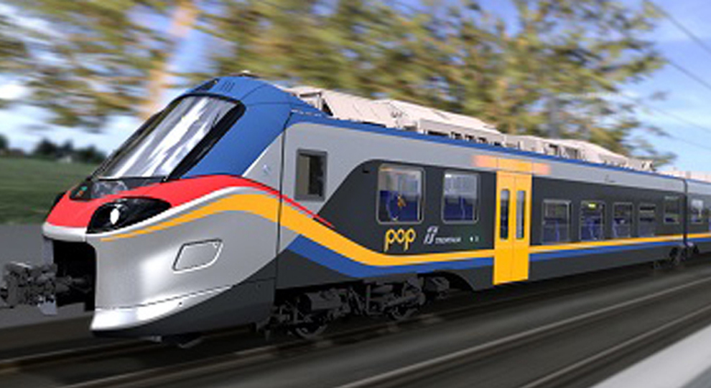
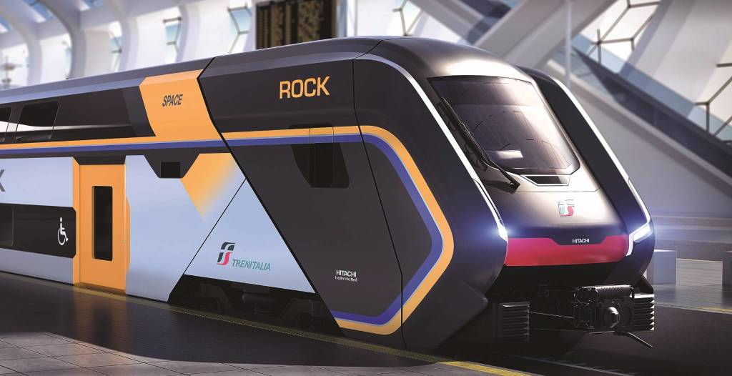
NEW PERCEPTIONS
FILT CGIL
RAIL SECTOR - 2023
- Retirements
New Hiring Processes
Quality of work

Slide 3
PROFESSIONALITY
FILT CGIL
Specialists of Work
Knowledge and competence
System failure
Safety, security, efficency

Slide 4
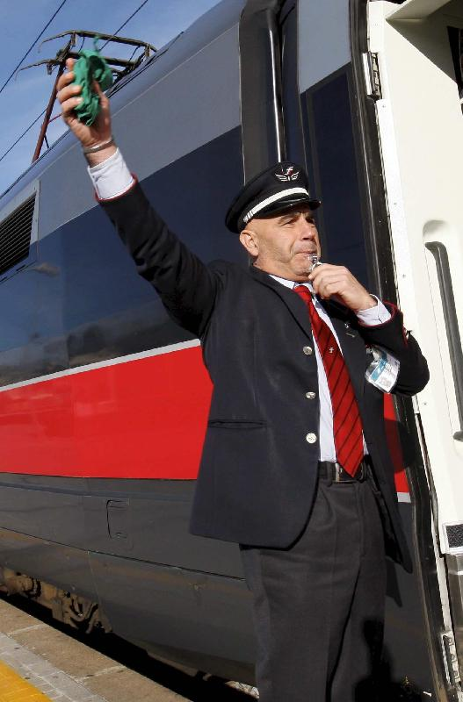
WORKING CONDITIONS
FILT CGIL
New technologies
Working hours and shifts
Work and life balance
National specificities
Local rules (non-regression principle)
TDD

Slide 5
WORKERS’ PRIORITIES
FILT CGIL
Better working conditions
Dignity
Good protection
Stable employment
Wages
Collective Agreements

Slide 6
CHALLANGES FOR FUTURE
FILT CGIL
Green Deal
EU 2050
Inclusivity
Female and Youth Employment

