Slide 1
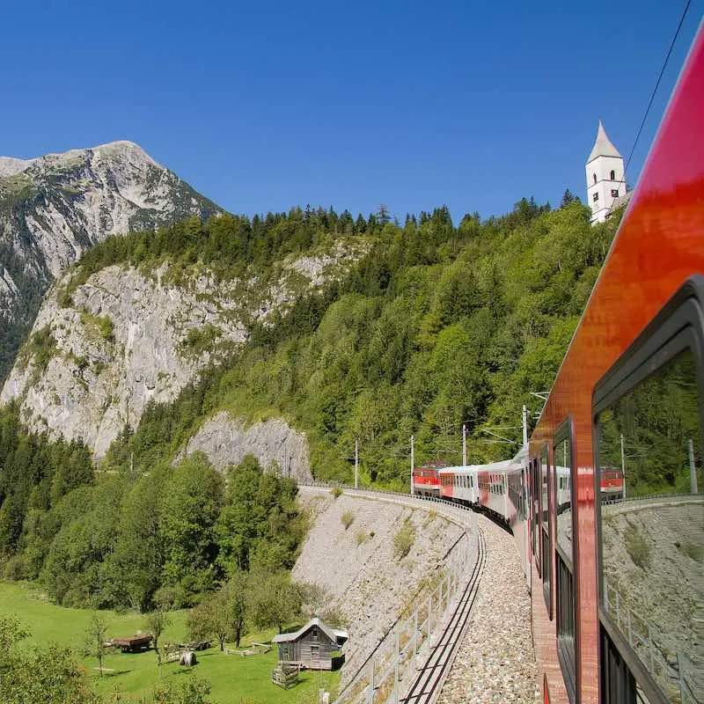
BUILDING A JUST TRANSITION TOWARDS A SMART AND SUSTAINABLE MOBILITY
RAILWAY SECTOR
Onsite Workshop, 27,28 June 2023
Spin360 Team

Slide 2
PROJECT TIMELINE
THE PACE OF THE GREEN AND DIGITAL TRANSITION: UNDERSTANDING THE BIG PICTURE IN THE FRAMEWORK OF A JUST TRANSITION
COLLECTION OF EXTERNAL EXPERTISE, BEST PRACTICES SHARING AND PRESENTATION OF KEY FINAL RESULTS
CONFERENCE LAUNCH
FINAL CONFERENCE
FIRST ONLINE WORKSHOP
WHERE WE ARE NOW: ONSITE WORKSHOP
SETTING THE SCENE: CURRENT STATUS AND KEY TRENDS ON EMPLOYMENT, SKILLS AND WORKING CONDITIONS FROM MANUFACTURING AND TRANSPORT
PRESENTATION OF FINAL REPORT AND WAY FORWARD

Slide 3
LACK OF CONCRETE ACTION PLANS TO GIVE RAILWAY A KEY ROLE IN THE DECARBONIZATION PROCESS
DIGITALIZATION AND AUTOMATION
OLD INFRASTRUCTURE
THE SECTOR TODAY AND THE PATHWAY TOWARDS A JUST TRANSITION
COMPETITION WITH CHINA
SHORTAGE OF WORKERS
ATTRACTING YOUNG TALENTS
SKILLS SHORTAGES
WORK-LIFE BALANCE AND JOB SECURITY
UNBALANCED GENDER REPRESENTATION

Slide 4
MANAGE JOB TRANSITIONS BETWEEN INDUSTRIES AND SECTORS
STRATEGIC INVESTMENTS
ENHANCING SKILLS FORECASTING
GREEN/DIGITAL: OPPORTUNITIES AND CHALLENGES FOR HEALTH, SAFETY AND SECURITY
UP/RESKILLING PATHWAYS
INTERMODAL COOPERATION
MODAL SHIFT: CHANGE PERCEPTIONS
ACHIEVING A JUST TRANSITION:
MAIN OPPORTUNITIES AND
CHALLENGES

Slide 5
ADVOCATE FOR A CONCRETE INDUSTRIAL POLICY AND STRATEGY FOR RAILWAY
EMPHASIZE THE NEED FOR INVESTMENTS/FINANCING AT EU AND PUBLIC LEVEL TO RENOVATE INFRASTRUCTURE
MORE VOICE TO REGIONS TO PINPOINT THE SPECIFIC CHALLENGES THAT THEY ARE FACING TO ACHIEVE A JUST TRANSITION
MORE INVOLVEMENT/COOPERATION WITH TRAINING AND EDUCATION TO DESIGN UPDATED/INNOVATIVE PROGRAMMES AND TO ATTRACT YOUNG PEOPLE
SECTORAL RECOMMENDATIONS
DEVELOP TOOLS TO EFFICIENTLY ANTICIPATE AND MANAGE JOB TRANSITIONS AND WORKERS’ MOBILITY
COMMITT TO FINANCING UP/RESKILLING OF WORKERS TOWARDS GREEN AND DIGITAL, INCLUDING FLEXIBLE PATHWAYS
ESTABLISH MANDATORY JUST TRANSITION RULES/STANDARDS/PRACTICES TO ENSURE WORKERS’ SAFETY AND DECENT WORKING CONDITIONS
ENSURE GENDER-BALANCE BY PROMOTING THE ENTERING OF WOMEN IN THE SECTOR

Slide 6
EXISTENT BEST PRACTICES IN THE RAILWAY SECTOR

Slide 7
BEST PRACTICE
DESCRIPTION
COUNTRY
STAFFER PROJECT
SKILLS IDENTIFICATION, DEVELOPING TRAINING AND EDUCATION PATHS FOR THE CURRENT AND FUTURE RAILWAY WORKFORCE
SPAIN
DEDICATED SITE FOR RAILWAY PROFESSIONALS PUBLISHING WORK SAFE COMMUNICATIONS TO HELP WORKERS IN AVOIDING THE POSSIBLE HEALTH AND SAFETY RISKS
NETWORK RAIL SAFETY CENTRAL
UNITED KINGDOM
UNIFE GENDER EQUITY POLICY
EU LEVEL
ATTENTION TO GENDER DISPARITIES, INCREASED EQUITY AND REITERATING SUPPLIERS’ OBLIGATION TO ADDRESS THESE DIVIDES

