Slide 1
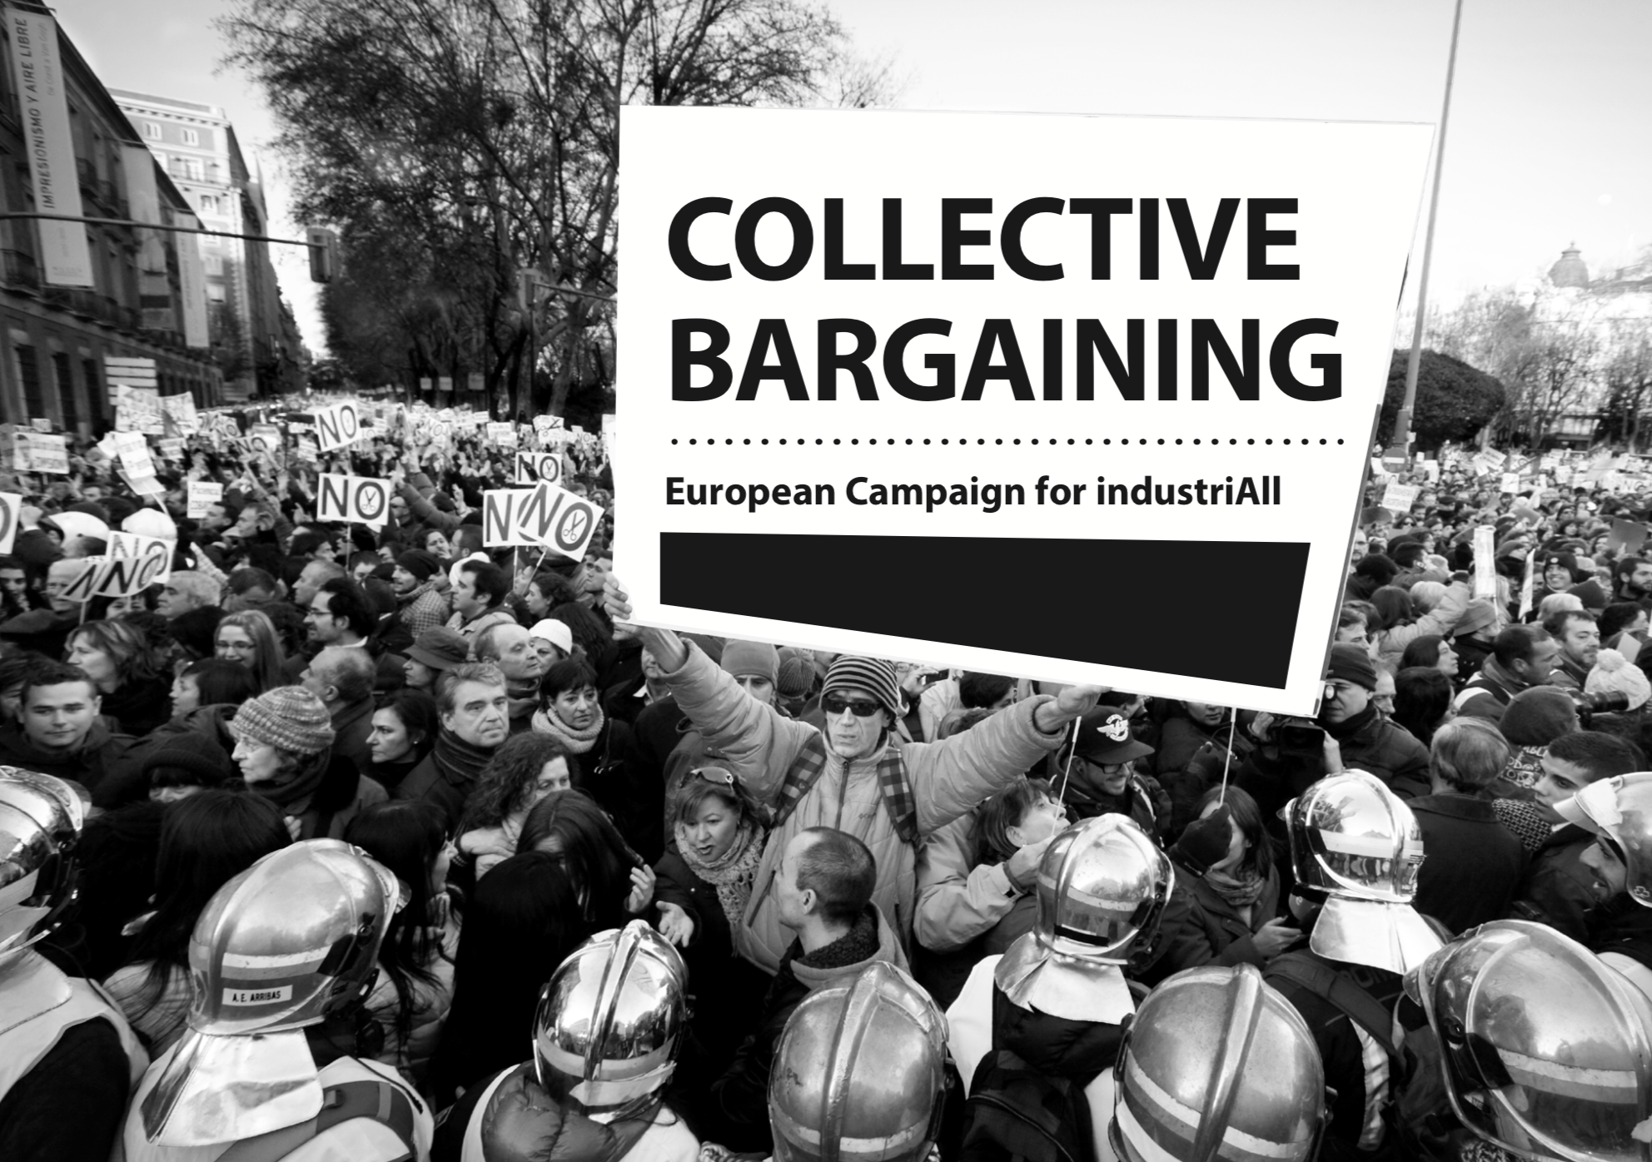
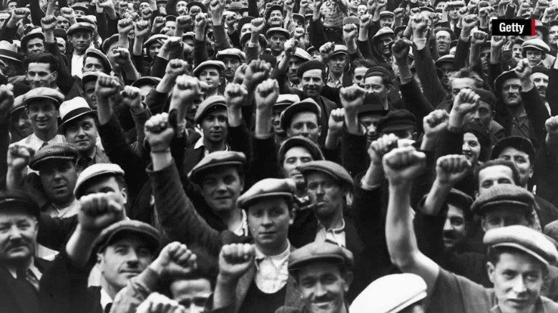
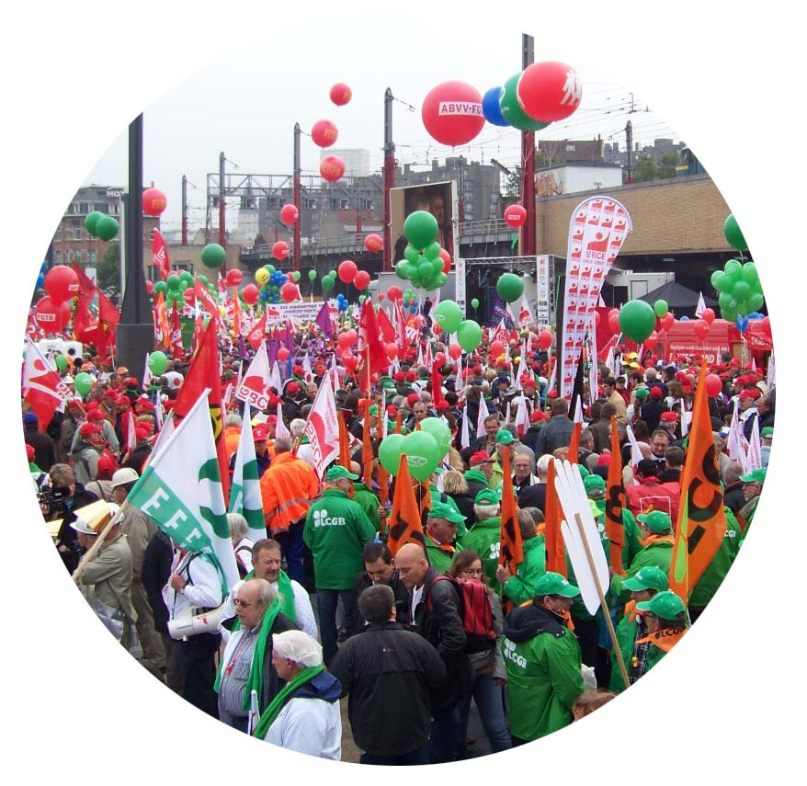
IndustriAll Europe Campaign:
For More Collective Bargaining
in Europe
Europe Affiliates
Notes:
•

Slide 2
Timeline CB Campaign: Together at Work
September – January 2019
September
October
November
January
February
Launch
Workers
Employers
Young Workers
Women Workers
-Event in the EP at the end of September
- Link between the erosion of CB and increase in low paid and precarious work
Obstacles to CB and how to remove them
CB/TU make the difference for workers
- Collective Bargaining benefits companies and society as a whole
- Benefits of CB for young workers and apprentices
CB for Equal Opportunities btw men & women
Women together at work
Workers fighting/winning together at work
Workers & Employers together at work
Young people together at work

Slide 3
Timeline CB Campaign
February – May 2020
March
April
May
June
Aftermath
European Action Week
End of Campaign
Congress
Evaluation
What next?
All affiliates do an action in the same time (week)
We highlight the common action taking place all over Europe
Overview of the campaign at the Congress
- Starting the process of evaluating the impacts of the campaign
-To be finetuned we will look back to the past months
#TogetherAtWork

Slide 8
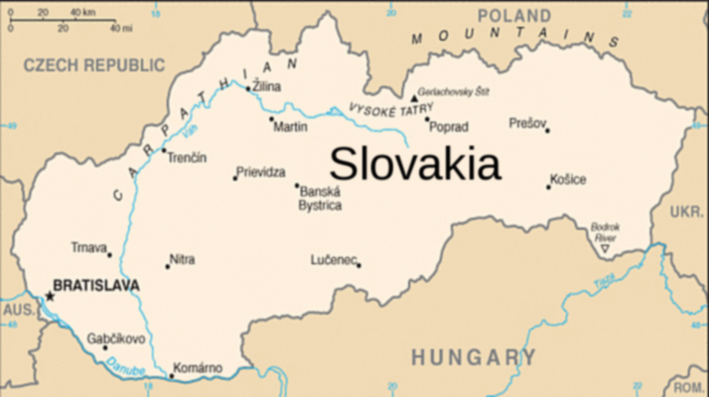
What do we expect from you?
Open Campaign to be multiplied and further developed at national level
Need your support and commitment
Best case example from OZ KOVO Slovakia
OZ KOVO sent us their own timeline based on the one we have proposed
They Identified the obstacles to CB they are faced in Slovakia
OZ KOVO’s timeline highlights how they will contribute to the campaign by:
Distributing IAll Europe campaign materials to all affiliates via web and social media
Press release for the campaign
Banner with campaign logo
Testimonial videos of their members about the benefits of CB
Photos and interview with employers supporting CB
Videos of young members about their conditions
Activity during the European Action Week (video of it to be distributed)

